Slide 1
Temporal Difference Learning
  CMPUT 261: Introduction to Artificial Intelligence
  S&B §6.0-6.2, §6.4-6.5

Slide 2
Title
Definition:
A function $f$ is a linear function of $x$ if it can be written as $f(x)=w_{0}+w_{1}x$
example text here
  likelihood
  prior
Questions:
If $f$ can be literally any function, then what is the solution?
  Is that desirable?
What could we do instead?
Why are we squaring the difference?
(Image: Goodfellow 2016)

Slide 3
Lecture Overview
Recap & Logistics
TD Prediction
On-Policy TD Control (Sarsa)
Off-Policy TD Control (Q-Learning)
Expected Sarsa
After this lecture, you should be able to:
trace an execution of the TD(0) algorithm
trace an execution of the Q-learning algorithm
trace an execution of the Sarsa algorithm
define bootstrapping
explain why bootstrapping is useful
trace an execution of the Expected Sarsa algorithm
describe the advantages of Expected Sarsa over Sarsa

Slide 4
Logistics
Assignment #4 is due December 4 at 11:59pm
    Late submissions for 20% deduction
    No remarking or EAs for empty submissions
SPOT (formerly USRI) surveys are now available
    Available until December 10

Slide 5
Previous Lecture Summary
Monte Carlo estimation estimates values by averaging returns over sample episodes
    Does not require access to full model of dynamics
    Does require access to an entire episode for each sample
Estimating action values requires either exploring starts or a soft policy (e.g., $ϵ$-greedy)
Off-policy learning is the estimation of value functions for a target policy based on episodes generated by a different behaviour policy
    Importance sampling is one way to perform off-policy learning
    Weighted importance sampling has lower variance than ordinary importance sampling
Off-policy control is learning the optimal policy (target policy) using episodes from a behaviour policy

Slide 6
Recap: Monte Carlo RL
Monte Carlo estimation: Estimate expected returns to a state or action by averaging actual returns over sampled trajectories
    Estimating action values requires either exploring starts or a soft policy (e.g., $ϵ$-greedy)
Off-policy learning is the estimation of value functions for a target policy based on episodes generated by a different behaviour policy
Off-policy control is learning the optimal policy (target policy) using episodes from a behaviour policy

Slide 7
Recap: Importance Sampling
Monte Carlo: For $X∼f$, can use a sample $x_{1},…,x_{n}$ drawn from $f$ :
  $$E[X]≐\underset{x}{∑}f(x)x≈\frac{1}{n}\overset{n}{\underset{i=1}{∑}}x_{i}$$
Importance Sampling: For $X∼f$, can use a sample $x_{1},…,x_{n}$ drawn from $g$ :
  $$E[X]≐\underset{x}{∑}f(x)x=\underset{x}{∑}g(x)\frac{f(x)}{g(x)}x≈\frac{1}{n}\overset{n}{\underset{i=1}{∑}}\frac{f(x_{i})}{g(x_{i})}x_{i}$$
Importance ratio

Slide 8
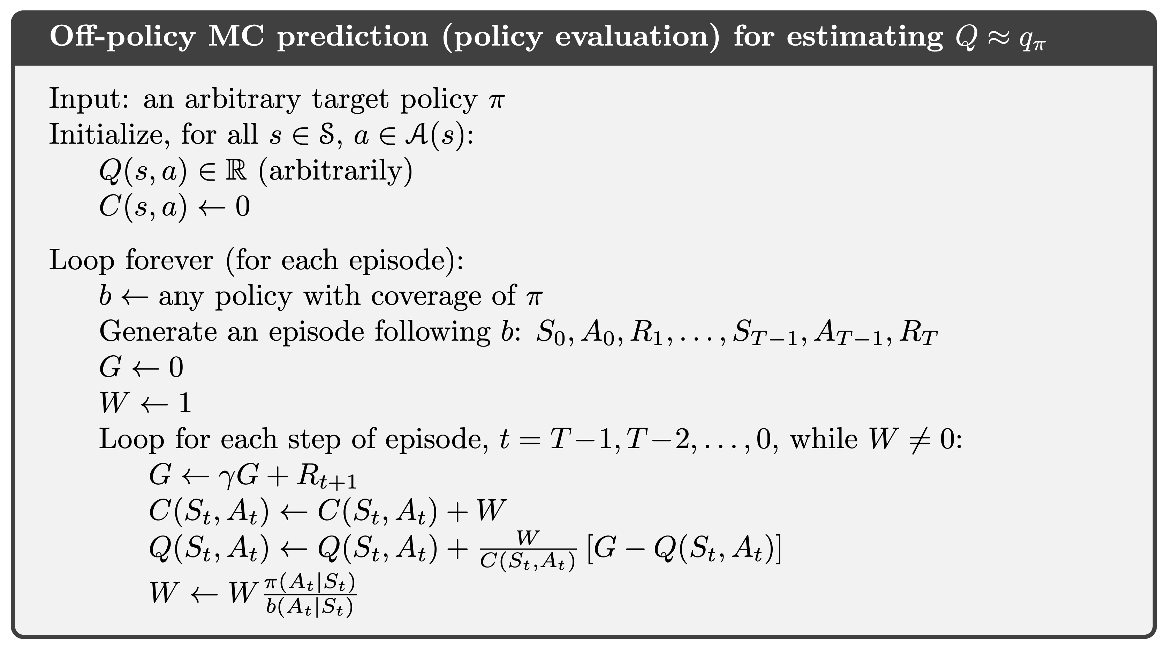
Recap: Off-Policy Monte Carlo Prediction

Slide 9
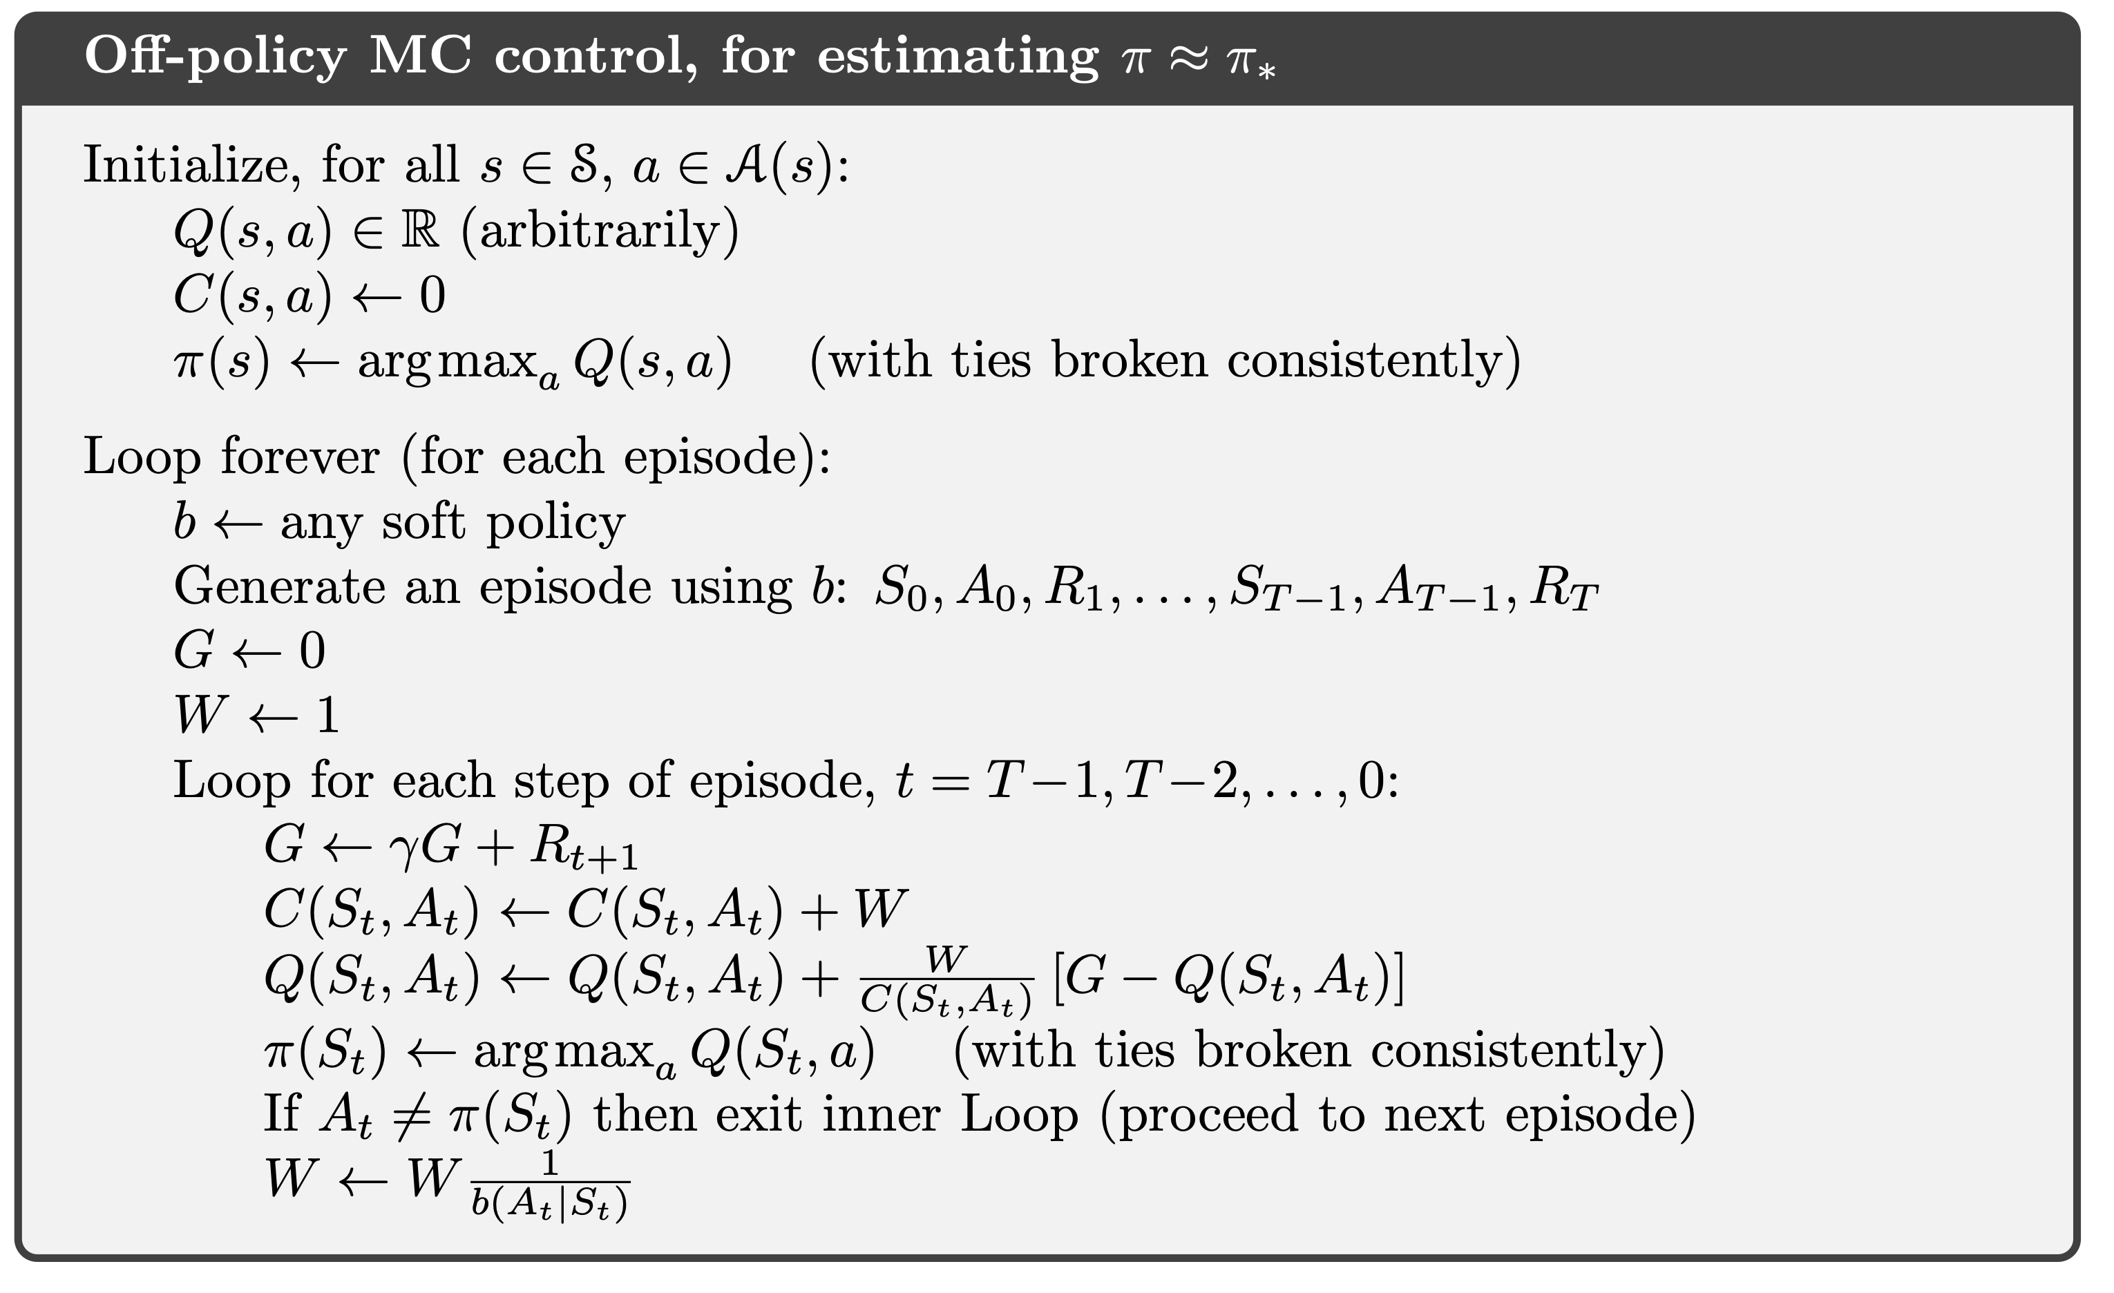
Recap: Off-Policy Monte Carlo Control

Slide 10
Learning from Experience
Suppose we are playing a blackjack-like game in person, but we don't know the rules.
    We know the actions we can take, we can see the cards, and we get told when we win or lose
Question: Could we compute an optimal policy using dynamic programming in this scenario?
Question: Could we compute an optimal policy using Monte Carlo?
    What would be the pros and cons of running Monte Carlo?

Slide 11
Bootstrapping
 | Bootstrapping | No bootstrapping
Learns from experience |  | MC
Requires full dynamics | DP
A 2x2 table. "DP" is in the "requires full dynamics" row and "bootstrapping" column; "MC" is in the "Learns from experience" row and "no bootstrapping" column; "TD" (in a star) is in the "learns from experience" row and "bootstrapping" column.
TD
Dynamic programming bootstraps: Each iteration's estimates are based partly on estimates from previous iterations
Each Monte Carlo estimate is based only on actual returns

Slide 12
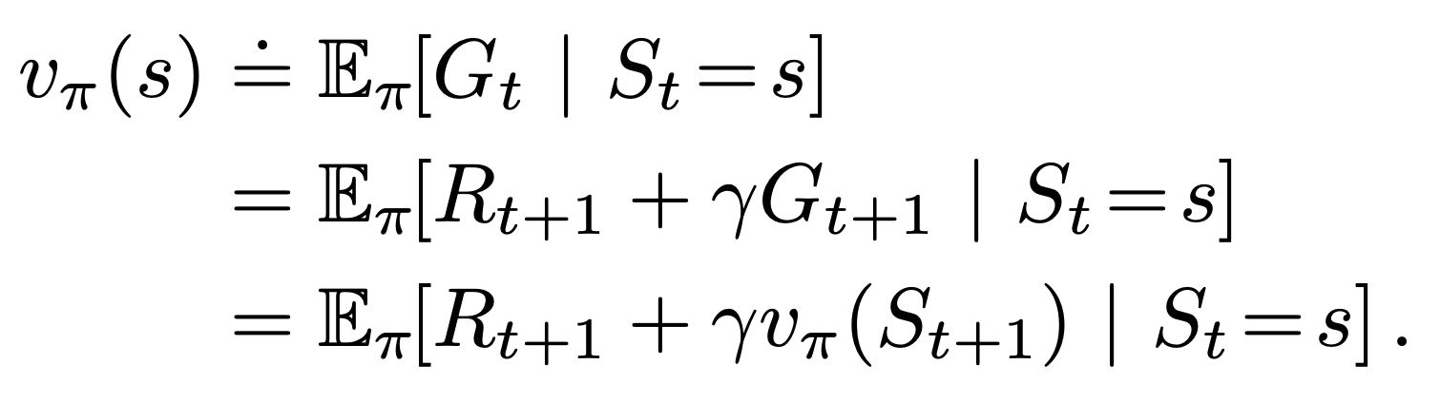
Updates
Dynamic Programming: $V(S_{t})←\underset{a}{∑}π(a|S_{t})\underset{s^{′},r}{∑}p(s^{′},r|S_{t},a)\left[r+γV(s^{′})\right]$
    Monte Carlo: $V(S_{t})←V(S_{t})+α\left[G_{t}-V(S_{t})\right]$
TD(0): $V(S_{t})←V(S_{t})+α\left[R_{t+1}+γV(S_{t+1})-V(S_{t})\right]$
Monte Carlo: Approximate because of 𝔼
Dynamic programming:
Approximate because $v_{π}$ not known
TD(0): Approximate because of 𝔼 and $v_{π}$ not known
Notes:
DP estimates 6.4 - estimate because v𝜋 is not known
MC estimates 6.3 - estimate because of expected values
TD(0) estimates 6.3 - estimate because of both expected values and also v𝜋 not known
backup diagrams here

Slide 13
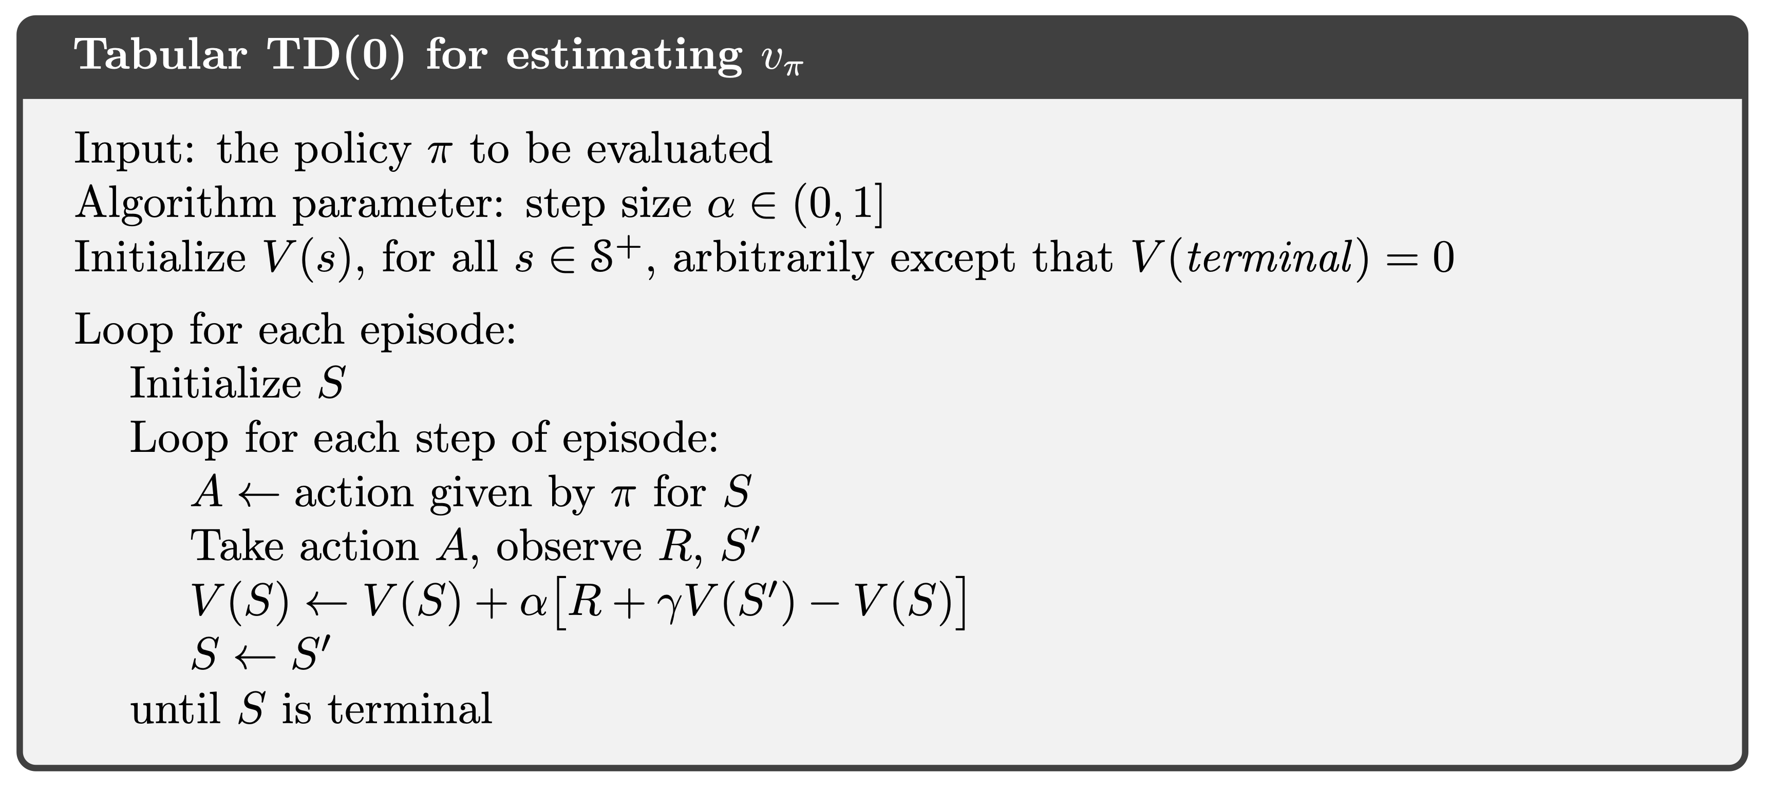
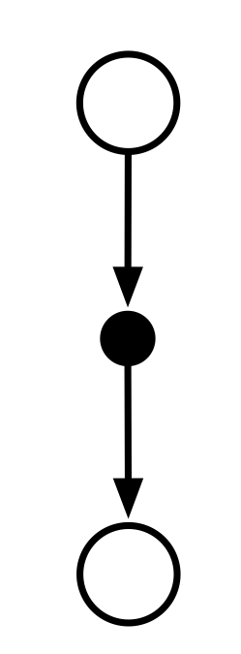
TD(0) Algorithm
An open circle has an arrow to a closed circle, which has an arrow to an open circle.
Question: What information does this algorithm use?

Slide 14
TD for Control
We can plug TD prediction into the generalized policy iteration framework
Monte Carlo control loop:
    Generate an episode using estimated $π$
    Update estimates of $Q$ and $π$
On-policy TD control loop:
    Take an action according to $π$
    Update estimates of $Q$ and $π$

Slide 15
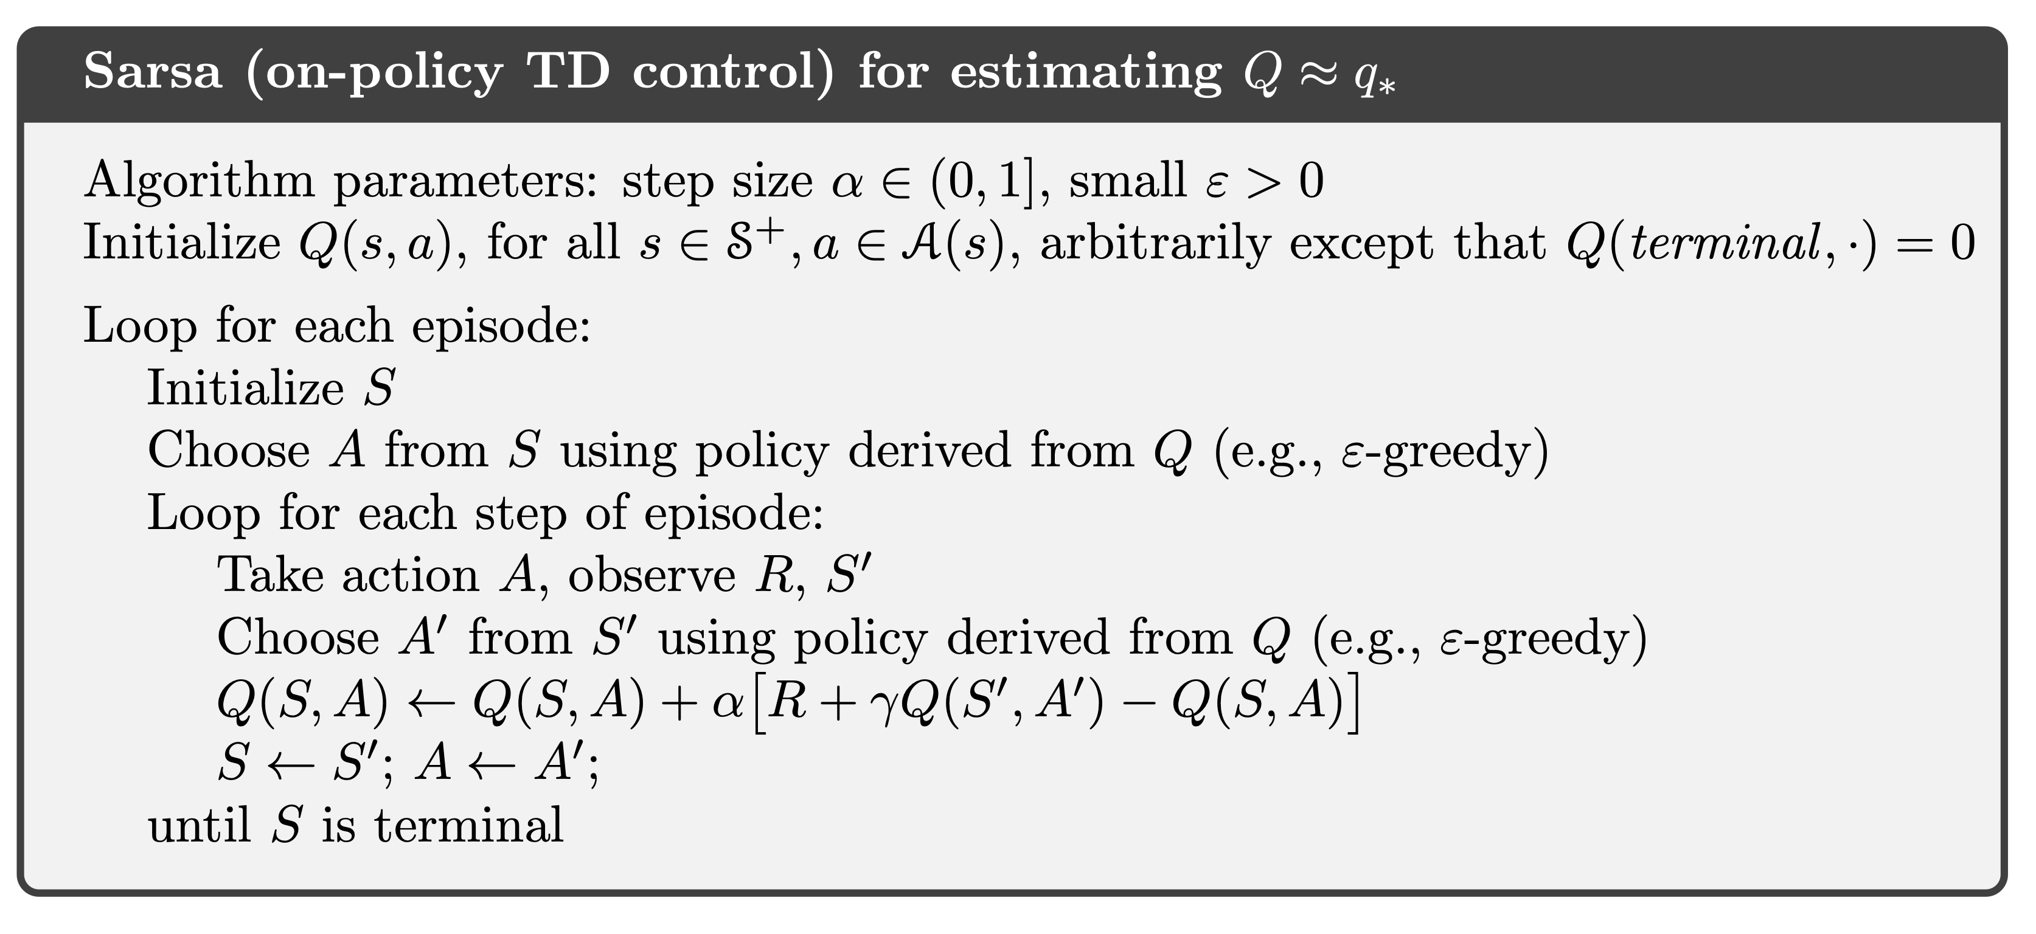
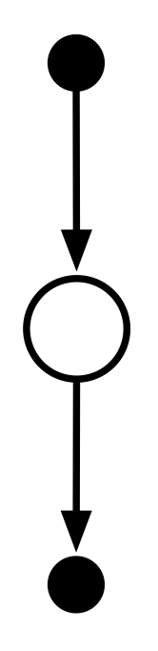
On-Policy TD Control
A closed circle has an arrow to an open circle, which has an arrow to a closed circle.
Question: What information does this algorithm use?
Question: Will this estimate the Q-values of the optimal policy?

Slide 16
Actual Q-Values vs.
Optimal Q-Values
Just as with on-policy Monte Carlo control, Sarsa does not converge to the optimal policy, because it always chooses an $ϵ$-greedy action
    And the estimated Q-values are with respect to the actual actions, which are $ϵ$-greedy
Question: Why is it necessary to choose $ϵ$-greedy actions?
What if we acted $ϵ$-greedy, but learned the Q-values for the optimal policy?
Notes:
+

Slide 17
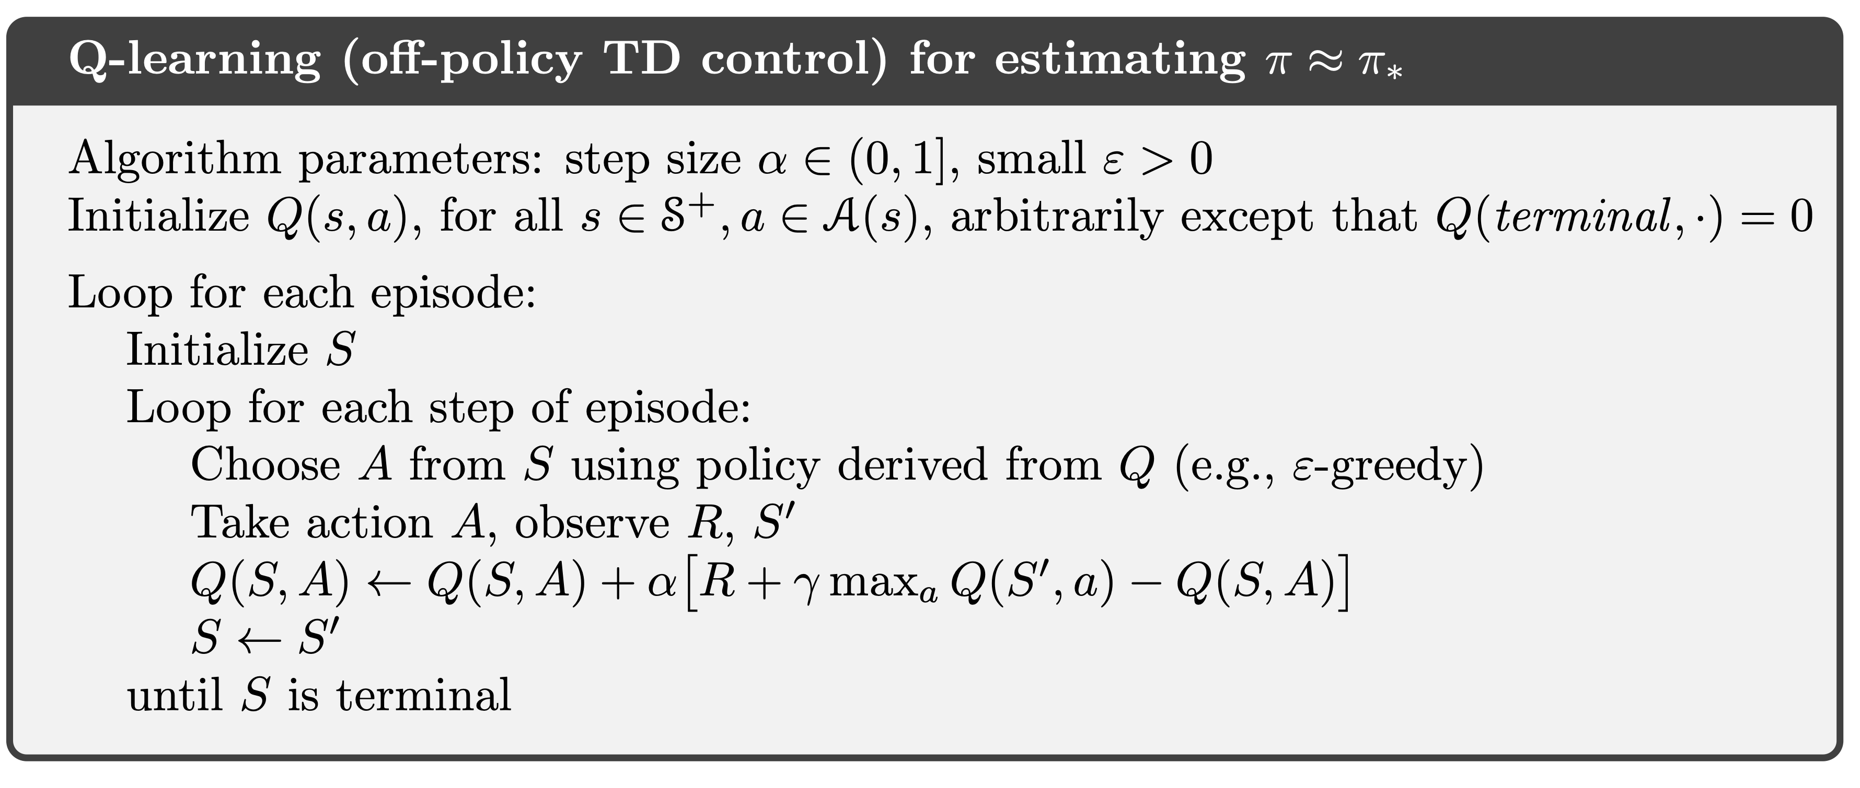
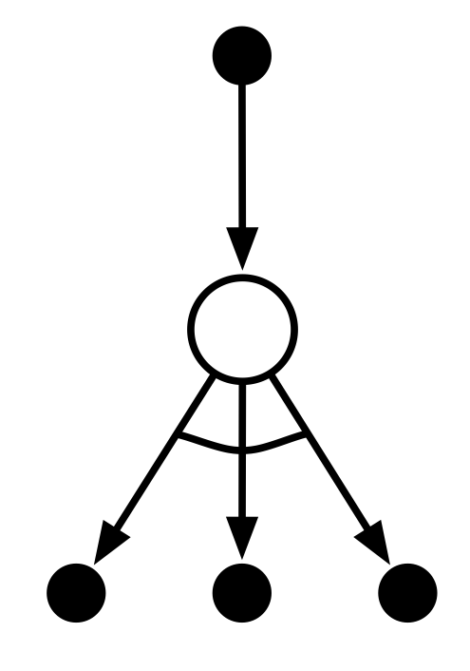
Off-Policy TD Control
A closed circle has an arrow to an open circle, which has multiple arrows to closed circles; the multiple arrows are connected by an arc.
Question: What information does this algorithm use?
Question: Why aren't we estimating the policy $π$ explicitly?

Slide 18
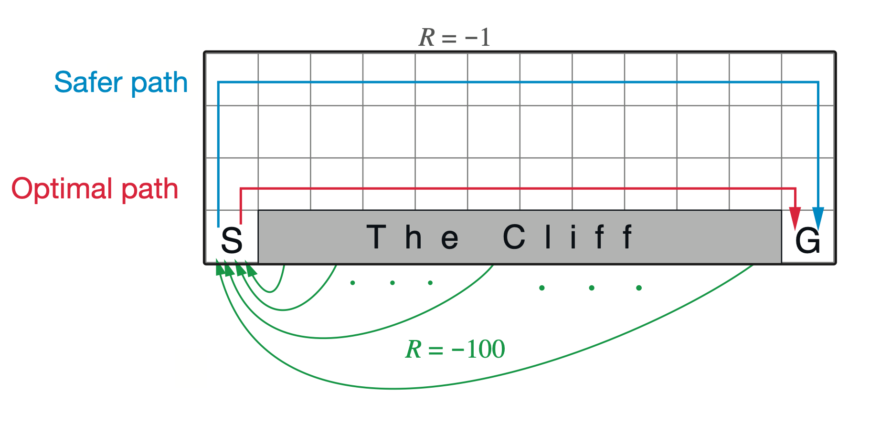
Example: The Cliff
𝛾=1 (undiscounted)
A gridworld; the bottom-left cell is labelled S and the bottom right cell is labelled G. The rest of the bottom row is a grey and labelled "The Cliff". A path labelled "optimal path" goes up one from S, right immediately beside the cliff, and then down one to G. Another path labelled "safer path" goes all the way to the top of the grid from S, all the way across to the right boundary, and then back down again to G. Each cell of The Cliff has an arrow labelled "R=-100" leading back to S. There is a star on the state just up from the cliff and two steps left of the right boundary.
Agent gets -1 reward until they reach the goal state
Step into the Cliff region, get reward -100 and go back to start
Question: How will Q-Learning estimate the value of this state?
Question: How will Sarsa estimate the value of this state?

Slide 19
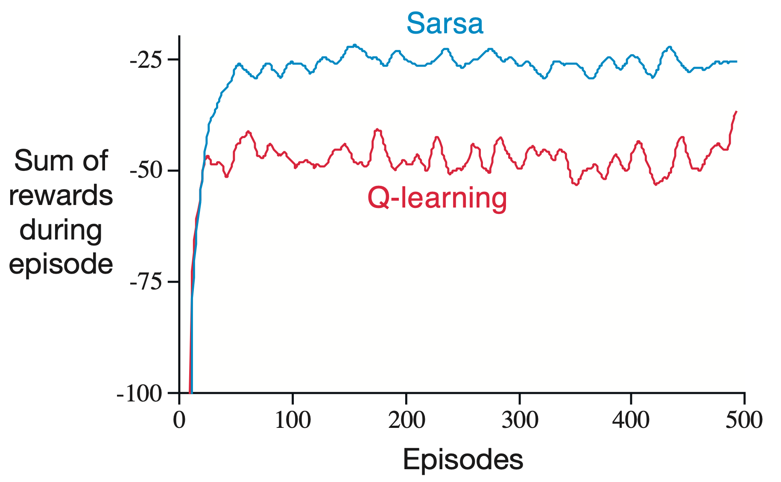
Performance on The Cliff
The y-axis is labelled "Sum of rewards during episode" and the x-axis is labelled "Episodes". The Sarsa trace climbs quickly to about -25 and then appears to converge. The Q-learning trace climbs at the same rate, but instead converges at around -50.
Q-Learning estimates optimal policy, but Sarsa consistently outperforms Q-Learning. (why?)

Slide 20
Sarsa Uses Sampled Actions
Sarsa updates the value of $Q(S_{t},A_{t})$ based on the estimated value of the next action that will actually be taken in the next state:
$$Q(S_{t},A_{t})←Q(S_{t},A_{t})+α\left[R_{t+1}+γQ(S_{t+1},A_{t+1})-Q(S_{t},A_{t})\right]$$
BUT:
    We know the distribution of $A_{t+1}$ (what is it?)
    The estimated value of that action doesn't depend on what happens after it is taken (why?)
    Why not estimate $E_{π}\left[Q(S_{t+1},A_{t+1})\right]$ by taking expectation over $A_{t+1}$?
estimate of $v_{π}(S_{t+1})=E_{π}\left[Q(S_{t+1},A_{t+1})\right]$

Slide 21
Expected Sarsa
Sarsa uses a single sample from $π(⋅∣S_{t})$ to estimate $v_{π}(S_{t+1})$:
  $$Q(S_{t},A_{t})←Q(S_{t},A_{t})+α\left[R_{t+1}+γQ(S_{t+1},A_{t+1})-Q(S_{t},A_{t})\right]$$
Expected Sarsa takes expectation over every possible action:
  $$\begin{matrix}Q(S_{t},A_{t}) & ←Q(S_{t},A_{t})+α\left[R_{t+1}+γE_{a∼π(⋅∣S_{t+1})}\left[Q(S_{t+1},a)\right]-Q(S_{t},A_{t})\right] \\ & =Q(S_{t},A_{t})+α\left[R_{t+1}+γ\underset{a∈A(S_{t+1})}{∑}\left[π(a∣S_{t+1})Q(S_{t+1},a)\right]-Q(S_{t},A_{t})\right]\end{matrix}$$

Slide 22
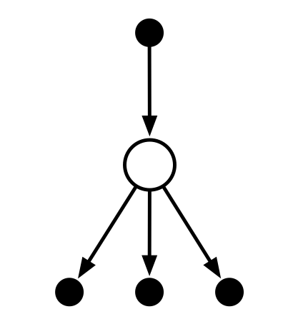
Expected Sarsa
Expected Sarsa (on-policy TD control)
$$α[R+γ\left(∑_{a}π(a∣S^{′})Q(S^{′},a)\right)-Q(S,A)]$$
A closed circle has an arrow to an open circle, which has multiple arrows to closed circles.

Slide 23
Information Usage
Sarsa uses the actual reward $R_{t}$ of the actual action $A_{t}$ taken from an actual state $S_{t}$, and the estimated value of the actual action $A_{t+1}$ to be taken in the actual next state $S_{t+1}$
Q-Learning uses the actual reward $R_{t}$ of the actual action $A_{t}$ taken from an actual state $S_{t}$, and the value of the highest-estimated-value action in the actual next state $S_{t+1}$
Expected Sarsa uses the actual reward $R_{t}$ of the actual action $A_{t}$ taken from an actual state $S_{t}$, and the expected estimated value of next action $A_{t+1}$ to be taken in the actual next state $S_{t+1}$
A closed circle has an arrow to an open circle, which has an arrow to a closed circle.
A closed circle has an arrow to an open circle, which has multiple arrows to closed circles; the multiple arrows are connected by an arc.
A closed circle has an arrow to an open circle, which has multiple arrows to closed circles.

Slide 24
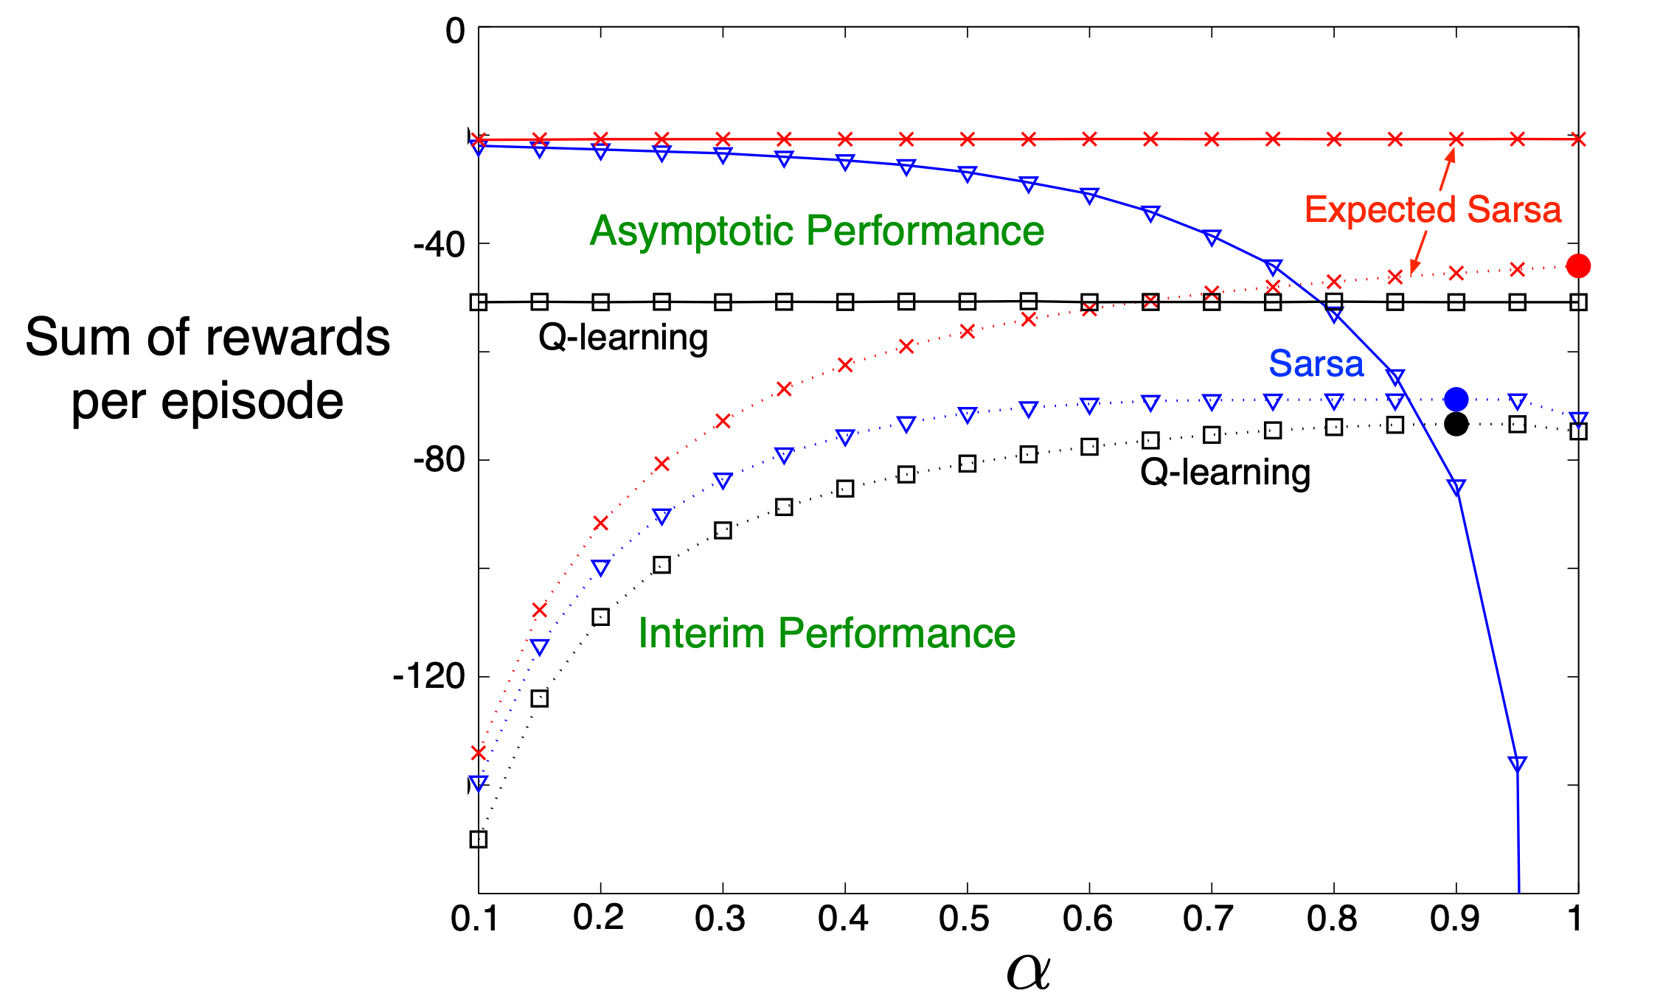
Performance on The Cliff, revisited
The y-axis is labelled "sum of rewards per episode" and the x-axis is labelled "alpha". Performance on the cliff environment is plotted for Q-learning, Sarsa, and Expected Sarsa for both asymptomatic performance and interim performance.
For small enough $α$, Sarsa and Expected Sarsa have same asymptotic performance
For larger $α$, Expected Sarsa has increasingly high interim performance, whereas Sarsa has increasingly poor interim performance (why?)

Slide 25
Summary
Temporal Difference Learning bootstraps and learns from experience
    Dynamic programming bootstraps, but doesn't learn from experience (requires full dynamics)
    Monte Carlo learns from experience, but doesn't bootstrap
Prediction: TD(0) algorithm
Sarsa estimates action-values of actual $ϵ$-greedy policy
    Expected Sarsa estimates action-values of $ϵ$-greedy policy
Q-Learning estimates action-values of optimal policy while executing an $ϵ$-greedy policy

