Slide 1
Optimality and
Dynamic Programming
  CMPUT 261: Introduction to Artificial Intelligence
  S&B §3.6, §4.0-4.4

Slide 2
Lecture Outline
Recap & Logistics
Policy Evaluation
Optimality
Policy Improvement
After this lecture, you should be able to:
justify why one policy is weakly better than another
trace an execution of iterative policy evaluation
state the Policy Improvement Theorem and describe why it is important
trace an execution of the Value Iteration algorithm

Slide 3
Logistics
Assignment #3 is due tonight at 11:59pm
    No remarking or EAs for empty submissions
Assignment #4 will be released today
    Due Thursday December 4 at 11:59pm
Reminder: TAs are available during labs to help

Slide 4
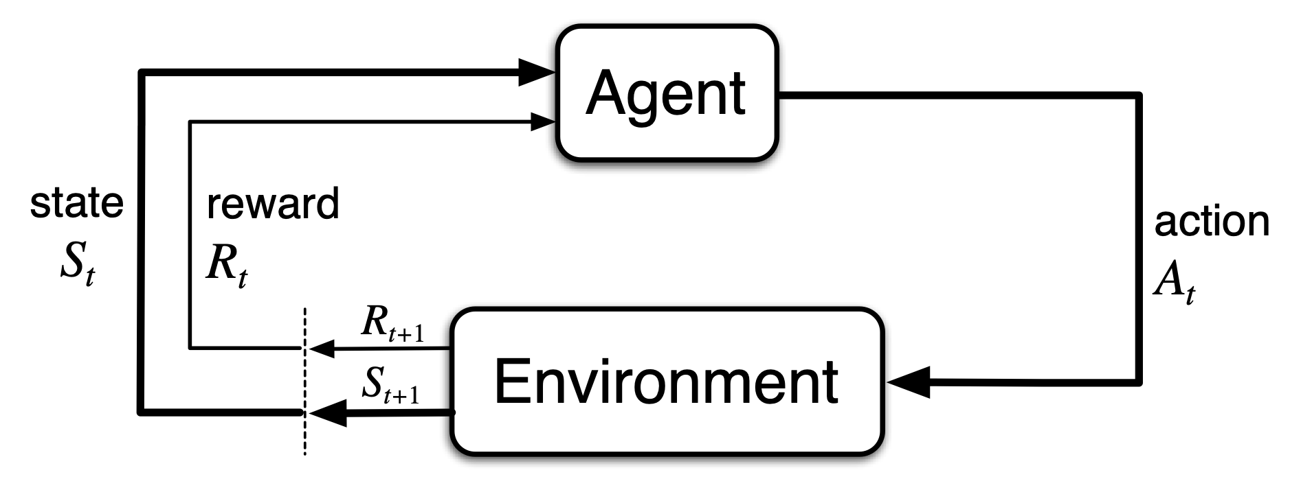
Recap: Markov Decision Process
At each time $t=1,2,3,…$
Agent receives input denoting current state $S_{t}$
Agent chooses action $A_{t}$
Next time step, agent receives reward $R_{t+1}$ and new state $S_{t+1}$, chosen according to a distribution $p(s^{′},r∣s,a)$
There are two boxes labelled "Agent" and "Environment". There is an arrow from Agent to Environment labelled "action A_t". There are two arrows from Environment pointing to a vertical dashed line labelled "R_{t+1}" and "S_{t+1}". From the dashed line there are two arrows pointing back to Agent labelled "state S_t" and "reward R_t".
This interaction between agent
and environment produces a trajectory:
$$S_{0},A_{0},R_{1},S_{1},A_{1},R_{2},S_{2},A_{2},R_{3},…$$

Slide 5
Recap: Policies & Value Functions
Policy: A function $π:S→Δ(A)$ that maps states to a distribution over actions
    For every state $s$, agent following policy $π$ will play action $a$ with probability $π(a∣s)$
State-value function:
$\begin{matrix}v_{π}(s) & ≐E_{π}[G_{t}|S_{t}=s] \\ & =E_{π}\left[\overset{∞}{\underset{k=0}{∑}}γ^{k}R_{t+k+1}|S_{t}=s\right]\end{matrix}$
Action-value function:
$\begin{matrix}q_{π}(s,a) & ≐E_{π}[G_{t}|S_{t}=s,A_{t}=a] \\ & =E_{π}\left[\overset{∞}{\underset{k=0}{∑}}γ^{k}R_{t+k+1}|S_{t}=s,A_{t}=a\right]\end{matrix}$

Slide 6
Recap: Bellman Equations
Value functions satisfy a recursive consistency condition called the Bellman equation:
$\begin{matrix}v_{π}(s) & ≐E_{π}[G_{t}|S_{t}=s] \\ & =E_{π}[R_{t+1}+γG_{t+1}|S_{t}=s] \\ & =\underset{a}{∑}π(a|s)\underset{s^{′}}{∑}\underset{r}{∑}p(s^{′},r|s,a)\left[r+γE_{π}[G_{t+1}|S_{t+1}=s^{′}]\right] \\ & =\underset{a}{∑}π(a|s)\underset{s^{′},r}{∑}p(s^{′},r|s,a)\left[r+γv_{π}(s^{′})\right]\end{matrix}$
$v_{π}$ is the unique solution to $π$'s (state-value) Bellman equation
There is also a Bellman equation for $π$'s action-value function

Slide 7
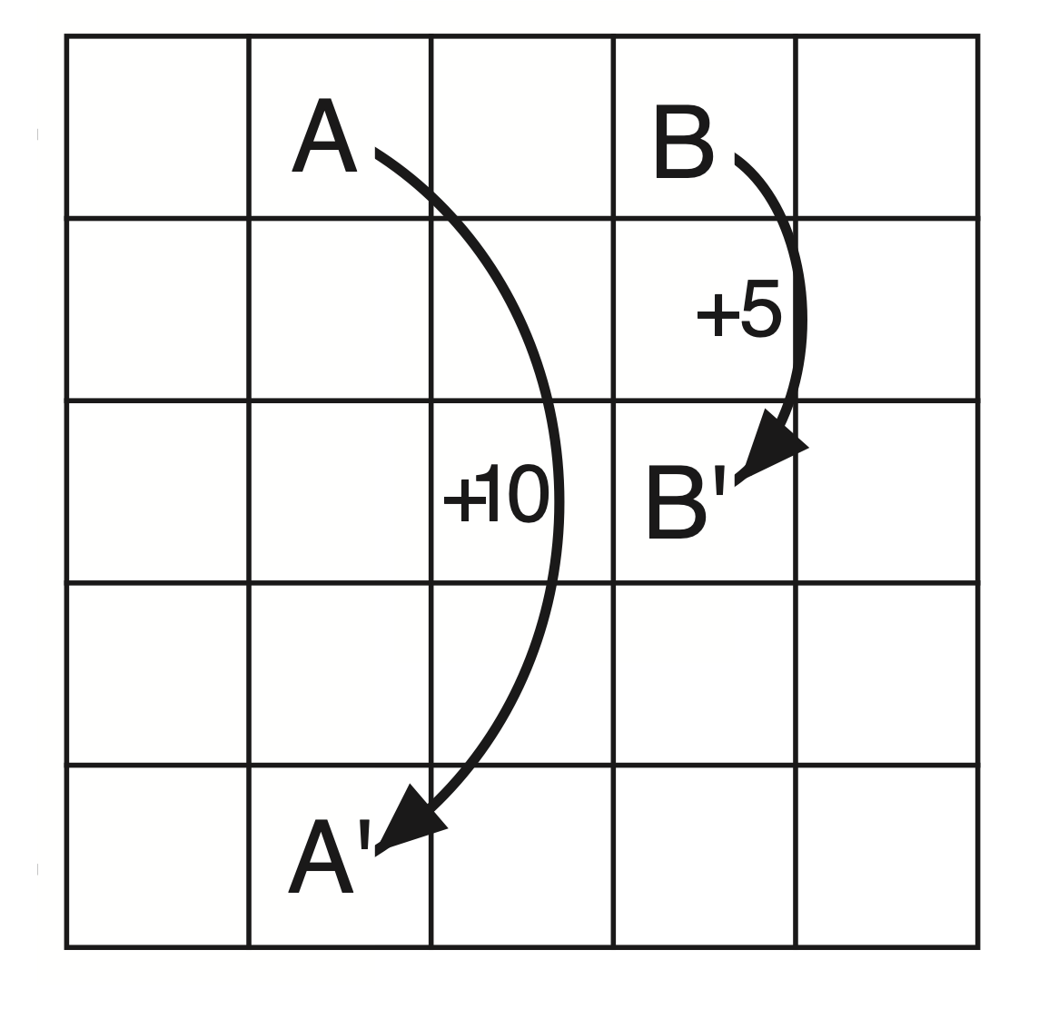
Example: GridWorld
At each cell, can go north, south, east, west
Try to go off the edge: reward of -1
Leaving state A: takes you to state Aʹ, reward of +10
Leaving state B: takes you to state Bʹ, reward of +5
A grid with five rows and five columns. The cell in the top row, second column is labelled "A" and has an arrow labelled "+10" leading to the cell in the bottom row second column labelled "A'". The cell in the top row, fourth column has an arrow labelled "+5" leading to the cell in the third row, fourth column labelled "B'".
(Image: Sutton & Barto, 2018)

Slide 8
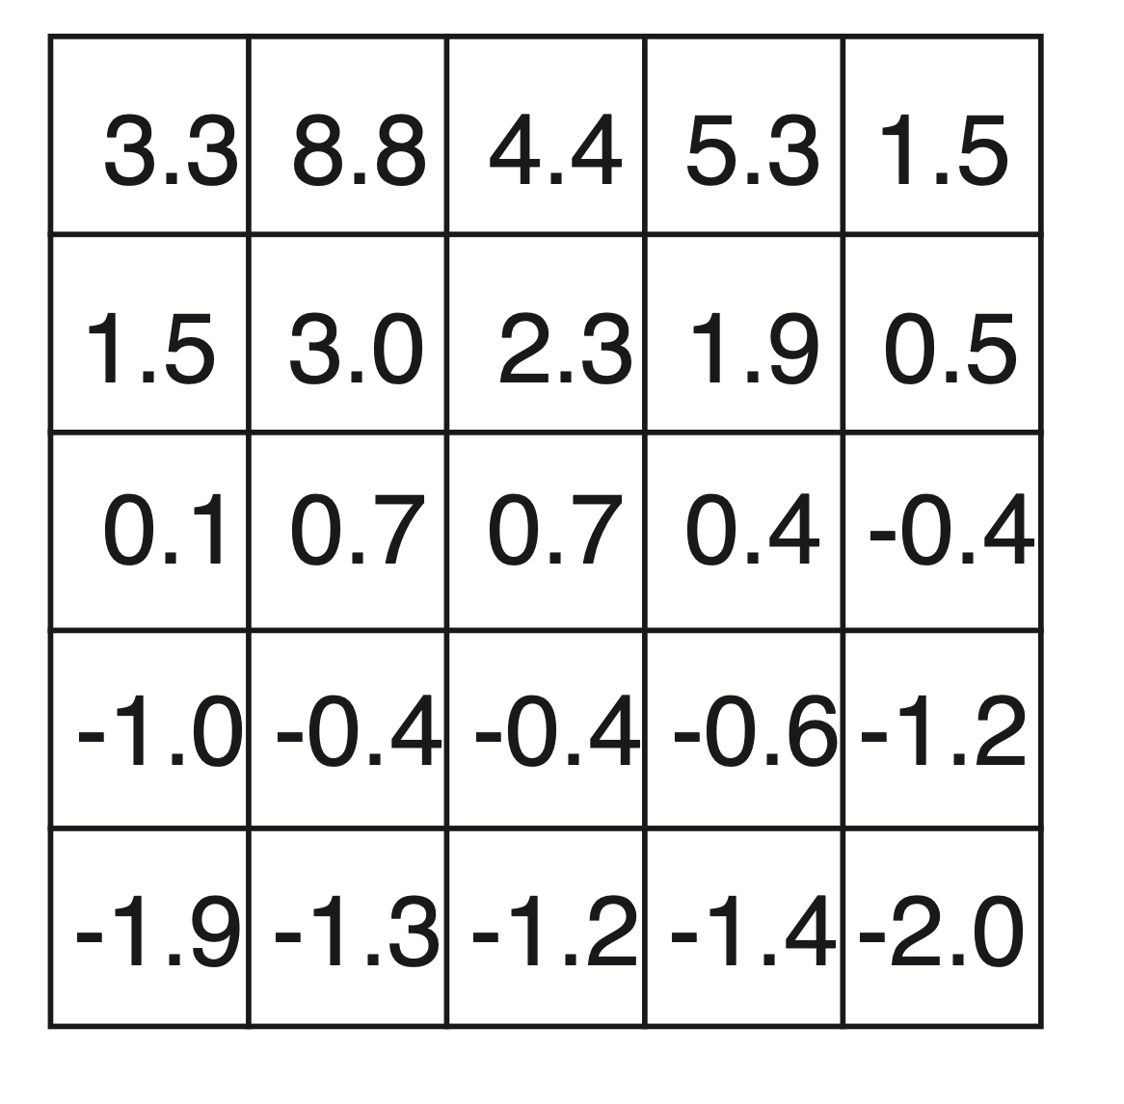
GridWorld
A grid with five rows and five columns. The cell in the top row, second column is labelled "A" and has an arrow labelled "+10" leading to the cell in the bottom row second column labelled "A'". The cell in the top row, fourth column has an arrow labelled "+5" leading to the cell in the third row, fourth column labelled "B'".
A five-by-five grid with numbers in each cell; the top row has 3.3, 8.8, 4.4., 5.3, 1.5; the bottom row has -1.9, -1.3, -1.2, -1.4, -2.0.
Reward dynamics
State-value function v𝜋 for random policy
$π(a|s)=0.25$
(Image: Sutton & Barto, 2018)

Slide 9
GridWorld with Bounds Checking
What about a policy where we never try to go over an edge?
6.7 | 10.8 | 6.4 | 6.7 | 4.3
4.2 | 4.7 | 3.7 | 3.4 | 2.8
2.4 | 2.4 | 2.1 | 1.9 | 1.7
1.5 | 1.4 | 1.3 | 1.2 | 1.1
1.1 | 1.0 | 0.9 | 0.9 | 0.9
A grid with five rows and five columns. The cell in the top row, second column is labelled "A" and has an arrow labelled "+10" leading to the cell in the bottom row second column labelled "A'". The cell in the top row, fourth column has an arrow labelled "+5" leading to the cell in the third row, fourth column labelled "B'".
A five-by-five grid with numbers in each cell; the top row has 3.3, 8.8, 4.4., 5.3, 1.5; the bottom row has -1.9, -1.3, -1.2, -1.4, -2.0.
State-value function $v_{π}$ for
random policy
$π(a∣s)=0.25$
State-value function $v_{π^{B}}$ for
bounded random policy $π^{B}$
Reward dynamics

Slide 10
Policy Evaluation
Question: How can we compute $v_{π}$?
  We know that $v_{π}$ is the unique solution to the Bellman equations, so we could just solve them (treating $v_{π}(s_{1}),…,v_{π}(s_{|S|})$ as variables)
        but that is tedious and annoying and slow
        (it's a system of $|S|$ linear equations in $|S|$ unknowns)
        Also requires a complete model of the dynamics
  Iterative policy evaluation
        Takes advantage of the recursive formulation

Slide 11
Iterative Policy Evaluation
Iterative policy evaluation uses the Bellman equation as an update rule:
$\begin{matrix}v_{k+1}(s) & ≐E_{π}[R_{t+1}+γv_{k}(S_{t+1})|S_{t}=s] \\ & =\underset{a}{∑}π(a|s)\underset{s^{′},r}{∑}p(s^{′},r|s,a)\left[r+γv_{k}(s^{′})\right]\end{matrix}$
$v_{π}$ is a fixed point of this update, by definition
Furthermore, starting from an arbitrary $v_{0}$, the sequence $\{v_{k}\}$ will converge to $v_{π}$ as $k→∞$
    (nontrivial to prove)
Notes:
Next time: Prove the "furthermore" statement?

Slide 12
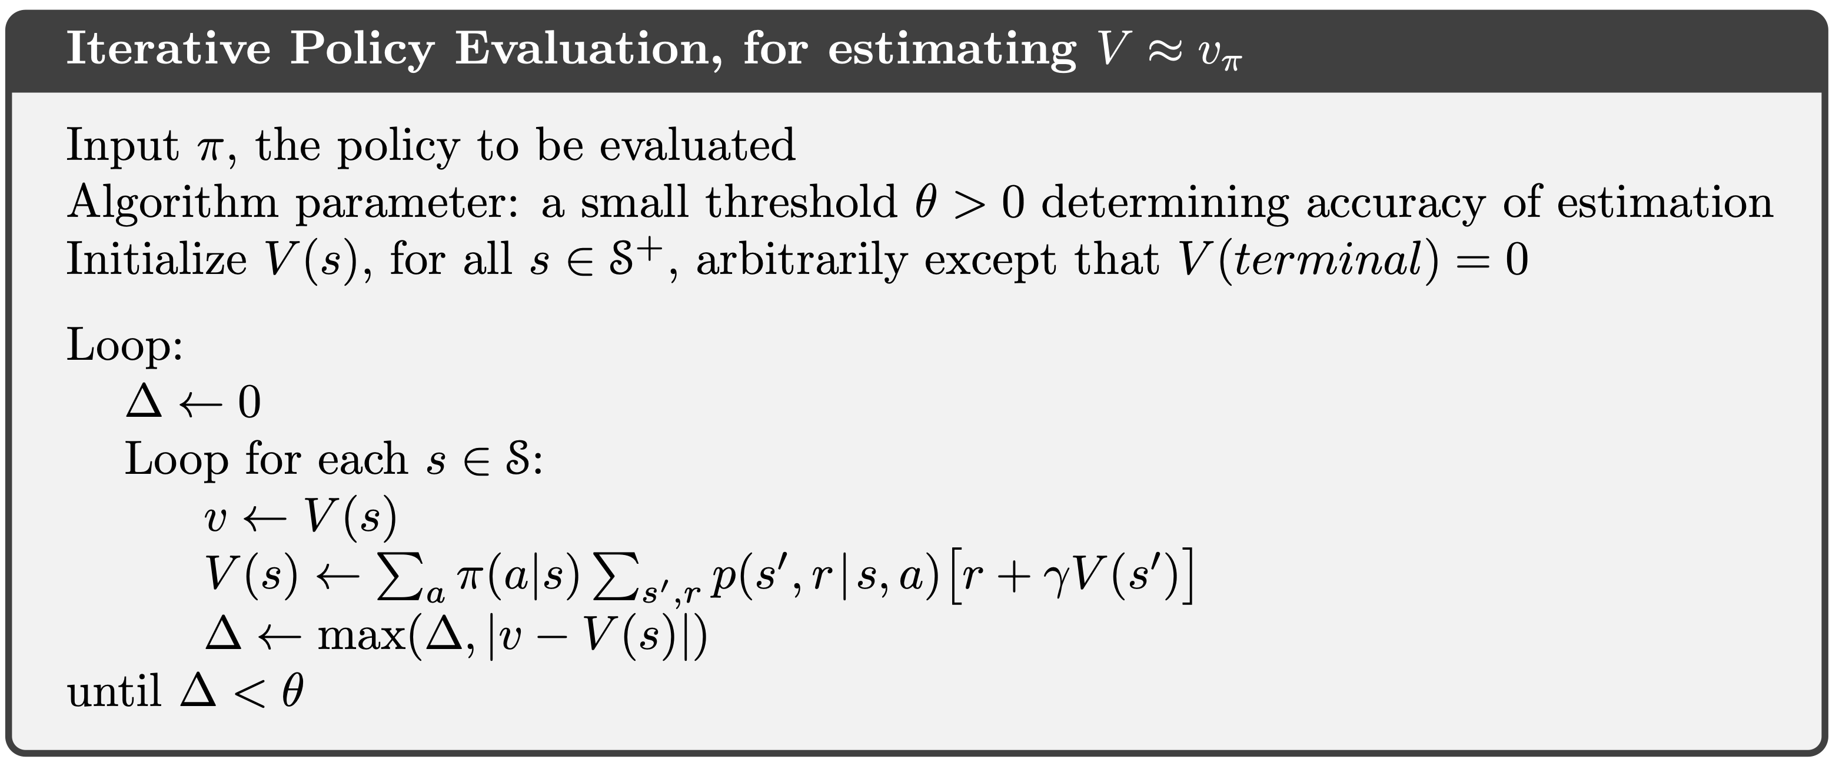
In-Place Iterative Policy Evaluation
The updates are in-place: we use new values for $V(s)$ immediately instead of waiting for the current sweep to complete (why?)
These are expected updates: Based on a weighted average (expectation) of all possible next states (instead of what?)

Slide 13
Iterative Policy Evaluation
0.0 | 0.0 | 0.0 | 0.0 | 0.0
0.0 | 0.0 | 0.0 | 0.0 | 0.0
0.0 | 0.0 | 0.0 | 0.0 | 0.0
0.0 | 0.0 | 0.0 | 0.0 | 0.0
0.0 | 0.0 | 0.0 | 0.0 | 0.0
A grid with five rows and five columns. The cell in the top row, second column is labelled "A" and has an arrow labelled "+10" leading to the cell in the bottom row second column labelled "A'". The cell in the top row, fourth column has an arrow labelled "+5" leading to the cell in the third row, fourth column labelled "B'".
Reward dynamics
$V$ at $k=0$

Slide 14
Iterative Policy Evaluation
V(s1,1)=π(n)[-1+γV(s1,1)]+π(w)[-1+γV(s1,1)]+=π(s)[0+γV(s1,2)]+π(e)[0+γV(s2,1)]=0.25(-1)+0.25(-1)+0.25(0)+0.25(0)
-0.5 | 0.0 | 0.0 | 0.0 | 0.0
0.0 | 0.0 | 0.0 | 0.0 | 0.0
0.0 | 0.0 | 0.0 | 0.0 | 0.0
0.0 | 0.0 | 0.0 | 0.0 | 0.0
0.0 | 0.0 | 0.0 | 0.0 | 0.0
A grid with five rows and five columns. The cell in the top row, second column is labelled "A" and has an arrow labelled "+10" leading to the cell in the bottom row second column labelled "A'". The cell in the top row, fourth column has an arrow labelled "+5" leading to the cell in the third row, fourth column labelled "B'".
Reward dynamics
$V$ at $k=0$

Slide 15
Iterative Policy Evaluation
V(s1,2)=π(n)[10+γV(s2,5)]+π(w)[10+γV(s2,5)]+=π(s)[10+γV(s2,5)]+π(e)[10+γV(s2,5)]=0.25[10+0.9(0)]+0.25[10+0.9(0)]+=0.25[10+0.9(0)]+0.25[10+0.9(0)]
-0.5 | 10 | 0.0 | 0.0 | 0.0
0.0 | 0.0 | 0.0 | 0.0 | 0.0
0.0 | 0.0 | 0.0 | 0.0 | 0.0
0.0 | 0.0 | 0.0 | 0.0 | 0.0
0.0 | 0.0 | 0.0 | 0.0 | 0.0
A grid with five rows and five columns. The cell in the top row, second column is labelled "A" and has an arrow labelled "+10" leading to the cell in the bottom row second column labelled "A'". The cell in the top row, fourth column has an arrow labelled "+5" leading to the cell in the third row, fourth column labelled "B'".
Reward dynamics
$V$ at $k=0$

Slide 16
Iterative Policy Evaluation
V(s3,1)=π(n)[-1+γV(s3,1)]+π(w)[-1+γV(s2,1)]+=π(s)[0+γV(s3,2)]+π(e)[0+γV(s4,1)]=0.25[-1+0.9(0)]+0.25[0+0.9(10)]+=0.25[0+0.9(0)]+0.25[0+0.9(0)]
-0.5 | 10 | 2 | 0.0 | 0.0
0.0 | 0.0 | 0.0 | 0.0 | 0.0
0.0 | 0.0 | 0.0 | 0.0 | 0.0
0.0 | 0.0 | 0.0 | 0.0 | 0.0
0.0 | 0.0 | 0.0 | 0.0 | 0.0
A grid with five rows and five columns. The cell in the top row, second column is labelled "A" and has an arrow labelled "+10" leading to the cell in the bottom row second column labelled "A'". The cell in the top row, fourth column has an arrow labelled "+5" leading to the cell in the third row, fourth column labelled "B'".
Reward dynamics
$V$ at $k=0$

Slide 17
Iterative Policy Evaluation
in GridWorld
-0.5 | 10 | 2 | 5 | 0.6
-0.3 | 2.1 | 0.9 | 1.3 | 0.2
-0.3 | 0.4 | 0.3 | 0.4 | -0.1
-0.3 | 0.0 | 0.0 | 0.1 | -0.2
-0.5 | -0.3 | -0.3 | -0.3 | -0.6
A grid with five rows and five columns. The cell in the top row, second column is labelled "A" and has an arrow labelled "+10" leading to the cell in the bottom row second column labelled "A'". The cell in the top row, fourth column has an arrow labelled "+5" leading to the cell in the third row, fourth column labelled "B'".
Reward dynamics
$V$ at $k=1$

Slide 18
Iterative Policy Evaluation
in GridWorld
1.4 | 9.7 | 3.7 | 5.3 | 1.0
0.4 | 2.5 | 1.8 | 1.7 | 0.4
-0.2 | 0.6 | 0.6 | 0.5 | -0.1
-0.5 | 0.0 | 0.0 | 0.0 | -0.5
-1.0 | -0.6 | -0.5 | -0.5 | -1.0
A grid with five rows and five columns. The cell in the top row, second column is labelled "A" and has an arrow labelled "+10" leading to the cell in the bottom row second column labelled "A'". The cell in the top row, fourth column has an arrow labelled "+5" leading to the cell in the third row, fourth column labelled "B'".
Reward dynamics
$V$ at $k=2$

Slide 19
Iterative Policy Evaluation
in GridWorld
3.4 | 8.9 | 4.5 | 5.3 | 1.5
1.6 | 3.0 | 2.3 | 1.9 | 0.6
0.1 | 0.8 | 0.7 | 0.4 | -0.4
-1.0 | -0.4 | -0.3 | -0.6 | -1.2
-1.9 | -1.3 | -1.2 | -1.4 | -2.0
A grid with five rows and five columns. The cell in the top row, second column is labelled "A" and has an arrow labelled "+10" leading to the cell in the bottom row second column labelled "A'". The cell in the top row, fourth column has an arrow labelled "+5" leading to the cell in the third row, fourth column labelled "B'".
Reward dynamics
$V$ at $k=10000$

Slide 20
Optimality
Question: What is an optimal policy?
A policy $π$ is (weakly) better than a policy $π^{′}$ if it is better for all $s∈S$ :
$π≥π^{′}⟺v_{π}(s)≥v_{π^{′}}(s)∀s∈S$.
An optimal policy $π_{*}$ is weakly better than every other policy
  Question: Is an optimal policy guaranteed to exist for a given MDP?
All optimal policies share the same state-value function: (why?)
$v_{*}(s)≐\max_{π}v_{π}(s)$
Also the same action-value function:
$q_{*}(s,a)≐\max_{π}q_{π}(s,a)$

Slide 21
Bellman Optimality Equations
$v_{*}$ must satisfy the Bellman equation too
In fact, it can be written in a special, policy-free way because we know that every state value is maximized by $π_{*}$:
$$v_{*}(s)=\max_{a}q_{π_{*}}(s,a)$$
v*(s)=maxaEπ*[Gt∣St=s,At=a]
v*(s)=maxaEπ*[Rt+1+γGt+1∣St=s,At=a]
v*(s)=maxaE[Rt+1+γv*(St+1)∣St=s,At=a]
v*(s)=maxa∑s′,rp(s′,r∣s,a)[r+γv*(s′)]

Slide 22
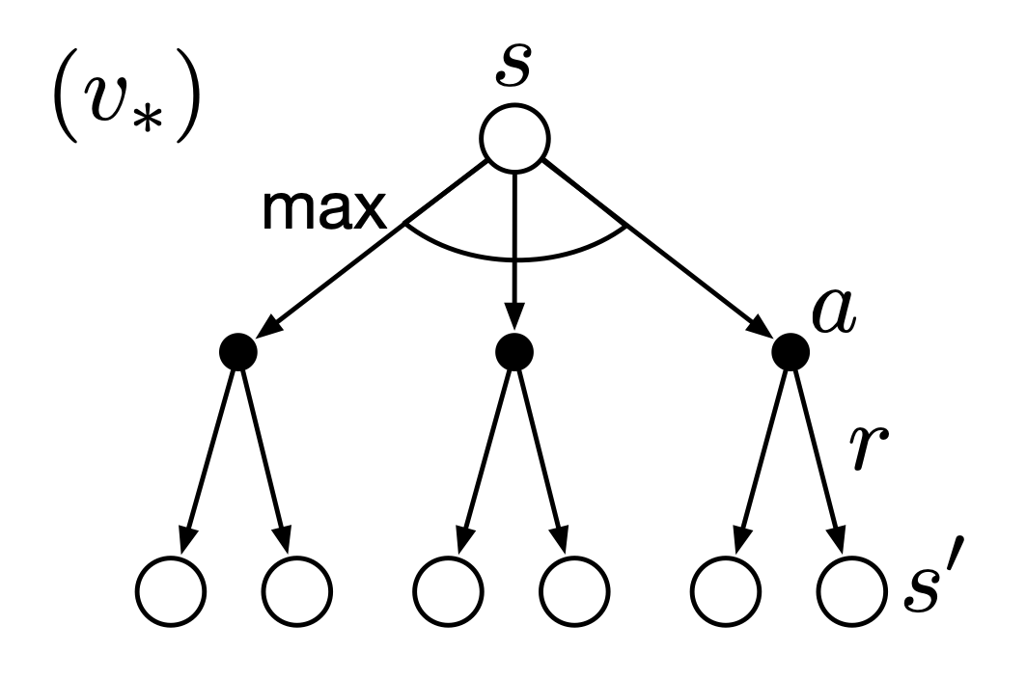
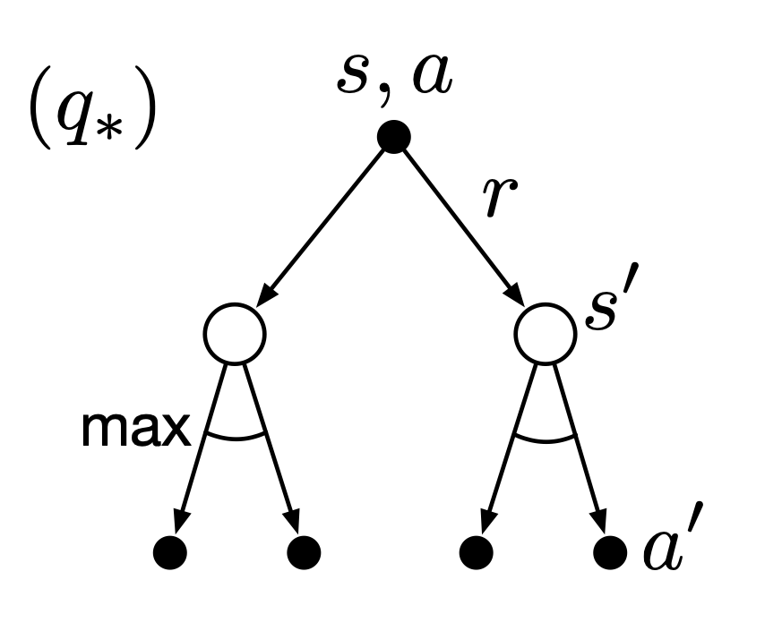
Bellman Optimality Equations
$$\begin{matrix}v_{*}(s) & =\max_{a}E[R_{t+1}+γv_{*}(S_{t+1})|S_{t}=s,A_{t}=a] \\ & =\max_{a}\underset{s^{′},r}{∑}p(s^{′},r|s,a)[r+γv_{*}(s^{′})]\end{matrix}$$
An open circle "s" has outgoing edges leading to three filled circles "a", each of which has two outgoing edges labelled "r" to open circles labelled "s'". The branches from "s" to the filled circles "a" are connected by an arc labelled "max".
$$\begin{matrix}q_{*}(s,a) & =E\left[R_{t+1}+γ\max_{a^{′}}q_{*}(S_{t+1},a^{′})|S_{t}=s,A_{t}=a\right] \\ & =\underset{s^{′},r}{∑}p(s^{′},r|s,a)\left[r+γ\max_{a^{′}}q_{*}(s^{′},a^{′})\right]\end{matrix}$$
A filled circle labelled "s,a" has outgoing edges labelled "r" to two open circles labelled "s'". Each "s'" circle has two edges leading to filled circles labelled "a'"; these two edges are joined by an arc labelled "max".

Slide 23
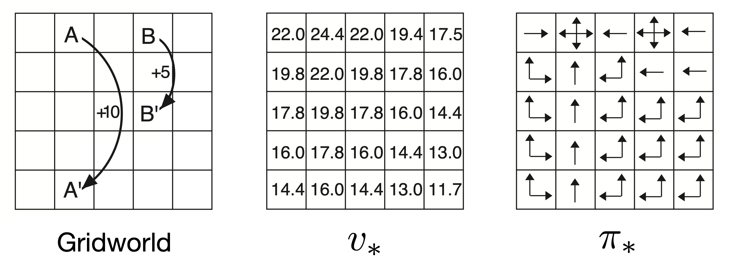
Optimal GridWorld
The reward dynamics for gridworld, a table of the optimal state values, and a grid showing the actions chosen by the optimal policy $π_{*}$.

Slide 24
Policy Improvement Theorem
Theorem:
Let $π$ and $π^{′}$ be any pair of deterministic policies.
If $q_{π}(s,π^{′}(s))≥v_{π}(s)∀s∈S$,
then $v_{π^{′}}(s)≥v_{π}(s)∀s∈S$.
If you are never worse off at any state by following $π^{′}$ for one step and then following $π$ forever after, then following $π^{′}$ forever has a higher expected value at every state.

Slide 25
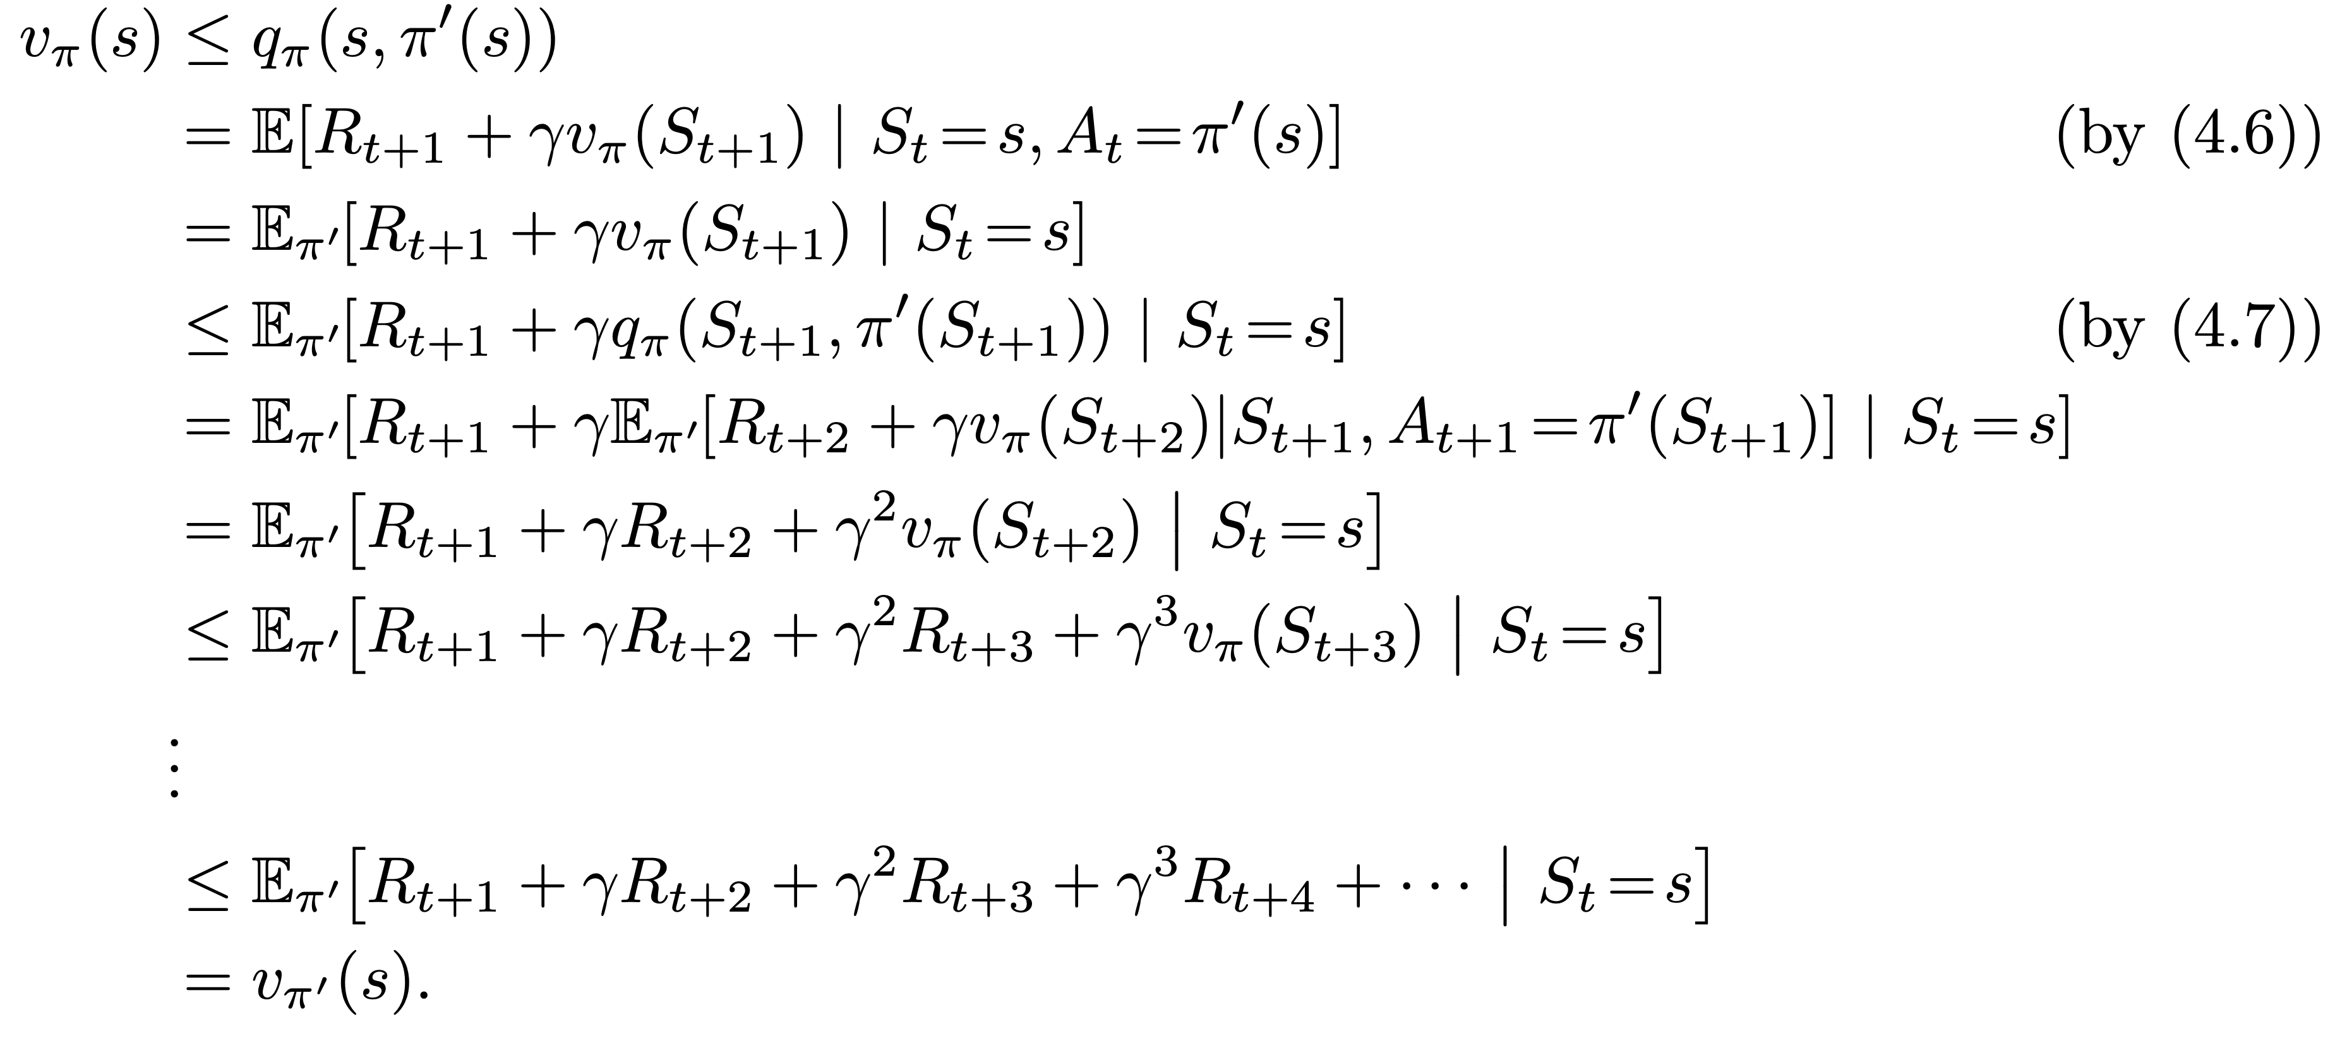
Policy Improvement Theorem Proof

Slide 26
Policy Improvement Theorem Proof
$$∀s$$
$$v_{π}(s)≤q_{π}(s,π^{′}(s))$$
vπ(s)=Eπ[Rt+1+γvπ(St+1)∣St=s,At=π′(s)]
vπ(s)=Eπ′[Rt+1+γvπ(St+1)∣St=s]
vπ(s)≤Eπ′[Rt+1+γqπ(St+1,π′(St+1))∣St=s]
vπ(s)=Eπ′[Rt+1+γEπ′[Rt+2+γvπ(St+2)∣St+1,At+1=π′(St+1)]∣St=s]
vπ(s)=Eπ′[Rt+1+γEπ′[Rt+2]+γ2Eπ′[vπ(St+2)]∣St=s]
vπ(s)=Eπ′[Rt+1+γRt+2+γ2vπ(St+2)∣St=s]
vπ(s)≤Eπ′[Rt+1+γRt+2+γ2Rt+3+γ3vπ(St+3)∣St=s]
vπ(s)⋮
vπ(s)≤Eπ′[Rt+1+γRt+2+γ2Rt+3+γ3Rt+4+⋯∣St=s]
vπ(s)=vπ′(s).

Slide 27
Greedy Policy Improvement
Given any policy $π$, we can construct a new greedy policy $π^{′}$ that is guaranteed to be at least as good:
$\begin{matrix}π^{′}(s) & ≐arg\max_{a}q_{π}(s,a) \\ & =arg\max_{a}E[R_{t+1}+γv_{π}(S_{T+1})|S_{t}=s,A_{t}=a] \\ & =arg\max_{a}\underset{s^{′},r}{∑}p(s^{′},r|s,a)\left[r+γv_{π}(s^{′})\right].\end{matrix}$
If this new policy is not strictly better than the old policy, then $v_{π}(s)=v_{π^{′}}(s)$ for all $s∈S$ (why?)
Also means that the new (and old) policies are optimal (why?)

Slide 28
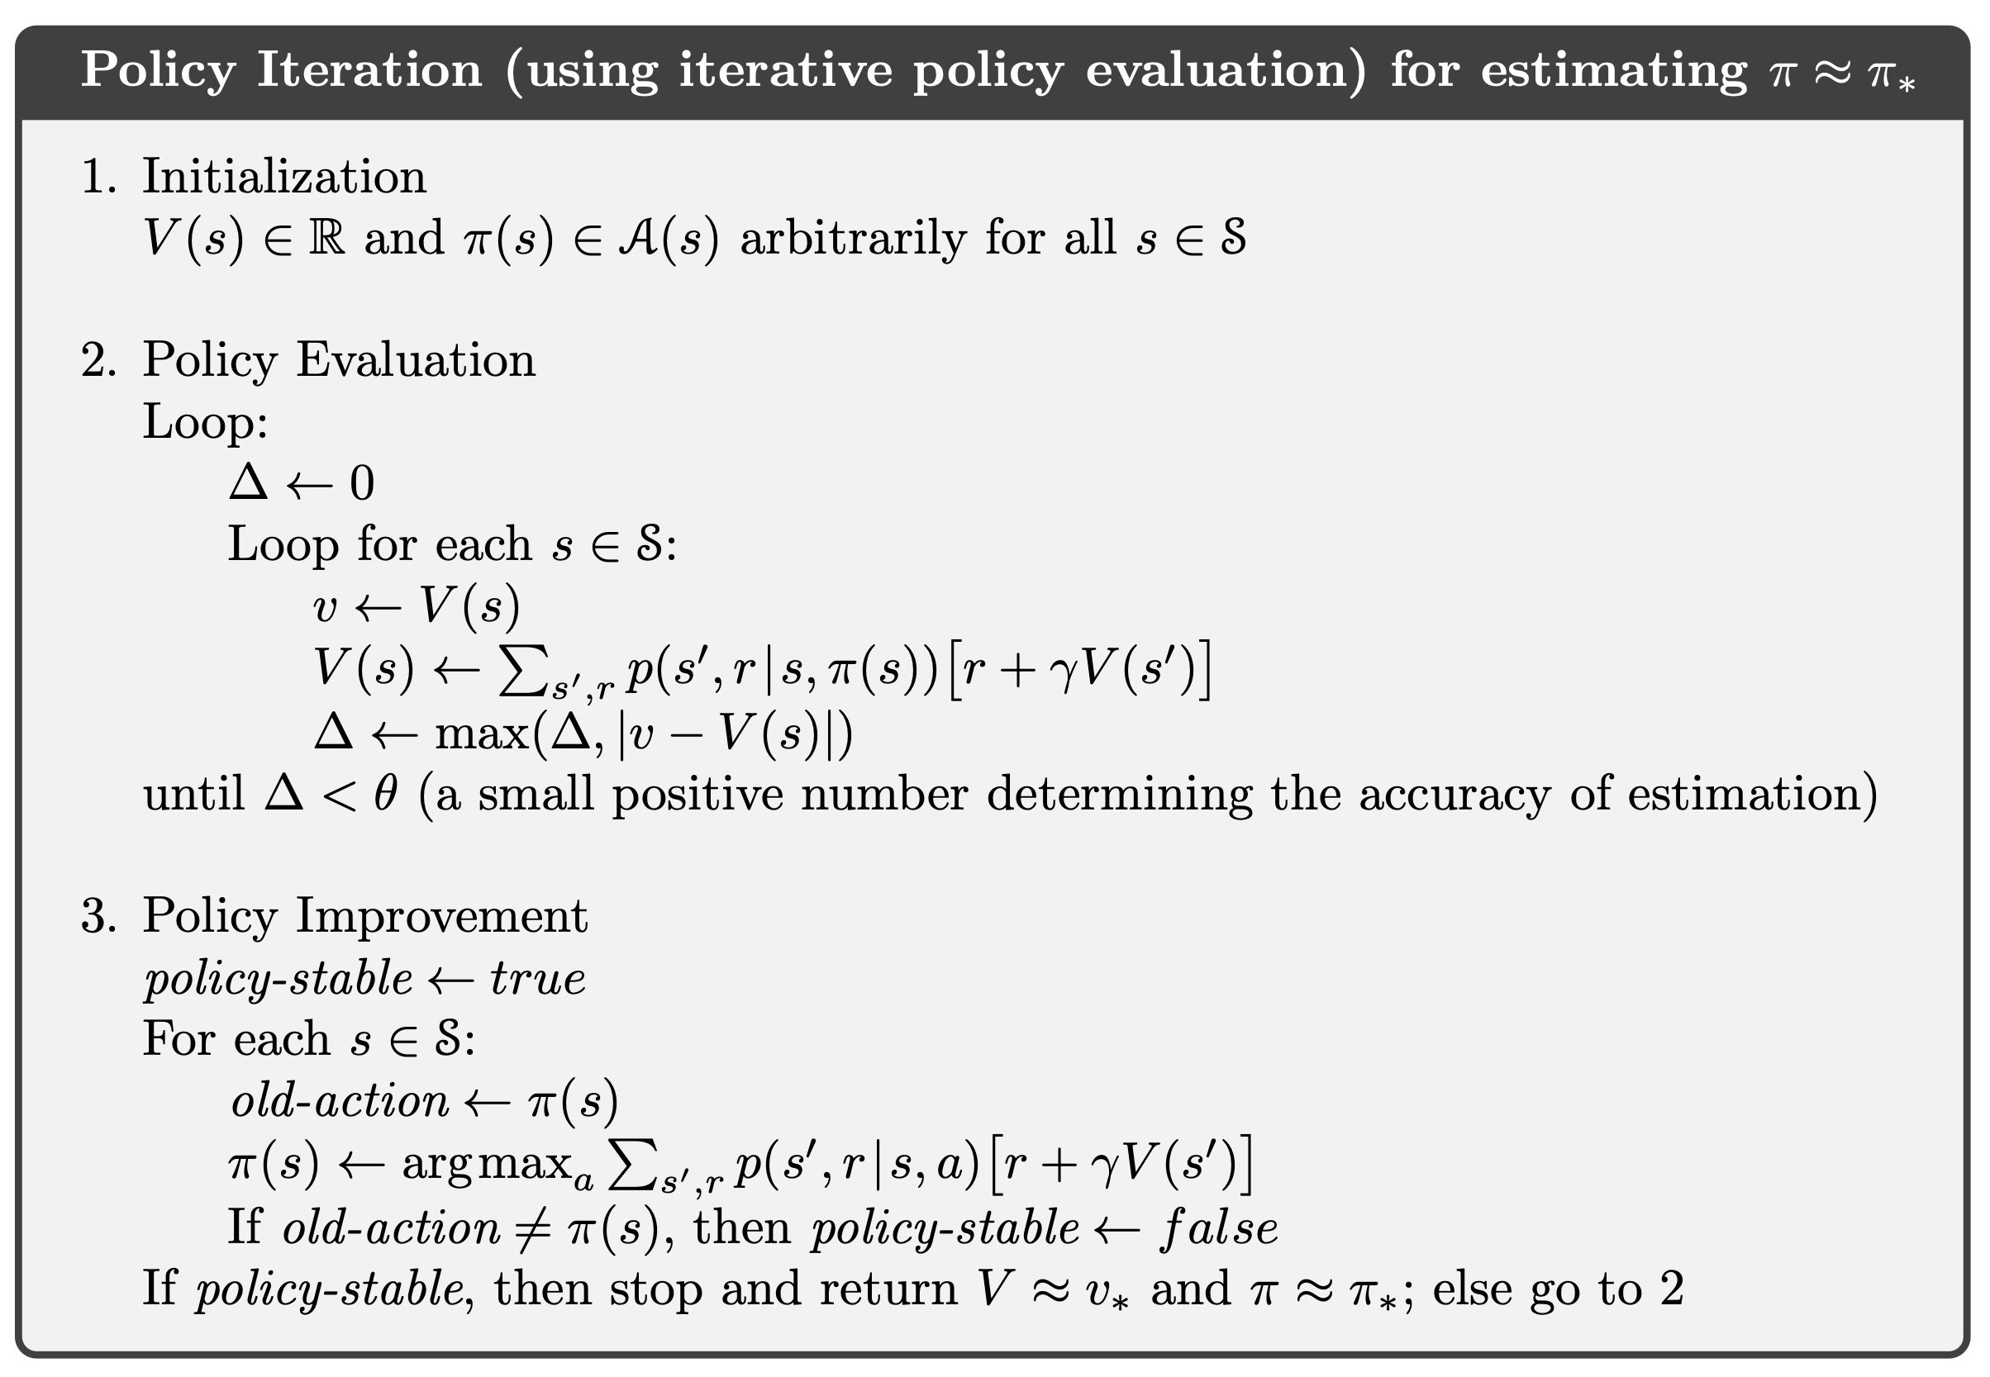
Policy Iteration
This is a lot of iterations!
Is it necessary to run to
completion?

Slide 29
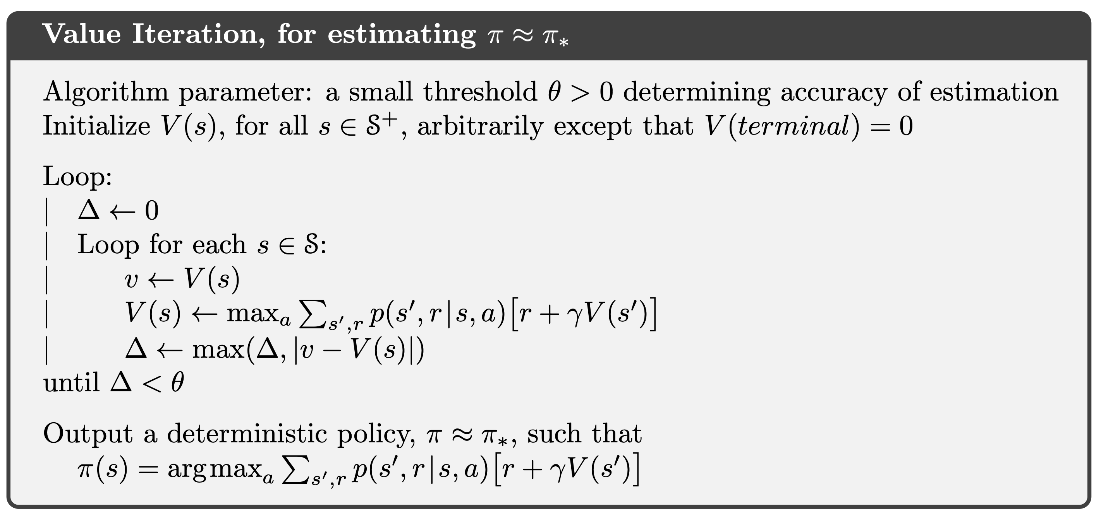
Value Iteration
Value iteration interleaves the estimation and improvement steps:
$\begin{matrix}v_{k+1}(s) & ≐\max_{a}E\left[R_{t+1}+γv_{k}(S_{t+1})|S_{t}=s,A_{t}=a\right] \\ & =\max_{a}\underset{s^{′},r}{∑}p(s^{′},r|s,a)\left[r+γv_{k}(s^{′})\right]\end{matrix}$

Slide 30
Summary
An optimal policy has higher state value than any other policy at every state
A policy's state-value function can be computed by iterating an expected update based on the Bellman equation
Given any policy $π$, we can compute a greedy improvement $π^{′}$ by choosing highest expected value action based on $v_{π}$
Policy iteration: Repeat:
Greedy improvement using $v_{π}$, then recompute $v_{π}$
Value iteration: Repeat:
Recompute $v_{π}$ by assuming greedy improvement at every update

