Slide 1
Markov Decision Processes
  CMPUT 261: Introduction to Artificial Intelligence
  S&B §3.0-3.5

Slide 2
Title
Definition:
A function $f$ is a linear function of $x$ if it can be written as $f(x)=w_{0}+w_{1}x$
example text here
  likelihood
  prior
Questions:
If $f$ can be literally any function, then what is the solution?
  Is that desirable?
What could we do instead?
Why are we squaring the difference?
(Image: Goodfellow 2016)

Slide 3
Lecture Outline
After this lecture, you should be able to:
define a Markov decision process
represent a problem as a Markov decision process
define a policy
explain whether a task is episodic or continuing
give expressions for the state-value function and the action-value function
state the Bellman equation for $v_{π}$
give expressions for episodic and discounted continuing returns
Recap & Logistics
Markov Decision Processes
Returns & Episodes
Policies & Value Functions
Bellman Equations

Slide 4
Logistics
Assignment #3 is due Thursday, November 20
    Submit via Canvas
    Blank submissions will not be regraded, nor granted EA
Midterm marks are released

Slide 5
Recap: Deep Learning
Feedforward neural networks are extremely flexible parametric models that can be trained by gradient descent
Convolutional neural networks add pooling and convolution operations
    Vastly more efficient to train on vision tasks, due to fewer parameters and domain-appropriate invariances
Recurrent neural networks process elements of a sequence one at a time, while maintaining state
    Same function with same parameters applied to each (element + state)
Transformers process elements of a sequence in parallel
    Each output element depends on weighed sum of transformed input elements, using same parameters
    Weights are dot product of input element's key and output element's query
    Keys and queries are computed using the same parameters for all elements

Slide 6
Recap: Supervised Learning
Neural networks are typically used to solve supervised learning tasks: Selecting a hypothesis $h:X→Y$ that maps from input features to target features.
Training
Examples
$$x$$
Model
Population
$$x$$
Model
$$h(x)$$
$$L$$
$$h(x)$$
$$y$$
A box named "Population" has an arrow labelled "x" pointing to a box labelled "Model" which has an outgoing arrow to empty space labelled "h(x)".
Loss
Metric
A box named "training examples" has an arrow labelled "x" pointing to a box named "Model" and an arrow labelled "y" pointing to a box labelled "Loss Metric". The "Loss Metric" box has an arrow labelled "L" pointing to "Model", which has a box labelled "h(x)" pointing back to "Loss Metric".
Training time
Test time

Slide 7
Example: CanBot
CanBot's job is to find and recycle empty cans
At any given time, its battery charge is either high or low
It can do three actions: search for cans, wait, or recharge
Goal: Find cans efficiently without running out of battery charge
Questions:
  Is this an instance of a supervised learning problem?
  Is this an instance of a search problem?

Slide 8
Reinforcement Learning
In a reinforcement learning task, an agent learns how to act based on feedback from the environment.
The agent's actions may change the environment
    Actions now can impact effects of actions in later timesteps
The "right answer" is not known
    Goal is to maximize total reward collected
The task may be either episodic or continuing
The agent makes decisions online: determines how to act while interacting with the environment

Slide 9
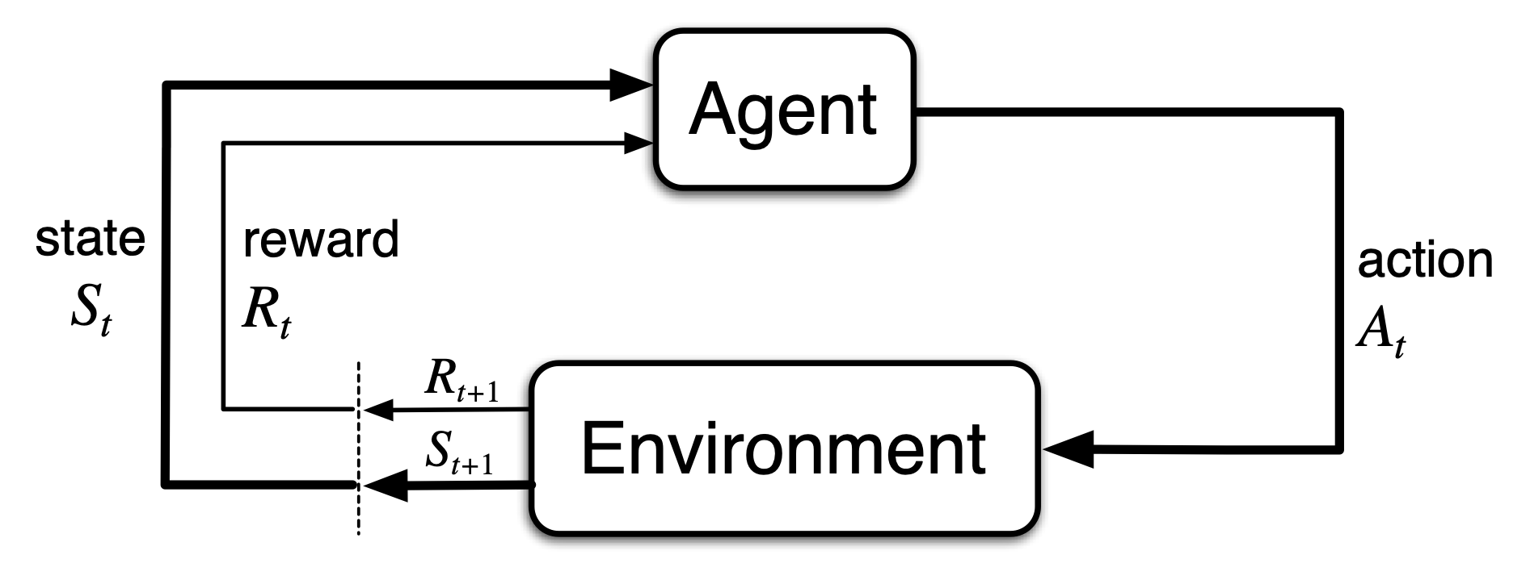
Interacting with the Environment
At each time $t=1,2,3,…$
Agent receives input denoting current state $S_{t}$
Agent chooses action $A_{t}$
Next time step, agent receives reward $R_{t+1}$ and new state $S_{t+1}$, chosen according to a distribution $p(s^{′},r∣s,a)$
There are two boxes labelled "Agent" and "Environment". There is an arrow from Agent to Environment labelled "action $A_{t}$". There are two arrows from Environment pointing to a vertical dashed line labelled "$R_{t+1}$" and "$S_{t+1}$". From the dashed line there are two arrows pointing back to Agent labelled "state $S_{t}$" and "reward $R_{t}$".
This interaction between agent
and environment produces a trajectory:
$$S_{0},A_{0},R_{1},S_{1},A_{1},R_{2},S_{2},A_{2},R_{3},…$$

Slide 10
Markov Decision Process
Definition:
A Markov decision process is a tuple $(S,A,R,p)$, where
  $S$ is a set of states,
  $A$ is a set of actions,
  $R⊂R$ is a set of rewards,
  $p(s^{′},r∣s,a)∈[0,1]$ defines the dynamics of the process, and
  the probabilities from $p$ completely characterize the environment's dynamics

Slide 11
Dynamics
The four-argument dynamics function returns the probability of every state transition:
$p(s^{′},r|s,a)≐Pr(S_{t}=s^{′},R_{t}=r|S_{t-1}=s,A_{t-1}=a)$
It is often convenient to use shorthand notation rather than the full four-argument dynamics function:
  $\begin{matrix}p(s^{′}|s,a) & ≐Pr(S_{t}=s^{′}|S_{t-1}=s,A_{t-1}=a) & =\underset{r∈R}{∑}p(s^{′},r|s,a) \\ r(s,a) & ≐E[R_{t}|S_{t-1}=s,A_{t-1}=a] & =\underset{r∈R}{∑}r\underset{s^{′}∈S}{∑}p(s^{′},r|s,a) \\ r(s,a,s^{′}) & ≐E[R_{t}|S_{t-1}=s,A_{t-1}=a,S_{t}=s^{′}] & =\underset{r∈R}{∑}r\frac{p(s^{′},r|s,a)}{p(s^{′}|s,a)}\end{matrix}$

Slide 12
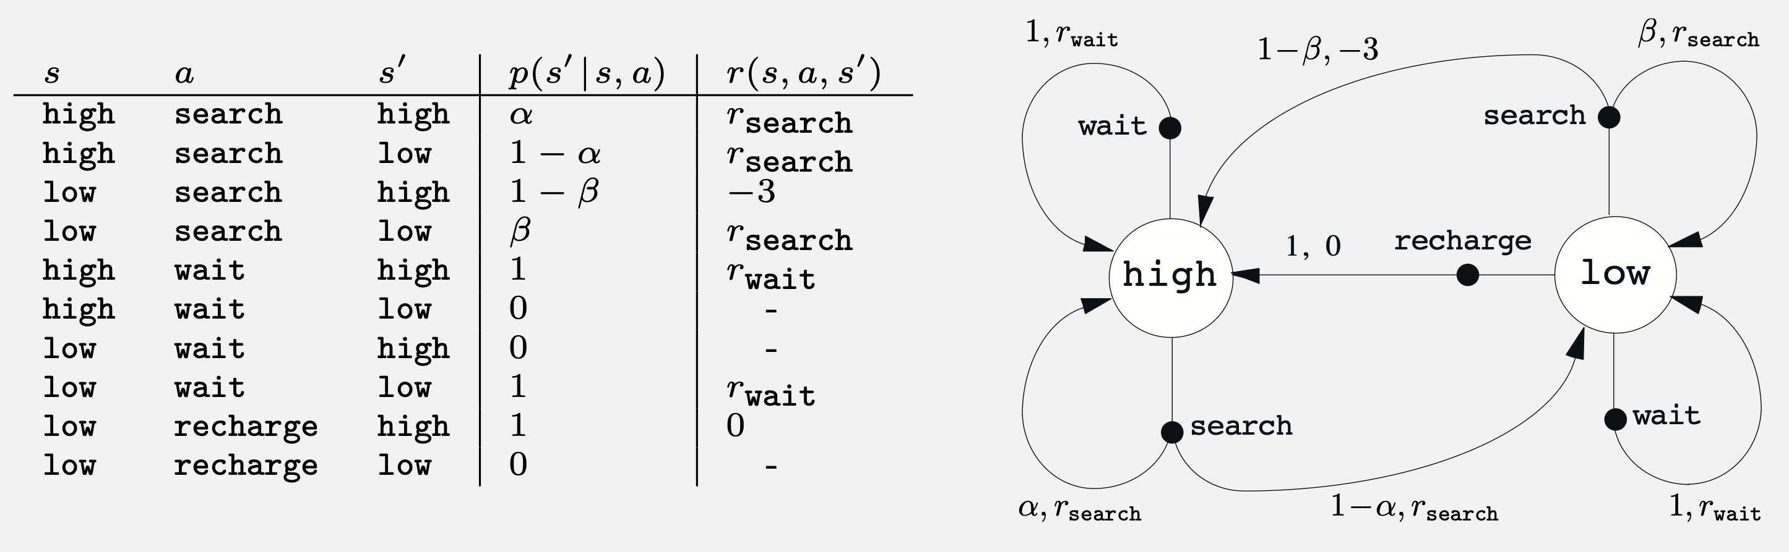
CanBot as a
Reinforcement Learning Agent
Question: How can we represent CanBot as a reinforcement learning agent?
    Need to define states, actions, rewards, and dynamics
There are two circles labelled "high" and "low". From high there is an edge to an action "wait" labelled "$1,r_{\text{wait}}$" that points back to high, and an edge to an action "search" that has two outgoing edges; one labelled "$α,r_{\text{search}}$" which points back to high, and one labelled "$1-α,r_{\text{search}}$" that points to low. From low there are three outgoing edges: one to action "recharge", which has a single outgoing edge to high labelled "1,0"; one to action "wait" which has a single outgoing edge labelled "$1,r_{\text{wait}}$" back to low; and one to action "search" that has two outgoing edges; one labelled "$β,r_{\text{search}}$" which points back to low, and one labelled "$1-β,-3$" that points to low.
(Image: Sutton & Barto, 2018)

Slide 13
Reward Hypothesis
Definition: Reward hypothesis
An agent's goals and purposes can be entirely represented as the maximization of the expected value of the cumulative sum of a scalar signal.

Slide 14
Returns for Episodic Tasks
Question:
What does "maximize the expected value of the cumulative sum of rewards" mean?
Definition: A task is episodic if it ends after some finite number $T$ of time steps in a special terminal state $S_{T}$.
Definition: The return $G_{t}$ after time $t$ is the sum of rewards received after time $t$: $G_{t}≐R_{t+1}+R_{t+2}+R_{t+3}+…+R_{T}$.
Answer: The return $G_{t}$ is a random variable. In an episodic task, we want to maximize its expected value $E[G_{t}]$.

Slide 15
Returns for Continuing Tasks
Definition: A task is continuing if it does not end (i.e., $T=∞$).
In a continuing task, we can't just maximize the sum of rewards (why?)
Instead, we maximize the discounted return:
$\begin{matrix}G_{t} & ≐R_{t+1}+γR_{t+2}+γ^{2}R_{t+3}+… \\ & =\overset{∞}{\underset{k=0}{∑}}γ^{k}R_{t+k+1}\end{matrix}$
Returns are recursively related to each other:
$\begin{matrix}G_{t} & ≐R_{t+1}+γR_{t+2}+γ^{2}R_{t+3}+… \\ & =R_{t+1}+γG_{t+1}\end{matrix}$
$γ≤1$ is the discount factor

Slide 16
Policies
Question: How should an agent in a Markov decision process choose its actions?
Markov assumption: The state incorporates all of the necessary information about the history up until this point
    i.e., Probabilities of future rewards & transitions are the same from state $S_{t}$ regardless of how you got there
So the agent can choose its actions based only on $S_{t}$
This is called a (memoryless) policy: $π(a∣s)∈[0,1]$ is
the probability of taking action $a$ given that the current state is $s$

Slide 17
State-Value Function
Once you know the policy $π$ and the dynamics $p$, you can compute the probability of every possible state transition starting from any given state
It is often valuable to know the expected return starting from a given state $s$ under a given policy $π$ (why?)
The state-value function $v_{π}$ returns this quantity:
$\begin{matrix}v_{π}(s) & ≐E_{π}[G_{t}|S_{t}=s] \\ & =E_{π}\left[\overset{∞}{\underset{k=0}{∑}}γ^{k}R_{t+k+1}|S_{t}=s\right]\end{matrix}$
$$∀t$$

Slide 18
Using State-Value Function
Question: Suppose state transitions are deterministic. Does it make sense to always choose the action that leads to the next state $s^{′}$ with the highest $v_{π}(s)$?
$$v_{π}=5$$
X:5
L:1
R:1
$$v_{π}=2$$
X:2
Initial state has an edge labelled "L:1" leading to a state labelled "$v_{π}=5$" which has an edge labelled "X:5" leading to the terminal state. Initial state has a second edge labelled "R:1" leading to a state labelled "$v_{π}=2$", which has an edage labelled "X:2" leading to the terminal state.

Slide 19
Using State-Value Function
Question: Suppose state transitions are deterministic. Does it make sense to always choose the action that leads to the next state $s^{′}$ with the highest $v_{π}(s)$?
Not always; the reward for the transition itself is also important!
$$v_{π}=5$$
X:5
L:1
R:999
$$v_{π}=2$$
X:2
Initial state has an edge labelled "L:1" leading to a state labelled "$v_{π}=5$" which has an edge labelled "X:5" leading to the terminal state. Initial state has a second edge labelled "R:999" leading to a state labelled "$v_{π}=2$", which has an edge labelled "X:2" leading to the terminal state.

Slide 20
Action-Value Function
The action-value function $q_{π}(s,a)$ estimates the expected return $G_{t}$ starting from state $s$ if we
  Take action $a$ in state $S_{t}=s$, and then
  Follow policy $π$ for every state $S_{t+1}$ afterward
$\begin{matrix}q_{π}(s,a) & ≐E_{π}[G_{t}|S_{t}=s,A_{t}=a] \\ & =E_{π}\left[\overset{∞}{\underset{k=0}{∑}}γ^{k}R_{t+k+1}|S_{t}=s,A_{t}=a\right]\end{matrix}$
Question:
How is this any different from the state-value function $v_{π}(s)$?

Slide 21
Bellman Equations
Value functions satisfy a recursive consistency condition
called the Bellman equation:
$v_{π}(s)≐E_{π}[G_{t}|S_{t}=s]$
vπ(s)=Eπ[Rt+1+γGt+1|St=s]
vπ(s)=Eπ[Rt+1∣St=s]+γEπ[Gt+1∣St=s]
vπ(s)=∑a∑s′∑rPr[St+1=s′,Rt+1=r,At=a∣St=s]r+γEπ[Gt+1|St+1=s′]
vπ(s)=∑a∑s′∑rPr[St+1=s′,Rt+1=r∣St=s,At=a]Pr[At=a∣St=s]r+γEπ[Gt+1|St+1=s′]
vπ(s)=∑aπ(a|s)∑s′∑rp(s′,r|s,a)r+γEπ[Gt+1|St+1=s′]
vπ(s)=∑aπ(a|s)∑s′,rp(s′,r|s,a)r+γvπ(s′)
$$\begin{matrix}G_{t} & ≐R_{t+1}+γR_{t+2}+γ^{2}R_{t+3}+… \\ & =R_{t+1}+γ\left(R_{t+2}+γR_{t+3}+…\right) \\ & =R_{t+1}+γG_{t+1}\end{matrix}$$
$$E[A+cB]=E[A]+cE[B]$$
Pr[St+1=s′,Rt+1=r,At=a∣St=s]⏞
Pr[St+1=s′,Rt+1=r∣St=s,At=a]Pr[At=a∣St=s]⏞
$v_{π}$ is the unique solution to $π$'s Bellman equation
There is also a Bellman equation for $π$'s action-value function
$$∎$$

Slide 22
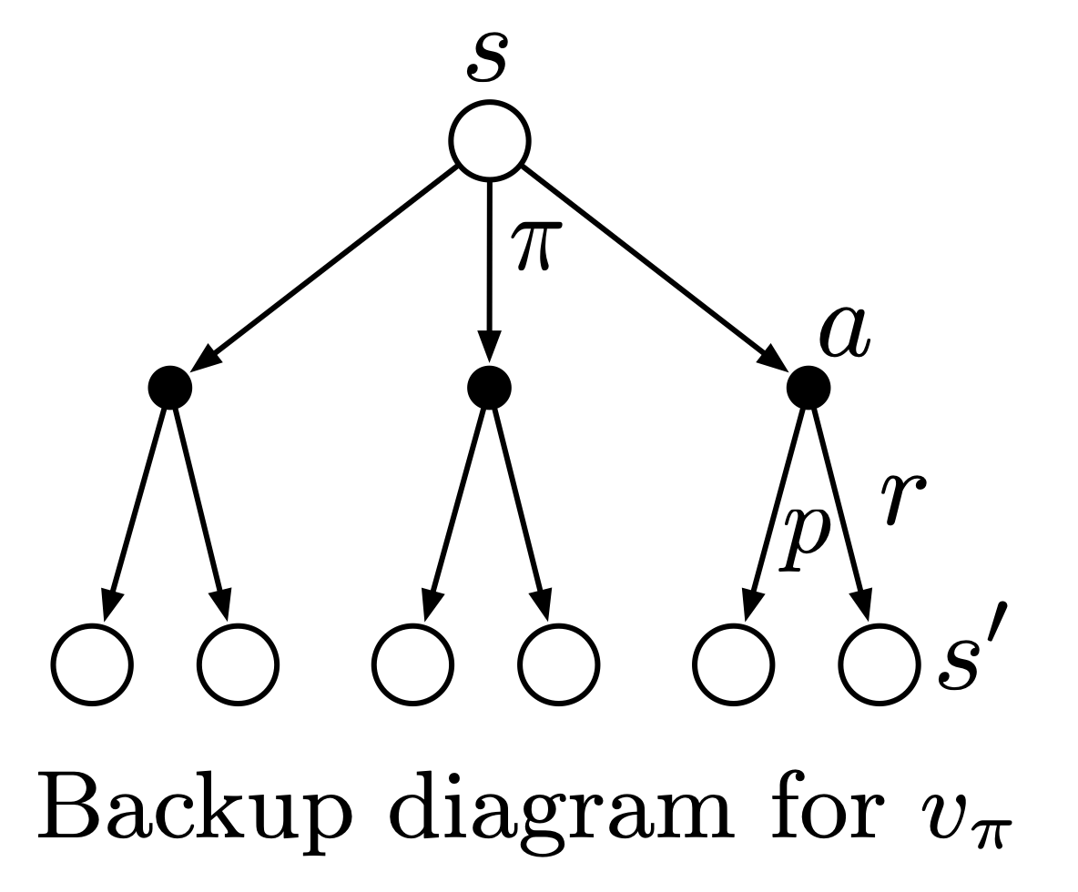
Backup Diagrams
Backup diagrams help to visualize the flow of information back to a state from its successor states or action-state pairs:
$$\begin{matrix}v_{π}(s) & ≐E_{π}[G_{t}|S_{t}=s] \\ & =\underset{a}{∑}π(a|s)\underset{s^{′},r}{∑}p(s^{′},r|s,a)\left[r+γv_{π}(s^{′})\right]\end{matrix}$$
An open circle "s" has outgoing edges leading to three filled circles "a", each of which has two outgoing edges labelled "p" and "r" to open circles labelled "s'".
(Image: Sutton & Barto, 2018)

Slide 23
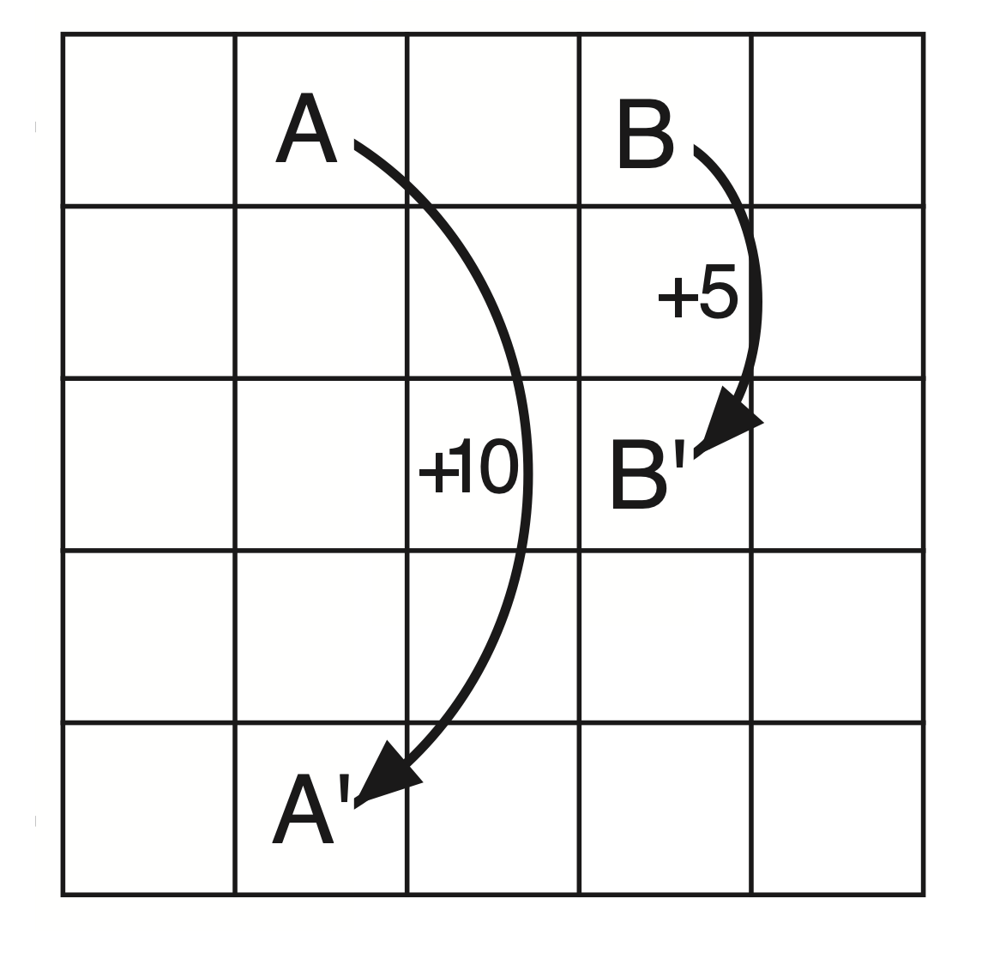
GridWorld
At each cell, can go north, south, east, west
Try to go off the edge: reward of -1
Leaving state A: takes you to state Aʹ, reward of +10
Leaving state B: takes you to state Bʹ, reward of +5
A grid with five rows and five columns. The cell in the top row, second column is labelled "A" and has an arrow labelled "+10" leading to the cell in the bottom row second column labelled "A'". The cell in the top row, fourth column has an arrow labelled "+5" leading to the cell in the third row, fourth column labelled "B'".
(Image: Sutton & Barto, 2018)

Slide 24
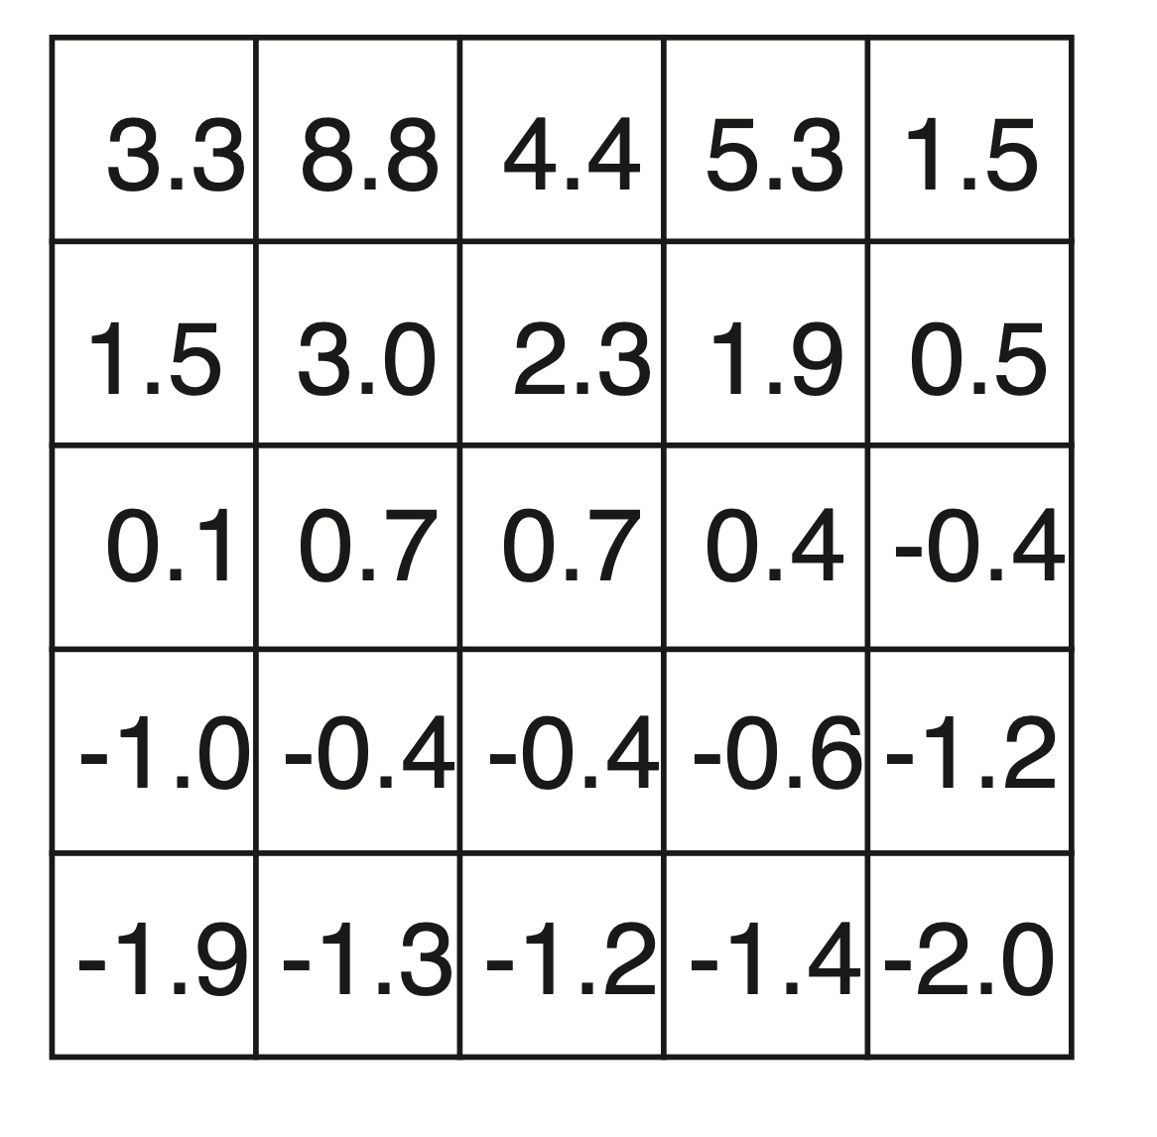
GridWorld
A grid with five rows and five columns. The cell in the top row, second column is labelled "A" and has an arrow labelled "+10" leading to the cell in the bottom row second column labelled "A'". The cell in the top row, fourth column has an arrow labelled "+5" leading to the cell in the third row, fourth column labelled "B'".
A five-by-five grid with numbers in each cell; the top row has 3.3, 8.8, 4.4., 5.3, 1.5; the bottom row has -1.9, -1.3, -1.2, -1.4, -2.0.
Reward dynamics
State-value function v𝜋 for random policy
$π(a|s)=0.25$
(Image: Sutton & Barto, 2018)

Slide 25
Summary
Supervised learning models are trained offline using labelled training examples, and then make predictions
Reinforcement learning agents choose their actions online, and update their behaviour based on rewards from the environment
We can formally represent reinforcement learning environments using Markov decision processes, for both episodic and continuing tasks
Reinforcement learning agents maximize expected returns
Policies map states to (distribution over) actions
Given a policy $π$, every state $s$ has an expected value $v_{π}(s)$
State-value and action-value functions satisfy the Bellman equations

