Slide 1
Neural Networks for Sequence Data
  CMPUT 261: Introduction to Artificial Intelligence
  GBC §10.0-10.2
  P §12.1-12.2, §12.4, §12.6

Slide 2
Title
Definition:
A function $f$ is a linear function of $x$ if it can be written as $f(x)=w_{0}+w_{1}x$
example text here
  likelihood
  prior
Questions:
If $f$ can be literally any function, then what is the solution?
  Is that desirable?
What could we do instead?
Why are we squaring the difference?
(Image: Goodfellow 2016)

Slide 3
Lecture Outline
After this lecture, you should be able to:
explain the problems with handling sequence input using dense or convolutional neural networks
explain the high-level idea behind neural networks and transformers
describe how self-attention combines inputs to generate its outputs
describe the architecture of a transformer layer
explain the high-level idea behind encoder-decoder architectures
Recap & Logistics
Unfolding Computations
Recurrent Neural Networks
Attention & Transformers

Slide 4
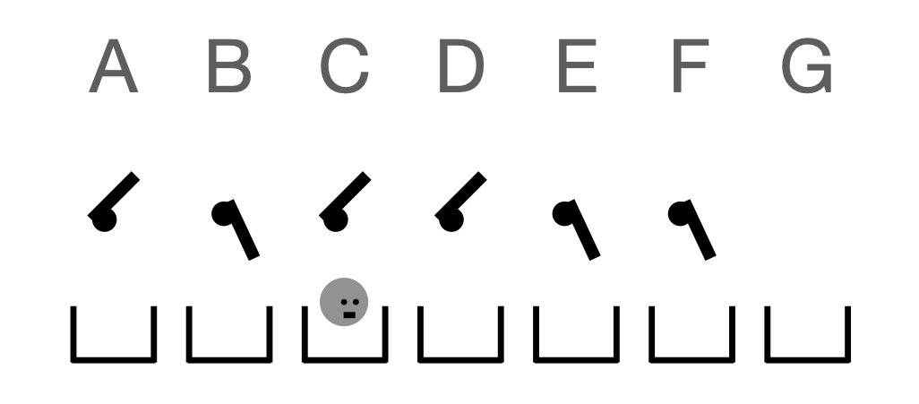
Midterm Review: States
Many people tracked only the on/off states of the switches
    You need to track the position of SwitchBot as well
Many people tracked only the position of SwitchBot, plus maybe the on/off state of the switch at the current position
    You need to track the states of all the switches

Slide 5
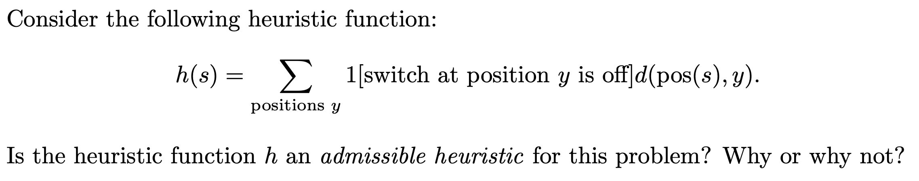
Midterm Review: Admissible Heuristic
Heuristic adds up cost to get from current position to position $y$ for every position $y$
But that's more actions than you need to take for any solution
Question: What will $h$ return from a state where all the switches are in the off state and SwitchBot is in position G?
Question: Can an admissible heuristic ever dominate a non-admissible heuristic?
Notes:
6+5+4+3+2+1 = 21

Slide 6
Midterm Review: Short Answer
Which of breadth-first search, least-cost-first search, and A∗ search has the best worst-case time complexity? Why?
Why is loss on the test set a good estimator for generalization error?
Notes:
34.25/52 = 66%

Slide 7
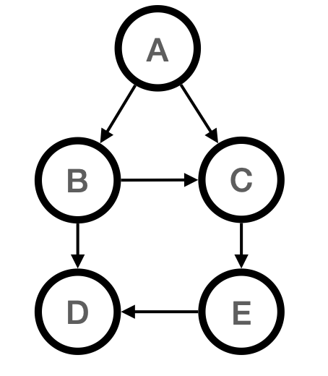
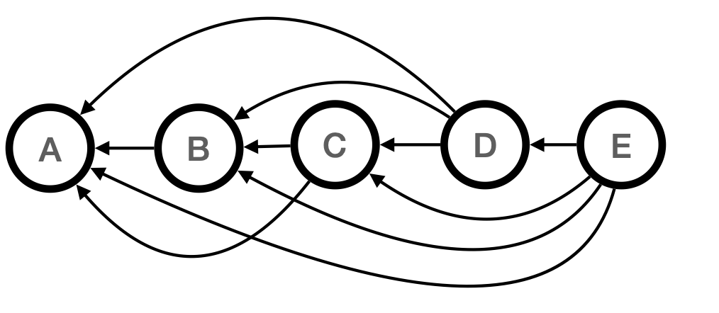
Midterm Review: Factorings
$$P(A)P(B∣A)P(C∣A,B)P(D∣B,E)P(E∣C)$$
$$P(A∣B,C,D,E)P(B∣C,D,E)P(C∣D,E)P(D∣E)P(E)$$
Many people spotted that these two belief networks represent different factorings of $P(A,B,C,D,E)$
Not every joint distribution can be factored according to the left network (e.g., any distribution where $E$ is not conditionally independent of $A$ given only $C$)
But any distribution over $A,…,E$ can be factored according to the right network (why?)

Slide 8
Logistics
Assignment #3 is available
    Due Thursday, Nov 20
    Submit via Canvas (deadline is firm)
    Blank submissions will not be regraded, nor granted EA
Next week is reading week
    No lectures, no labs

Slide 9
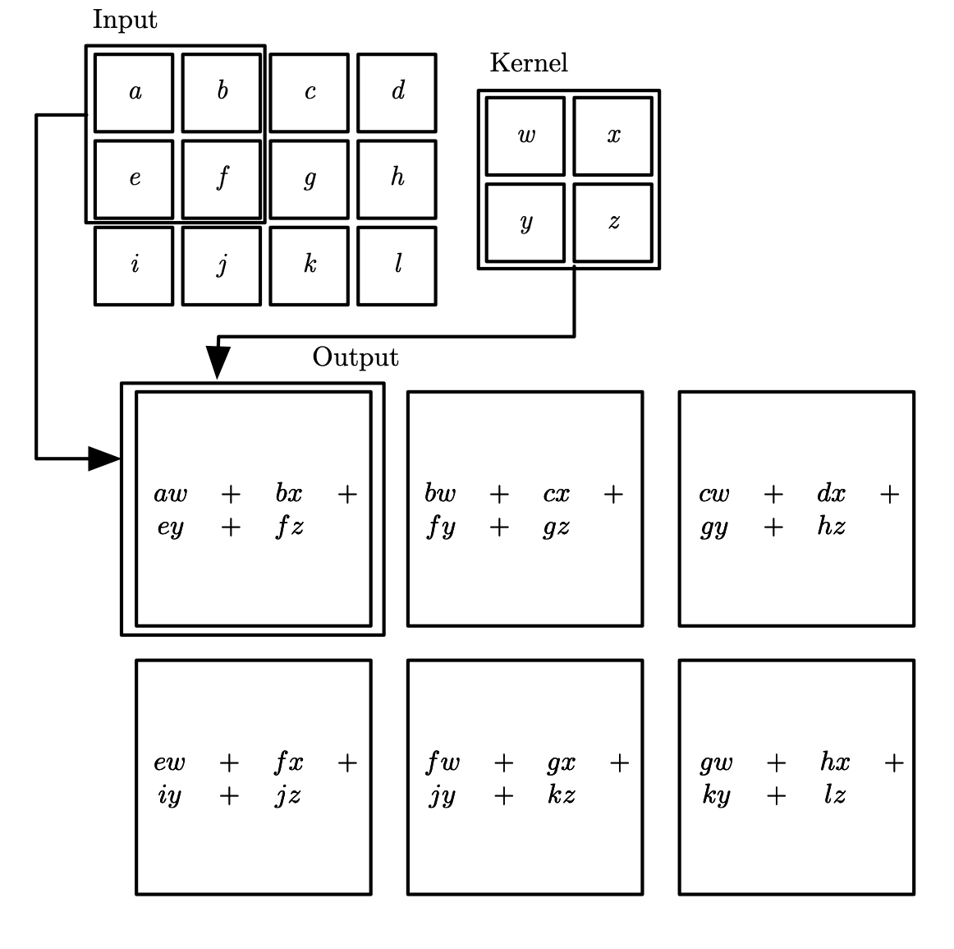
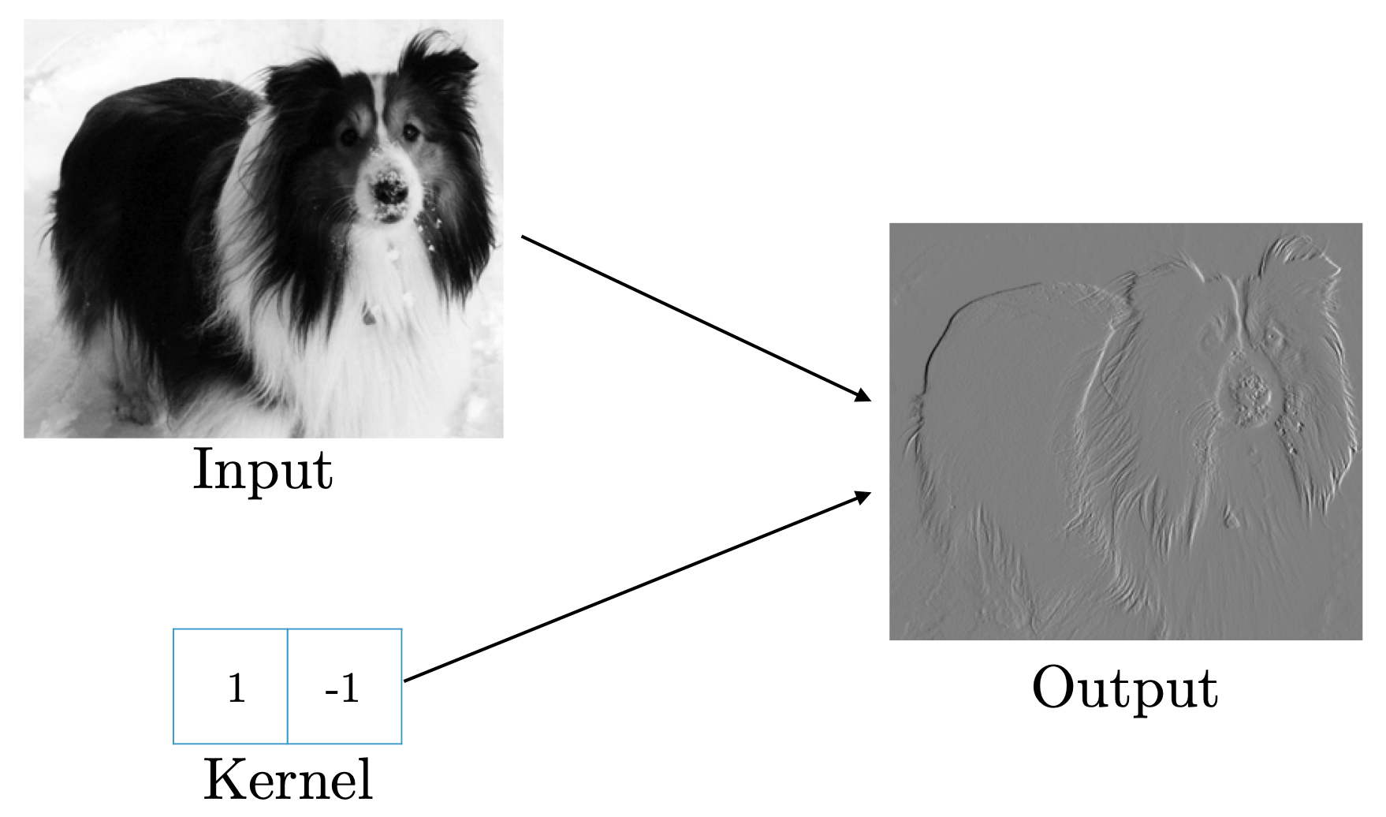
Recap:
Convolutional Neural Networks
Convolutional networks: Specialized architecture for images
Number of parameters controlled by using convolutions and pooling operations instead of dense connections
Fewer parameters means more efficient to train
figure depicting convolution
figure depicting example of edge-detection using convolution
(Images: Goodfellow 2016)
(Image: Goodfellow 2016)

Slide 10
Sequence Modelling
For many tasks, especially involving language, we want to model the behaviour of sequences
Example: Translation
    The cat is on the carpet ⟹ Le chat est sur le tapis
Example: Sentiment analysis
    This pie is great ⟹ POSITIVE
    This pie is okay, not great ⟹ NEUTRAL
    This pie is not okay ⟹ NEGATIVE
Example: Text generation
    CMPUT 261 is the ⟹ CMPUT 261 is the best class ever

Slide 11
Sequential Inputs
Question: How should we represent sequential input to a neural network?
1-hot vector for each word
(Sequence must be a specific length?)
1-hot vector for last few words
($n$-gram)
Single vector indicating each word that is present
(bag of words)
    The cat is on the carpet
carpet
cat
...
the
Three columns of circles, each circle except one is empty in each column. In first column, bottom circle is filled in and labelled "the". In second column, second circle is filled in and labelled "cat". Ellipses between second and third columns. In last column, top circle is filled in and labelled "carpet".
carpet
the
Two columns of circles, each circle except one is empty in each column. In first column, bottom circle is filled in and labelled "the". In second column, top circle is filled in and labelled "carpet".
carpet
cat
the
A single columns of circles. Top circle is filled in and labelled "carpet". Second circle is filled in and labelled "cat". Third circle is empty. Bottom circle is filled in and labelled "the".

Slide 12
One-Hot Representations
$$\left[\begin{aligned}0 \\ 0 \\ 0 \\ 0 \\ ⋮ \\ 0 \\ 0 \\ 1 \\ 0 \\ 0 \\ 0 \\ 0 \\ 0 \\ 0 \\ 0 \\ 0 \\ 0 \\ 0 \\ 0 \\ 0 \\ 0 \\ 0 \\ ⋮ \\ 0 \\ 0 \\ 0 \\ 0\end{aligned}\right]$$
One-hot representations of words have some problems:
Wasteful: Each input vector must have a dimension equal to the size of the vocabulary (possible words)
    If vocabulary has 30,000 words, then each vector has 29,999 zeros
Poor generalization: Ideally, similar words would be treated similarly
    Exploiting meaningful similarity between images was an important feature of convolutional neural networks
carpet

Slide 13
Semantic Embeddings
The usual approach is to first learn a semantic embedding for one-hot vectors
Every word gets represented as a dense vector with smaller dimension than the vocabulary
(typical size: 1,024)
Goal: Words with similar meanings will have small distance between embedded vectors; words with different meanings will have large distance between embedded vectors
rug
carpet
mattress
turnip
A graph with four quadrants. Top right quadrant has three dots near to each other labelled "rug", "carpet", and "mattress". Bottom right has a single dot, far from the top three, labelled "turnip".

Slide 14
(Pre-)Training Semantic Embeddings
Question: How many parameters are required to convert a one-hot encoding for vocabulary of $V$ words into a $D$-dimensional embedding?
Embeddings require the training of many parameters
Fortunately, this can be done with unlabeled data
Trick: "Pre-train" neural network for a task that we don't care about
    But which can be evaluated using unlabeled data
    Predicting words from $k$ nearby words
    Predicting "masked" words
Keep the weights that convert the one-hot layer into a dense embedding layer
Throw away the weights that convert the embedding layer into output

Slide 15
Processing
Variable-Length Sequences
Image inputs can be restricted to a standard size (20x20, 1024x768, etc.)
Sequence inputs (e.g., text) are variable-length
    And often very long
Solution: Apply the same operations to each position in the sequence
Two such approaches:
  Recurrent neural networks:
  input is current token + fixed-dimension "state" from previous operation
  Transformers / self-attention: Size of state varies with size of sequence

Slide 16
Dynamical Systems
A dynamical system is a system whose state at time $t+1$ depends on its state at time $t$:
$s^{(t)}=f(s^{(t-1)};θ)$
An expression that depends on the same expression at an earlier time is recurrent.
s

Slide 17
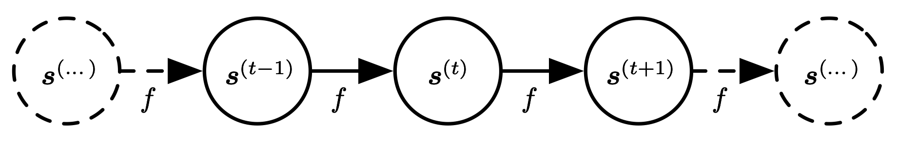
Unfolding Computations
A recurrent expression can be converted to a non-recurrent expression by unfolding:
$\begin{matrix}s^{(3)} & =f(s^{(2)};θ) \\ & =f(f(s^{(1)};θ);θ)\end{matrix}$
(Image: Goodfellow 2016)

Slide 18
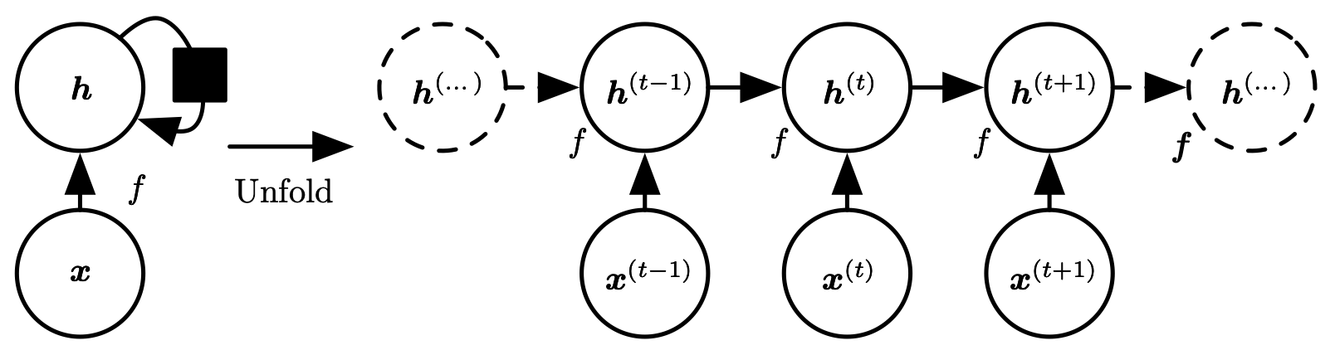
External Signals
Dynamical systems can also be driven by external signals:
$s^{(t)}=f(s^{(t-1)},x^{(t)};θ)$
These systems can also be represented by non-recurrent, unfolded computations:
s
s
s
s
s
s
(Image: Goodfellow 2016)

Slide 19
Recurrent Neural Networks
Recurrent neural network: a specialized architecture for modelling sequential data
Input presented one element at a time
Parameter sharing by:
    Treating the sequence as a system with state
    Introducing hidden layers that represent state
    Computing state transitions and output using same functions at each stage
The same computation is applied to each pair of state and input
    But the state is different after each application
carpet
$$x^{(6)}=$$

Slide 20
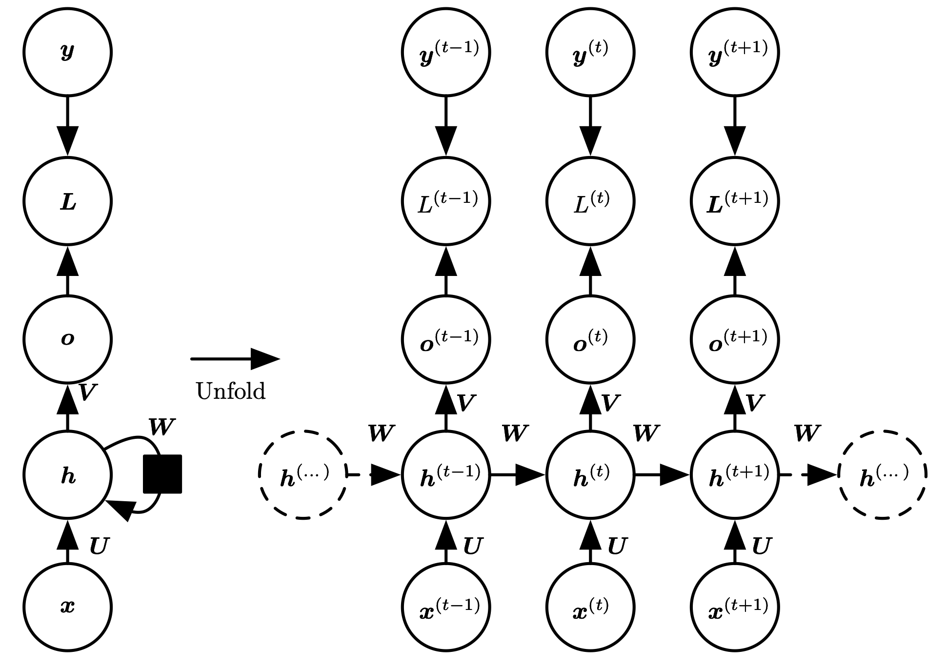
Recurrent Hidden Units:
Sequence to Sequence
Input values x connected to hidden state h by weights $U$
Hidden state h mapped to output o by weights $V$
Hidden state $h^{(t-1)}$ connected to hidden state $h^{(t)}$ by weights $W$
Gradients computed by back propagation through time: from final loss all the way back to initial input.
All hidden states computed must be stored for computing gradients
(Image: Goodfellow 2016)

Slide 21
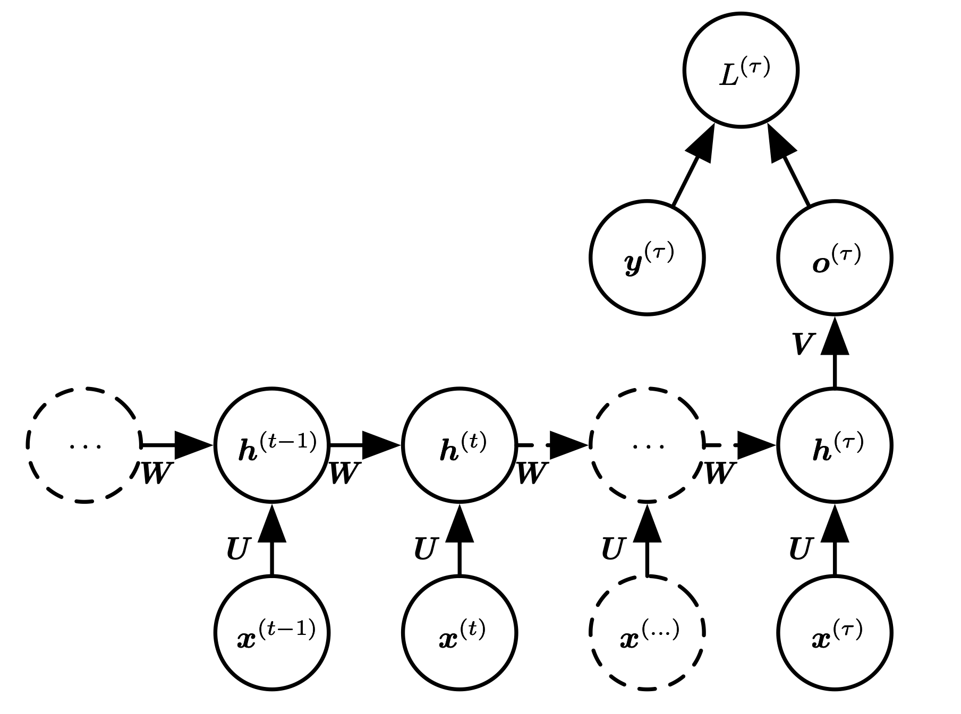
Recurrent Hidden Units:
Sequence to Single Output
Update state as inputs are provided
Only compute a single output at the end
$W,U$ still shared at every stage
Back propagation through time still requires evaluating every state in gradient computation
(Image: Goodfellow 2016)

Slide 22
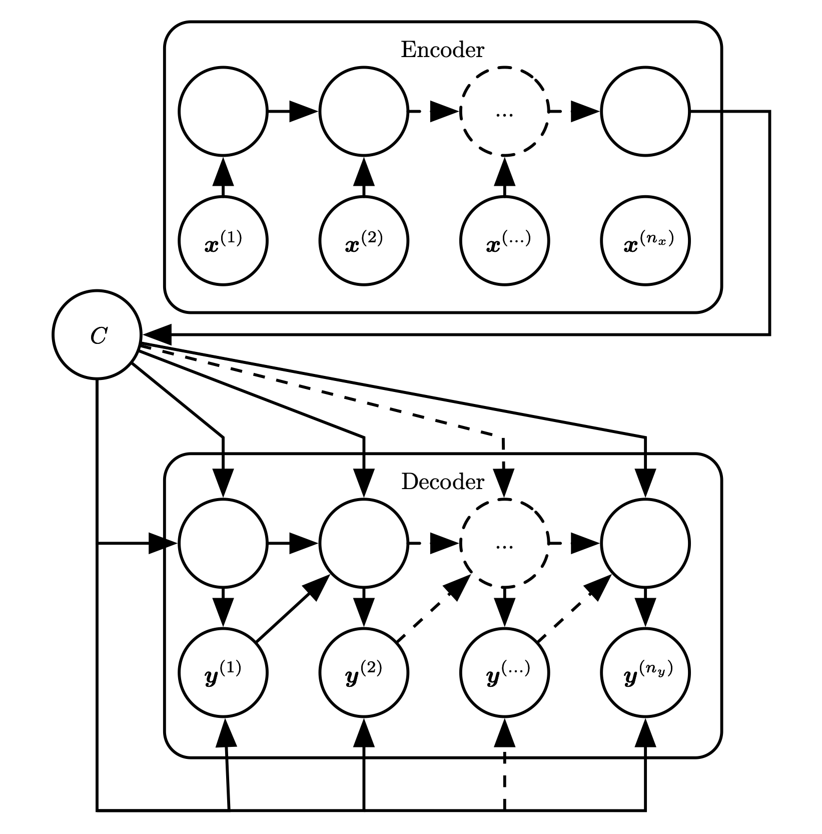
Encoder/Decoder Architecture for Sequence to Sequence
Can combine approaches for sequence-to-sequence:
Accept entire input to construct a single "context" output $C$
Construct new sequence using context $C$ as only input
(Image: Goodfellow 2016)

Slide 23
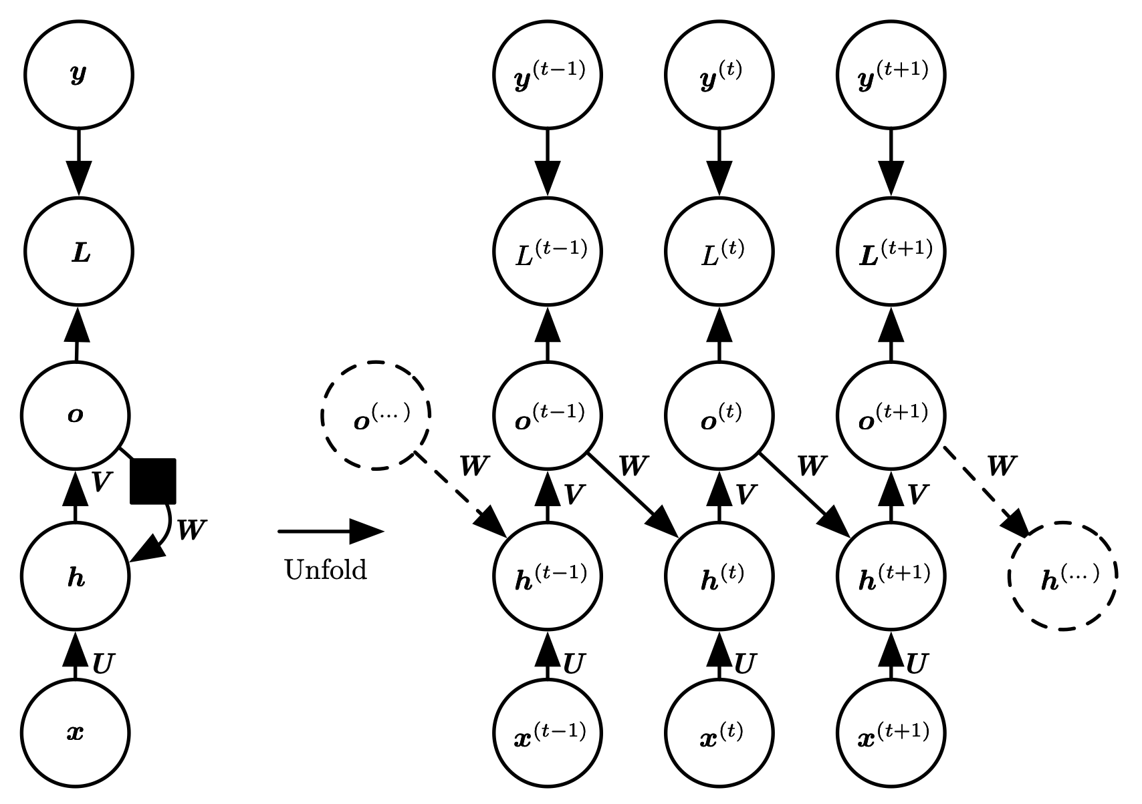
Recurrence through
(only) Outputs
Can have recurrence go from output (at $t-1$) to hidden (at $t$) instead of hidden to hidden
Less general (why?)
Question: Why would we want to do this?
(Image: Goodfellow 2016)
Notes:
why? because it requires output at time t to capture all information network will need for time t+1
but we don't get to specify the structure of the output, it's part of the problem

Slide 24
Recurrence Through Outputs Example
Suppose we want to train an RNN to match brackets
Recurring hidden units:
  Hidden state can track the type of bracket and how many remain to be closed
  E.g.: Hidden: ("[", 3) Output: "]" New hidden: ("[",2)
Recurring through output only:
  All we get to see at each step is the previous step's output (e.g., "]")
  No way to track extra information that is not part of the output
  But the correct output is not under the network's control
Training examples:
    (()( $↦$ ))
    [[ $↦$ ]]
    ( $↦$ )
    (()() $↦$ )
    {}{{ $↦$ }}
    etc...

Slide 25
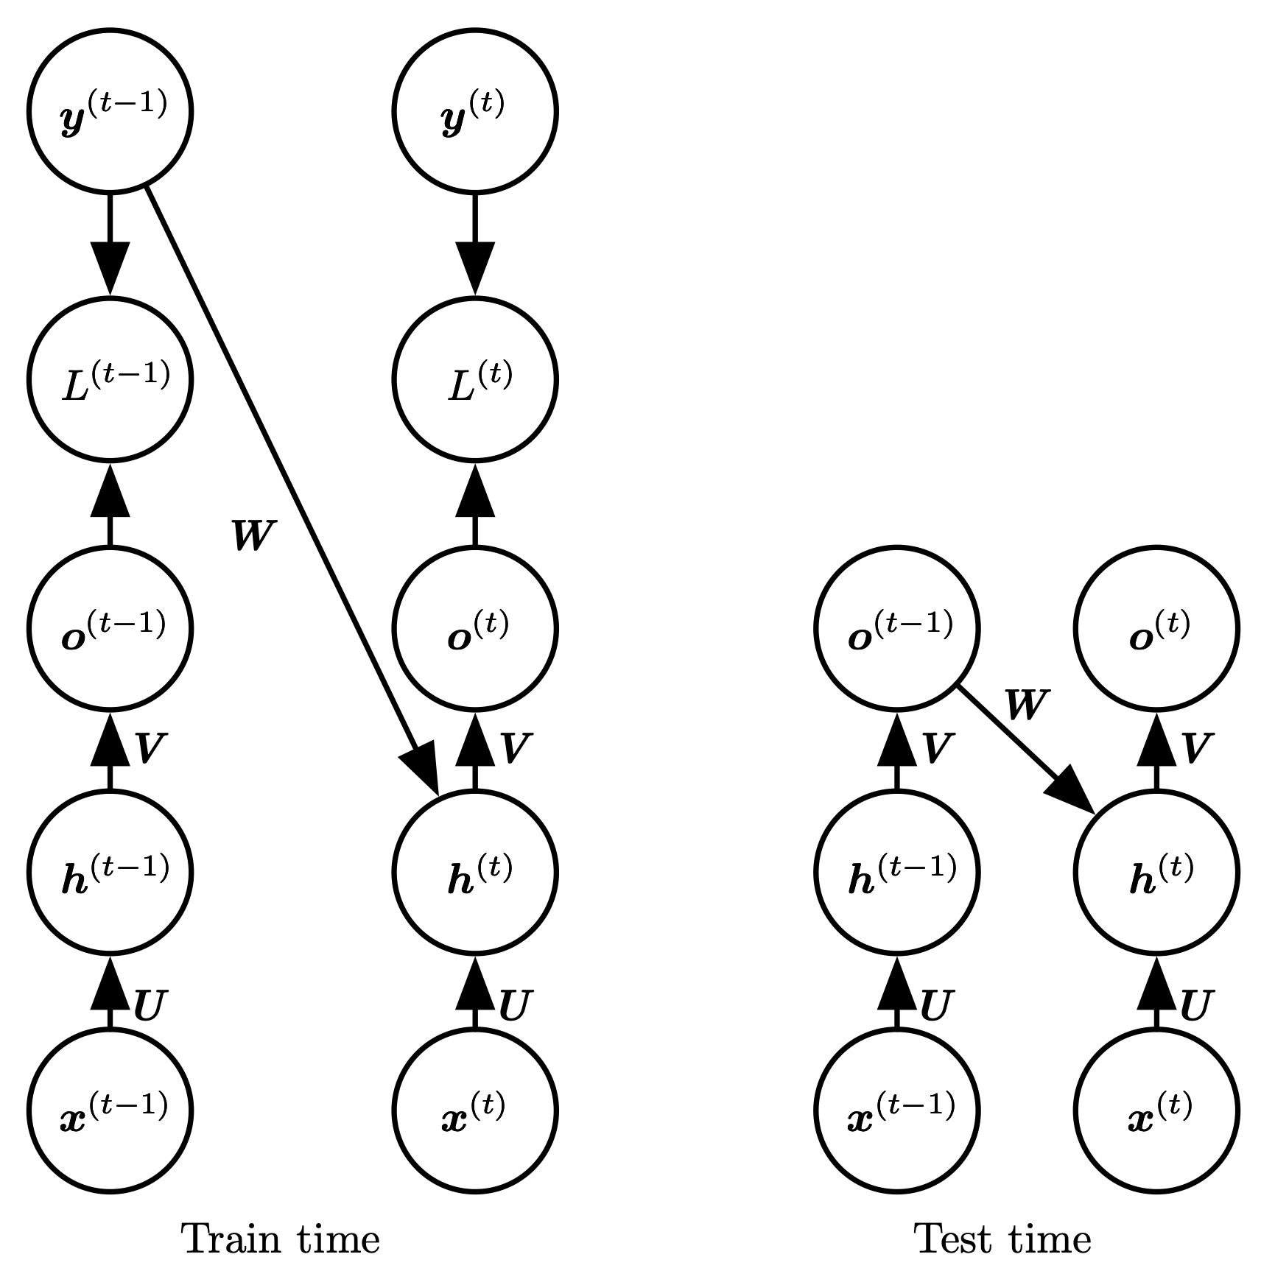
Teacher Forcing
Dependence on previous step is only on output, not hidden state
  Loss gradient depends only on a single transition
  Training can be parallelized (don't need to compute previous states to compute current state)
(Image: Goodfellow 2016)

Slide 26
Long-Range Dependence
The submarine, which was the subject of a well known song by the Beatles, was yellow.
Information sometimes needs to be accumulated for a long part of the sequence
But how long an individual piece of information should be accumulated is context-dependent
Long-range dependence can be difficult for a recurrent network
  Often need to accumulate information in the state, and then forget it later

Slide 27
Self-Attention vs. RNN
This lecture
$$x_{1}$$
RNN
$$x_{1}$$
$$y_{1}$$
$$y_{1}$$
$$x_{2}$$
$$y_{2}$$
self-attention
$$⋮$$
$$⋮$$
$$x_{2}$$
RNN
$$x_{N}$$
$$y_{N}$$
$$y_{2}$$
A graph depicting the operation of a self-attention unit. Boxes labelled "x1", "x2", ..., "xN" all point to a box labelled "self-attention", which points to boxes labelled "y1", "y2", ..., "yN".
$$⋮$$
RNN: accept "previous" state and current input; output "next" state
    Final output is last state
Self-attention: Accept ALL inputs
    Final output is ALL states
$$y_{N-1}$$
$$x_{N}$$
RNN
$$y_{N}$$
A graph depicting the operation of an RNN. A box labelled "x1" has an arrow going into a box labelled "RNN". From RNN, an arrow points to a box labelled "y1". From y1, an arrow points to another box labelled "RNN", which also has an arrow from a box labelled "x2". After ellipses, boxes labelled "y N-1" and "xN" point to a box labelled "RNN", which points to a box labelled "yN".

Slide 28
Self-Attention
Each input is transformed into a single output
    $N$ inputs means $N$ outputs
An output is computed by:
  Each input $x_{i}$ transformed into value $v_{i}$ by a linear operation
  $$v_{i}=β_{v}+Ωx_{i}$$
  Each output $y_{j}$ is a weighted combination of the values:
  $$y_{j}=\underset{i}{∑}a[x_{i},x_{j}]v_{i}$$

Slide 29
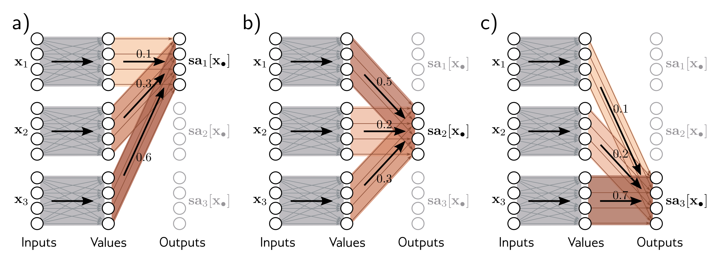
Self-Attention:
Outputs are Weighted Sums of Values
Three figures depicting attention weighting. In each figure, there is a column of three groups of four dots labelled "Inputs". The groups are labelled "x1", "x2", and "x3. Next to that is a column of three groups of four dots labelled "Values". Next to that is a column of three groups of four dots labelled "Outputs". The output groups are labelled "sa1[x]", "sa2[x]", and "sa3[x]". In each figure, there is a large arrow connecting one input group to one value group, with faint edges connecting each input dot in the group to all of the dots in the value group.
In figure (a), there is an arrow labelled "0.1" connecting the value group for x1 to sa1[x], an arrow labelled "0.3" connecting the value group for x2 to sa1[x], and an arrow labelled "0.6" connecting the value group for x3 to sa1[x]. The top dot of the each value group has a faint edge connecting it to the top dot of the sa1[x] group; the second dot of each value group has a faint edge connecting it to the second dot of each value group; and so forth. In figure (b), the arrows got from each value group to sa2[x], and are labelled "0.5", "0.2", and "0.3", with faint arrows from top dot of each value dot to top dot of sa2[x] and so forth. In figure (b), the arrows got from each value group to sa3[x], and are labelled "0.1", "0.2", and "0.7", with faint arrows from top dot of each value dot to top dot of sa3[x] and so forth.
$x_{1}$ transformed into $v_{1}$ by linear operation ($β_{v}+Ω_{v}x_{1}$)
  $x_{2}$ transformed into $v_{2}$ by the same linear operation ($β_{v}+Ω_{v}x_{2}$), ...
$y_{1}$ is a weighted average of $v_{1},v_{2},v_{3}$
  The weights are the attention values $a[x_{1},x_{1}],a[x_{2},x_{1}],a[x_{3},x_{1}]$
(Image: Prince 2022)

Slide 30
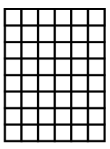
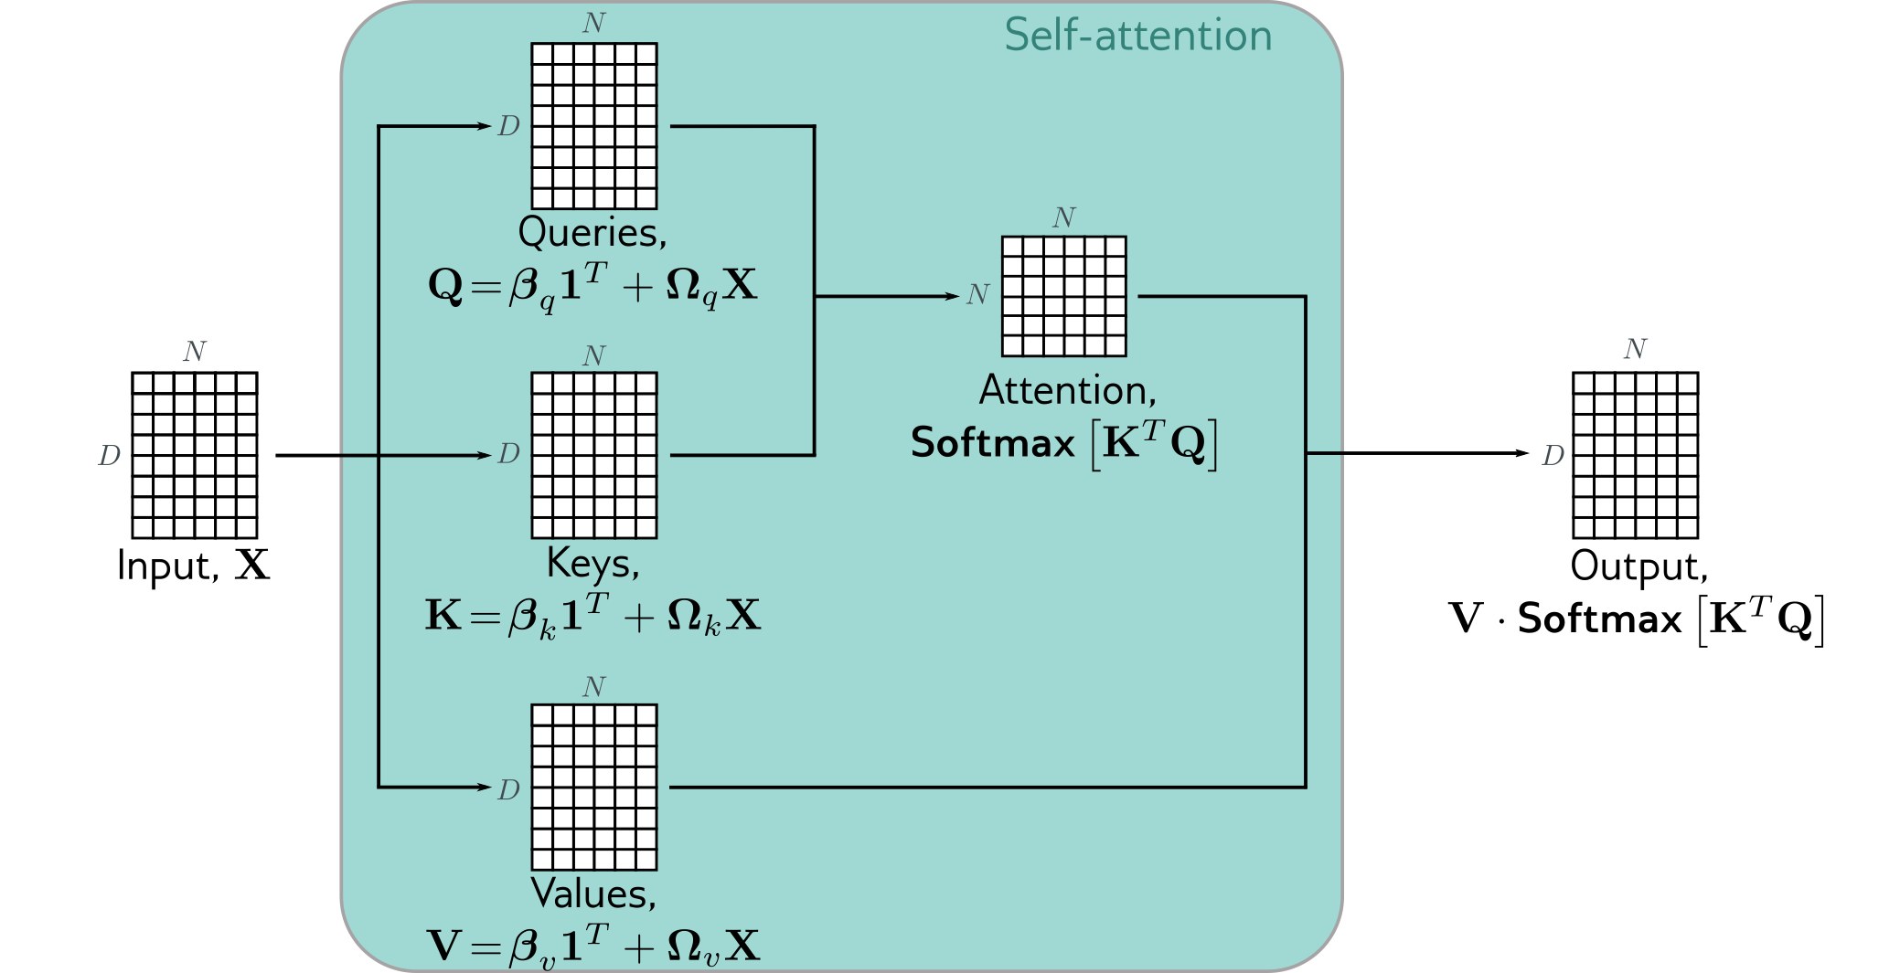
Dot-Product Self-Attention
$$D$$
$$D_{1}$$
$$Ω_{q}$$
A self-attention unit computes three values for each input $x_{i}$:
    Query $q_{i}$, Key $k_{i}$, and Value $v_{i}$
    These values are computed in the same way for each input
Each output is a weighted combination of the values of all inputs:
$$y_{j}=\underset{i}{∑}a[x_{i},x_{j}]v_{i}=\underset{i}{∑}w_{ij}v_{i}$$
Weight for output $y_{j}$ of value $x_{i}$ is proportional to the dot-product of $j$'s query and $i$'s key
$$w_{ij}=\frac{exp(q_{j}^{⊤}k_{i})}{∑_{ℓ}exp(q_{j}^{⊤}k_{ℓ})}$$
$$D_{1}$$
$$D_{1}$$
$$D_{2}$$
$$D_{2}$$
A DxN matrix labelled "Input X" has arrows going to three additional matrices: "Queries", a D1xN matrix labelled with the equation$Q=β_{q}1^{⊤}+Ω_{q}X$; "Keys", a D1xN matrix labelled with the equation$K=β_{k}1^{⊤}+Ω_{k}X$; and "Values", a D2xN matrix labelled with the equation $V=β_{v}1^{⊤}+Ω_{v}X.$ Queries and Keys have arrows leading to an NxN matrix "Attention", labelled with the equation $softmax[K^{t}opQ].$ Attention and Values have arrows pointing to a D2xN matrix "Output" labelled with the equation$V⋅softmax[K^{t}opQ]$. $Ω_{q}$ is a D1xD matrix. There is a shaded box labelled "Self-attention" that contains all elements except for Input on the left and Output on the right.
(Image: Prince 2022)

Slide 31
Transformer Blocks
A transformer layer is a self-attention unit followed by a dense feedforward network
The same feedforward network gets applied to each output of the self-attention unit:
    $y_{j}=mlp(x_{j};Ω)$ for $j=1,…,N$
In a typical transformer architecture, several transformer blocks will be strung together in parallel ("multiple heads")
mlp
self-attention
A matrix of squares has an arrow pointing to a block labelled "self-attention", which has an arrow pointing to another matrix of squares. An arrow goes from the leftmost vector of the second matrix to the leftmost vector of a third vector via an oval labelled "mlp". A shaded box encloses self-attention, the second matrix, and mlp; the first and third matrices are outside the shaded box.

Slide 32
Training a Transformer Network
(for encoding tasks)
Transformers are trained in two phases:
Semi-supervised pre-training: Using a very large dataset, train the network to perform task for which dataset implies the answer
    we need not label the examples manually
    e.g., predicting masked words
Fully supervised fine-tuning:
Add another layer or two at the end, and train for the real task using manually labelled examples
    e.g., sentiment analysis, word classification, text span prediction
Question: Is this important? Why?

Slide 33
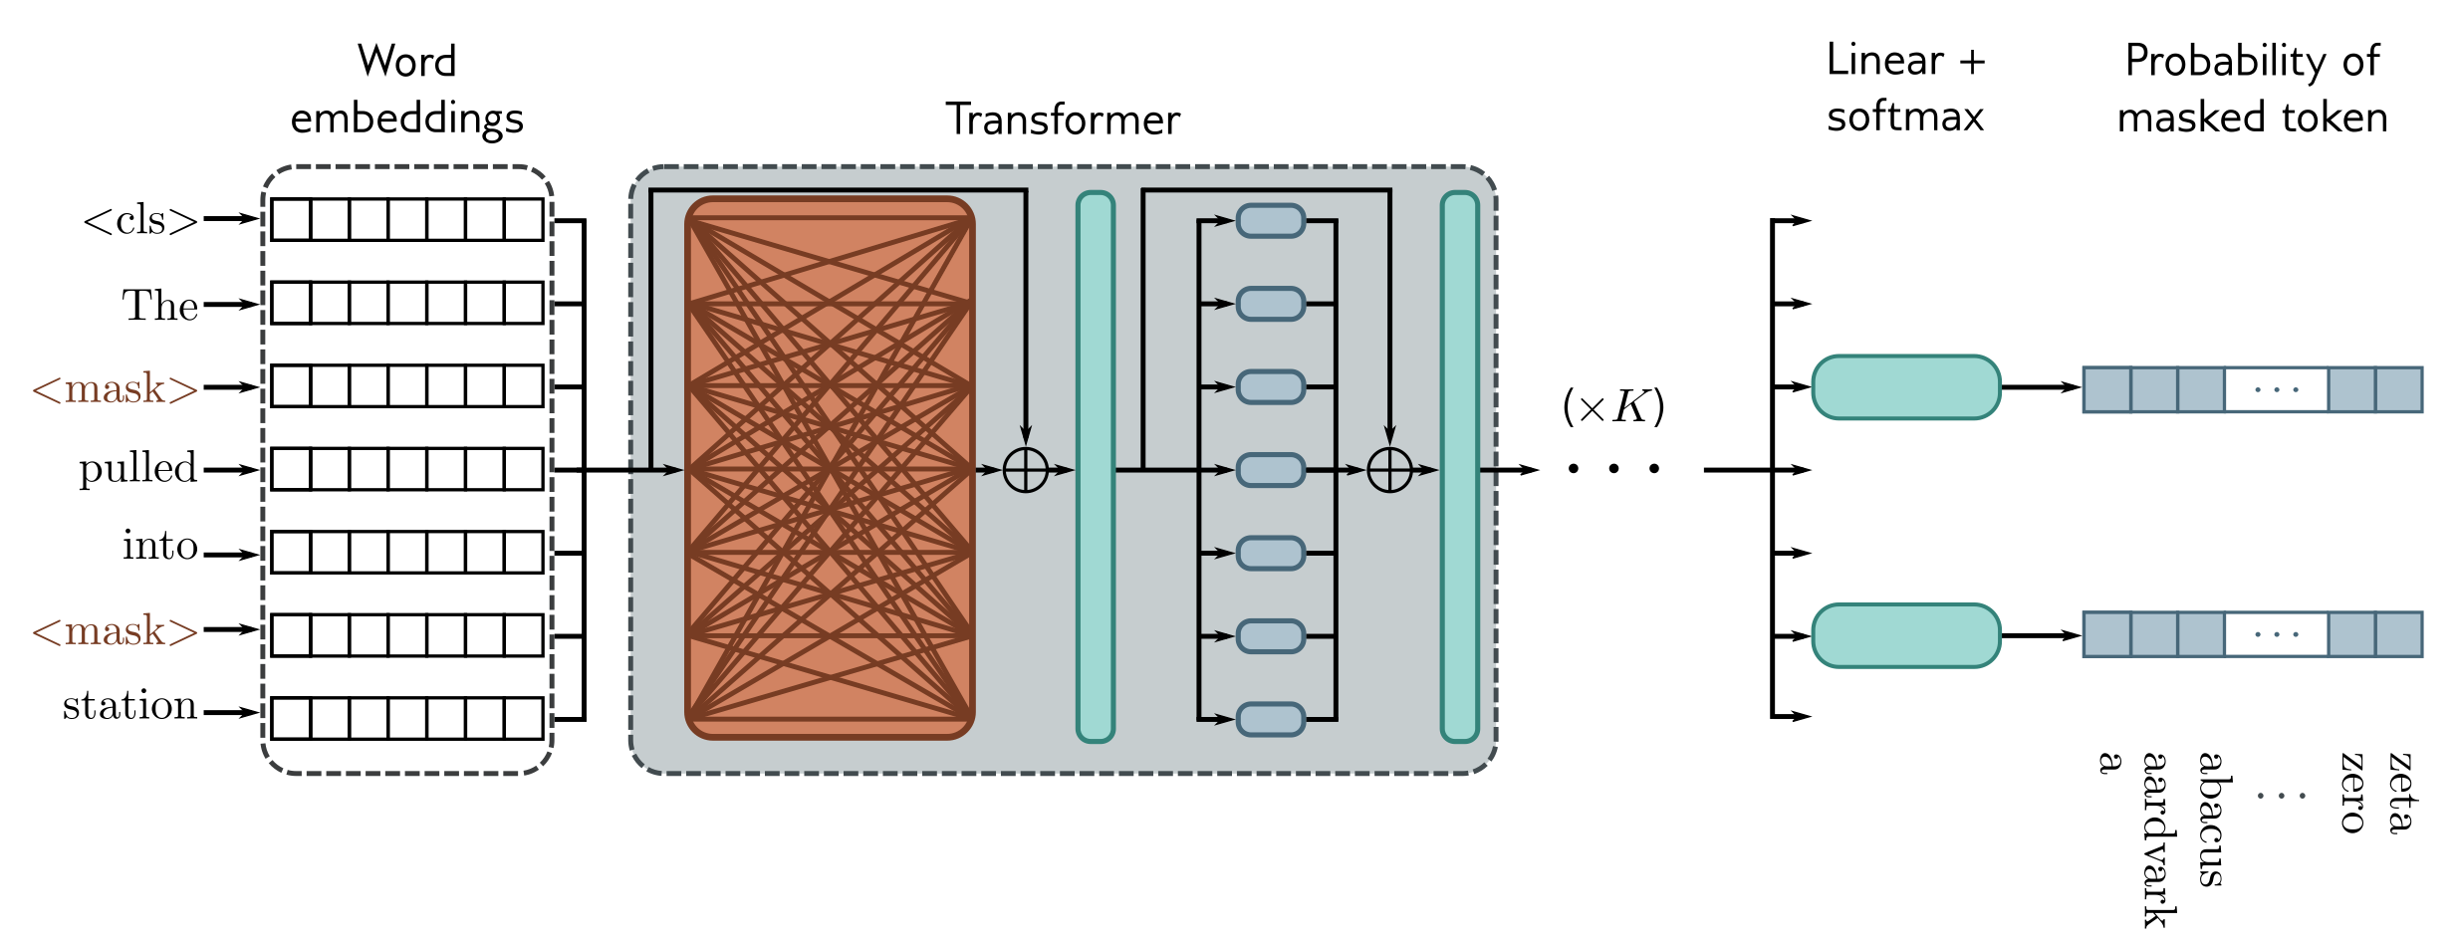
Pre-training
Column of row vectors labelled "word embeddings"; the vectors are laeblled "<cls>", "the", "<mask>", "pulled", "into", "<mask>", "station".
There are arrows from the embedding vectors to a large block labelled "transformer". From the transformer blow there is an arrow to ellipses laeblled "(x K)", and from ellipses there are a set of arrows (one for each embedding vector). Beside each arrow corresponding to the two "<mask>" inputs, there is an oval labelled "linear + softmax", pointing to a row vector of squares labelled "probability of masked token".
Subset of tokens in an example sequence are masked (replaced with a special token)
Neural network applied to each masked output predicts probabilities for missing token
    Loss is back-propagated through entire network
At end of training, that neural network is thrown away
(Image: Prince 2022)

Slide 34
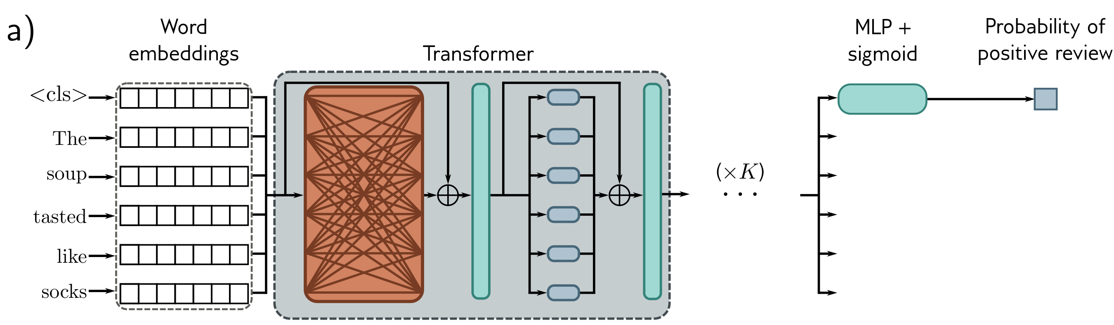
Fine-tuning: BERT
for Sentiment classification
Column of row vectors labelled "word embeddings"; the vectors are labelled "<cls>", "the", "soup", "tasted", "like", "socks".
There are arrows from the embedding vectors to a large block labelled "transformer". From the transformer blow there is an arrow to ellipses laeblled "(x K)", and from ellipses there are a set of arrows (one for each embedding vector). Beside the first arrow (corresponding to the two "<cls>" input), there is an oval labelled "MLP + sigmoid", pointing to a single square labelled "probability of positive review".
Sentiment classification: Predict if a sequence is positive or negative
First token of sequence is always a special "classify" token
Neural network trained on corresponding output token using labelled dataset
(Image: Prince 2022)

Slide 35
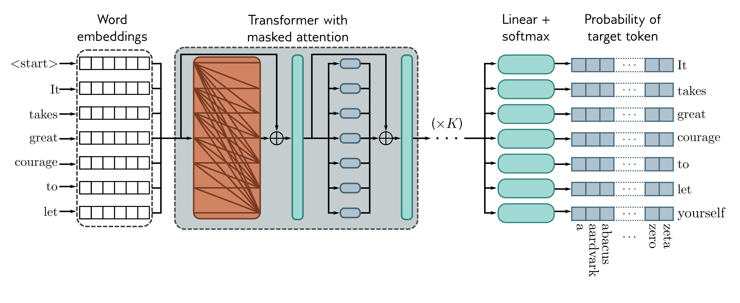
GPT3: Autoregressive Text
Column of row vectors labelled "word embeddings"; the vectors are labelled "<start>", "It", "takes", "great", "courage", "to", "let", "yourself".
There are arrows from the embedding vectors to a large block labelled "transformer". From the transformer blow there is an arrow to ellipses laeblled "(x K)", and from ellipses there are a set of arrows (one for each embedding vector except the first). Beside each arrow is an oval labelled "Linear + softmax", pointing to a vector of squares labelled "Probability of target token".
Produces probability distribution for each output
Goal: Maximize probability of each token given only the previous tokens
Accomplished with masked self-attention: all attention values to subsequent tokens are forced to zero

Slide 36
GPT3: Masked Self-Attention
0
0
0
Three figures depicting attention weighting. In each figure, there is a column of three groups of four dots labelled "Inputs". The groups are labelled "x1", "x2", and "x3. Next to that is a column of three groups of four dots labelled "Values". Next to that is a column of three groups of four dots labelled "Outputs". The output groups are labelled "sa1[x]", "sa2[x]", and "sa3[x]". In each figure, there is a large arrow connecting one input group to one value group, with faint edges connecting each input dot in the group to all of the dots in the value group.
In figure (a), there is an arrow labelled "0.1" connecting the value group for x1 to sa1[x], an arrow labelled with a bold red "X" connecting the value group for x2 to sa1[x], and an arrow labelled with a bold red "X" connecting the value group for x3 to sa1[x]. The top dot of the each value group has a faint edge connecting it to the top dot of the sa1[x] group; the second dot of each value group has a faint edge connecting it to the second dot of each value group; and so forth. In figure (b), the arrows got from each value group to sa2[x], and are labelled "0.5", "0.2", and bold red "X", with faint arrows from top dot of each value dot to top dot of sa2[x] and so forth. In figure (b), the arrows got from each value group to sa3[x], and are labelled "0.1", "0.2", and "0.7", with faint arrows from top dot of each value dot to top dot of sa3[x] and so forth.
When computing attention values, use 0 for all weights that point to later tokens
This prevents the model from "cheating" by guessing next token given the later tokens

Slide 37
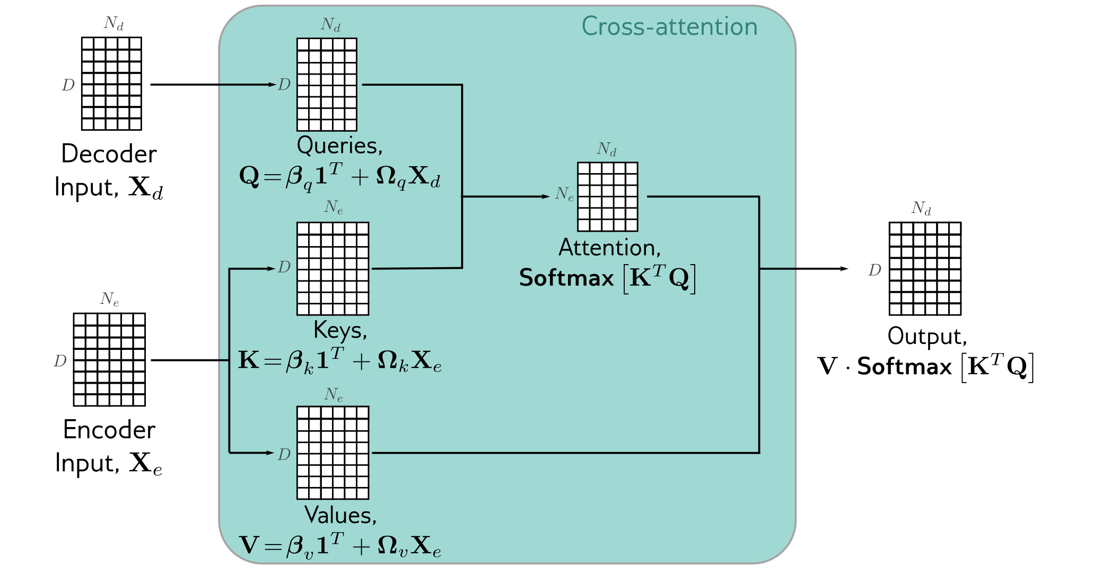
Cross-Attention
The transformers described so far will construct a context: an encoding of the sequence
For some tasks (e.g., translation), this encoding must then be decoded
Decoder looks almost identical to encoder, except that it attends to the context as well as the previous input
This is accomplished using
cross-attention
(Image: Prince 2022)

Slide 38
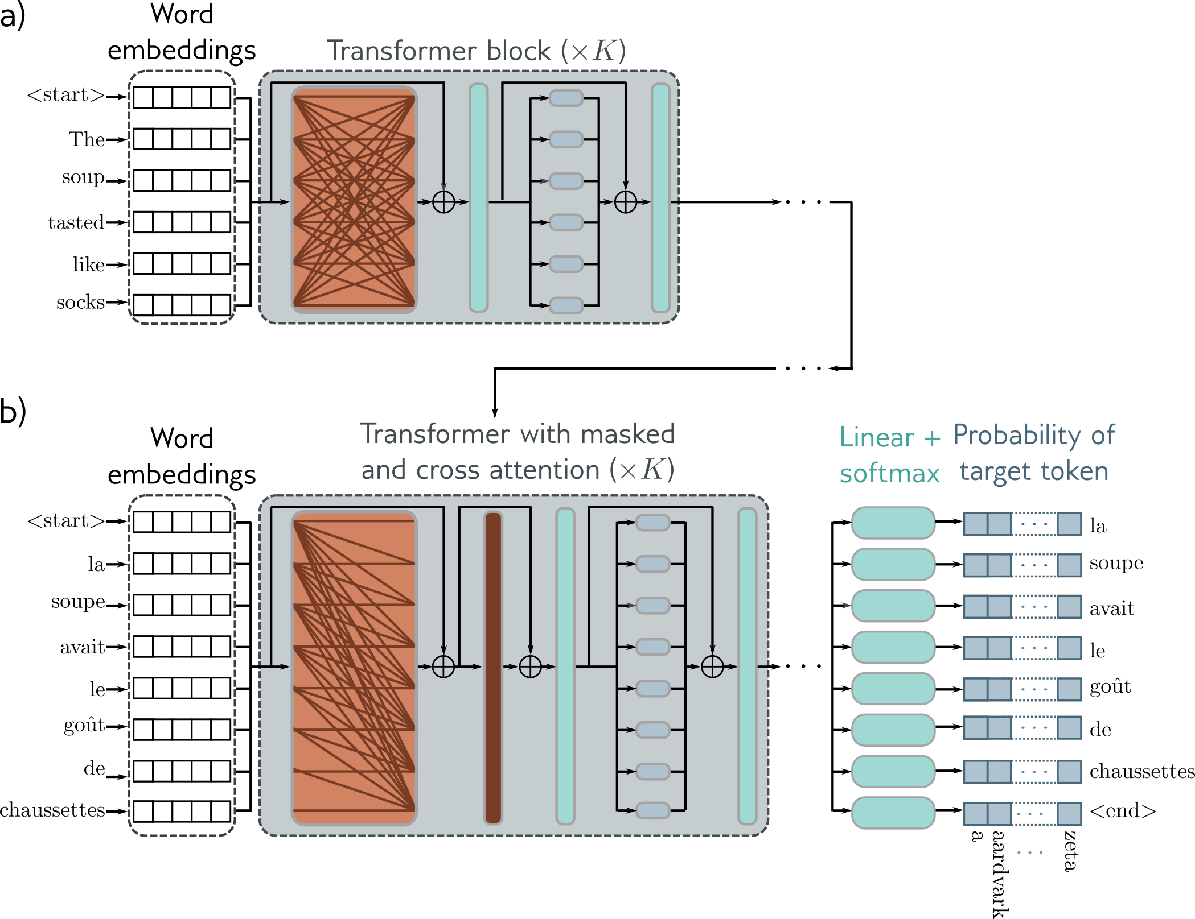
  Example Encoder-Decoder
(Image: Prince 2022)

Slide 39
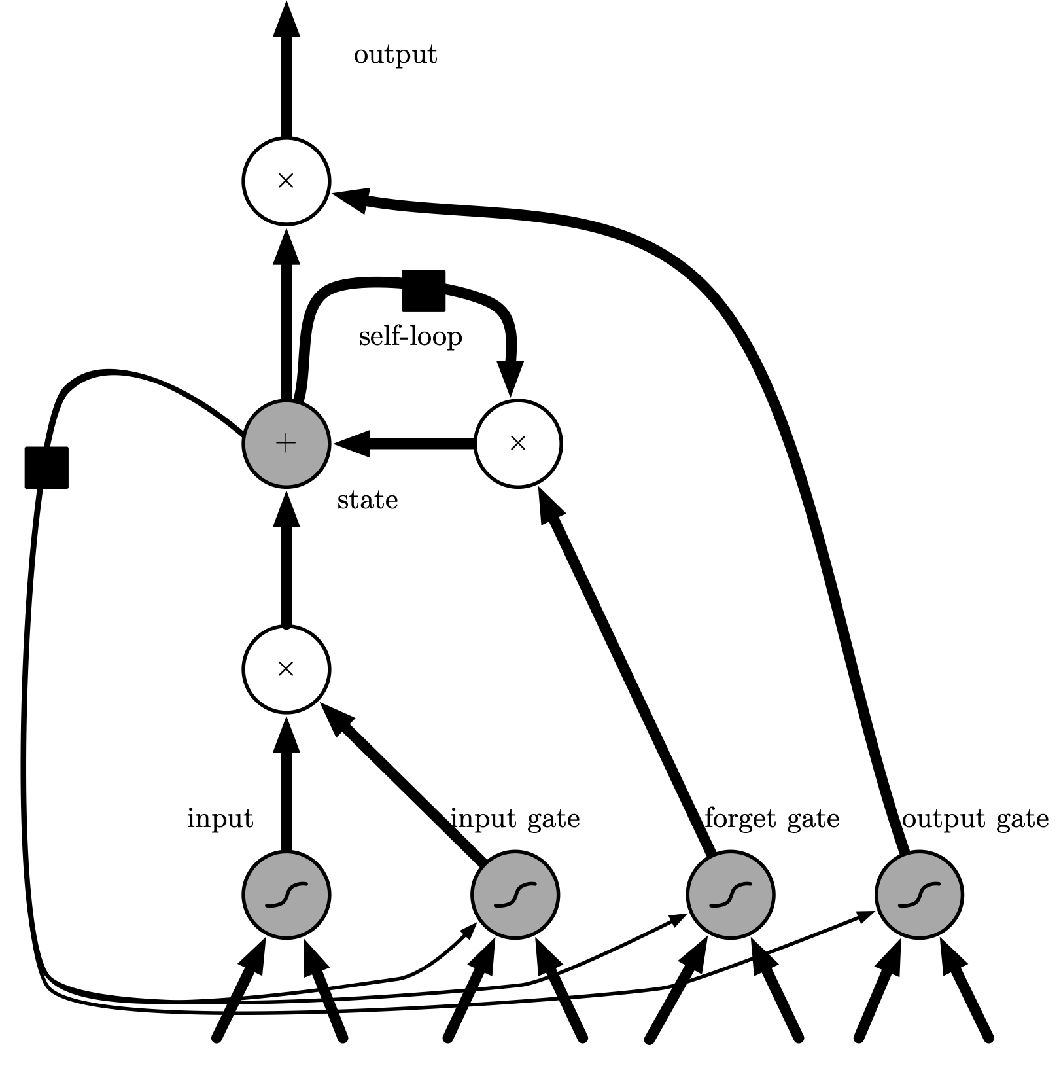
Long Short-Term Memory
LSTM networks replace regular hidden units with cells
Input feature computed with regular neuron
Feature accumulated into state only if input gate allows it
State decays according to value of forget gate
Output can be shut off by the output gate

Slide 40
Summary
Naïvely representing sequential inputs for a neural network requires infeasibly many input nodes (and hence parameters)
One-hot encodings are wastefully large and have no semantic structure
    Embeddings solve these problems and can be trained without explicit labels
Recurrent neural networks are a specialized architecture for sequential inputs
    State accumulates across input elements
    Each stage computed from previous stage using same parameters
Transformers are another specialized architecture!
    Self-attention to combine inputs instead of accumulating state
    All states output (not just last in a sequence)
    Improved ability to attend to long-range dependence
    Pre-training followed by fine-tuning
    Classification: attend to the output corresponding to a special "classify" input token
    Text generation: probabilities of each word given preceding words; required masked attention

