Slide 1
Convolutional
Neural Networks
  CMPUT 261: Introduction to Artificial Intelligence
  P §10.1-10.4.1, §10.5

Slide 2
Lecture Outline
Recap & Logistics
Neural Networks for Image Recognition
Convolutional Neural Networks
After this lecture, you should be able to:
explain why convolutional neural networks are more efficient to train on image data than dense feedforward networks
define sparse interactions and parameter sharing
define the convolution operation and demonstrate it on an example input
define the pooling operation and demonstrate it on an example input

Slide 3
Logistics
Assignment #3 is available
    Due Thursday, Nov 20
    Submit via Canvas (deadline is firm)
    Blank submissions will not be regraded, nor granted EA

Slide 4
Midterm Details
The midterm is Thursday, Nov 3 in this room at 9:30am
There will be a 80 minute time limit for the midterm
You may use a single, handwritten cheat sheet if you wish (double-sided)
You may use a non-programmable calculator if you wish
    It shouldn't make a difference, but many students find it comforting
All material from lectures before the midterm are included
    Everything up to and including today's material

Slide 5
Midterm Structure
There will be 60 marks total
There will be 10 short answer questions with 1-2 sentence answers
    The rest will be more in-depth
    Like assignments but a little easier
There will be no coding questions
    But you may be asked to execute a few steps of an algorithm
Every question will be based on the learning objectives ("after this lecture...") from the slides

Slide 6
Recap:
Feedforward Neural Network
x1
h1
$$h_{1}(x;w^{(1)},b^{(1)})=g\left(b^{(1)}+\overset{n}{\underset{i=1}{∑}}w_{i}^{(1)}x_{i}\right)$$
y
x2
h2
A graph representing a feedforward neural network. There are two nodes labelled x1 and x2, two additional nodes labelled h1 and h2, and a final node labelled y. h1 has an incoming edge from x1 and an incoming edge from x2. h2 has an incoming edge from x1 and an incoming edge from x2. y has incoming edges from h1 and h2.
$$\begin{matrix}y(x;w,b) & =g\left(b^{(y)}+\overset{n}{\underset{i=1}{∑}}w_{i}^{(y)}h_{i}(x_{i};w^{(i)},b^{(i)})\right) \\ & =g\left(b^{(y)}+\overset{n}{\underset{i=1}{∑}}w_{i}^{(y)}g\left(b^{(i)}+\overset{n}{\underset{j=1}{∑}}w_{j}^{(i)}x_{j}\right)\right)\end{matrix}$$
A neural network is many units composed together
Feedforward neural network: Units arranged into layers
    Each layer takes outputs of previous layer as its inputs

Slide 7
Recap: Training Neural Networks
Specify a loss $L$ and a set of training examples:
$E=(x^{(1)},y^{(1)}),...,(x^{(n)},y^{(n)})$
Training by gradient descent:
    Compute loss on training data: $L(W,b)=\underset{i}{∑}ℓ\left(f(x^{(i)};W,b),y^{(i)}\right)$
    Compute gradient of loss: $∇L(W,b)$
    Update parameters to make loss smaller:
    $\left[\begin{aligned}W^{new} \\ b^{new}\end{aligned}\right]=\left[\begin{aligned}W^{old} \\ b^{old}\end{aligned}\right]-η∇L(W^{old},b^{old})$
Loss function
(e.g., squared error)
Prediction
Target

Slide 8
Recap: Automatic Differentiation
Forward mode sweeps through the graph, computing $s_{i}^{′}=\frac{∂s_{i}}{∂s_{1}}$ for each $s_{i}$
    The numerator varies, and the denominator is fixed
    At the end, we have computed $s_{n}^{′}=\frac{∂s_{n}}{∂x_{i}}$ for a single input $x_{i}$
Backward mode does the opposite:
    For each $s_{i}$, computes the local gradient $\overline{s_{i}}=\frac{∂s_{n}}{∂s_{i}}$
    The numerator is fixed, and the denominator varies
    At the end, we have computed $\overline{x_{i}}=\frac{∂s_{n}}{∂x_{i}}$ for each input $x_{i}$
Key point: The intermediate results are computed numerically at each step

Slide 9
Image Classification
FIVE
Pixelated image of a handwritten digit "5" with an arrow pointing to the English word "FIVE"
Problem: Recognize the handwritten digit from an image
  What are the inputs?
  What are the outputs?
  What is the loss?

Slide 10
Image Classification with
Neural Networks
How can we use a neural network to solve this problem?
    How to represent the inputs?
    How to represent the outputs?
    What are the parameters?
    What is the loss?
x1,1
h1,1
h2,1
zero
x1,2
h1,2
h2,2
one
x1,3
h1,3
h2,3
.
.
.
.
.
.
.
.
.
.
.
.
nine
x32,32
h1,512
h2,256
Pixelated image of a handwritten digit "1" to the left of a fully-connected feedforward neural network with ten output nodes labelled "zero", "one", ..., "nine". The output node "one" is highlighted.

Slide 11
Image Recognition Issues
For a large image, the number of parameters will be very large
    For 32x32 greyscale image,
    hidden layer of 512 units
    hidden layer of 256 units,
    1024×512 + 512×256 + 256×10
    = 657,920 weights (and 1,802 offsets)
    Needs lots of data to train
Want to generalize over transformations of the input
x1,1
h1,1
h2,1
zero
x1,2
h1,2
h2,2
one
x1,3
h1,3
h2,3
.
.
.
.
.
.
.
.
.
.
.
.
nine
x32,32
h1,512
h2,256
A fully-connected feedforward neural network with ten output nodes labelled "zero", "one", ..., "nine". The output node "one" is highlighted.
=
A box containing a pixelated handwritten digit "5" in the bottom right followed by an equal sign followed by another box containing an identical "5" in the top left .

Slide 12
Convolutional Neural Networks
Convolutional neural networks: a specialized architecture for image recognition
Introduce two new operations:
    Convolutions
    Pooling
Efficient learning via:
    Sparse interactions
    Parameter sharing
    Equivariant representations

Slide 13
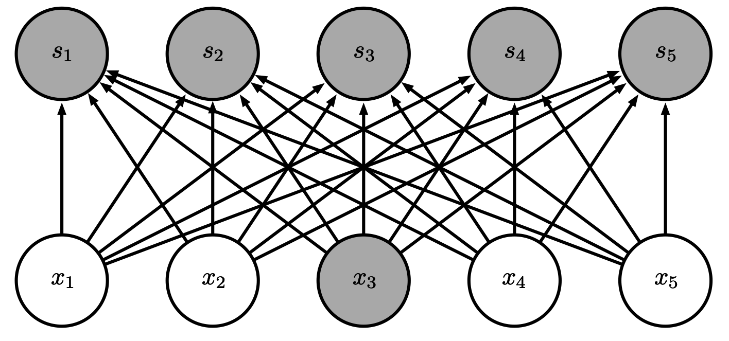
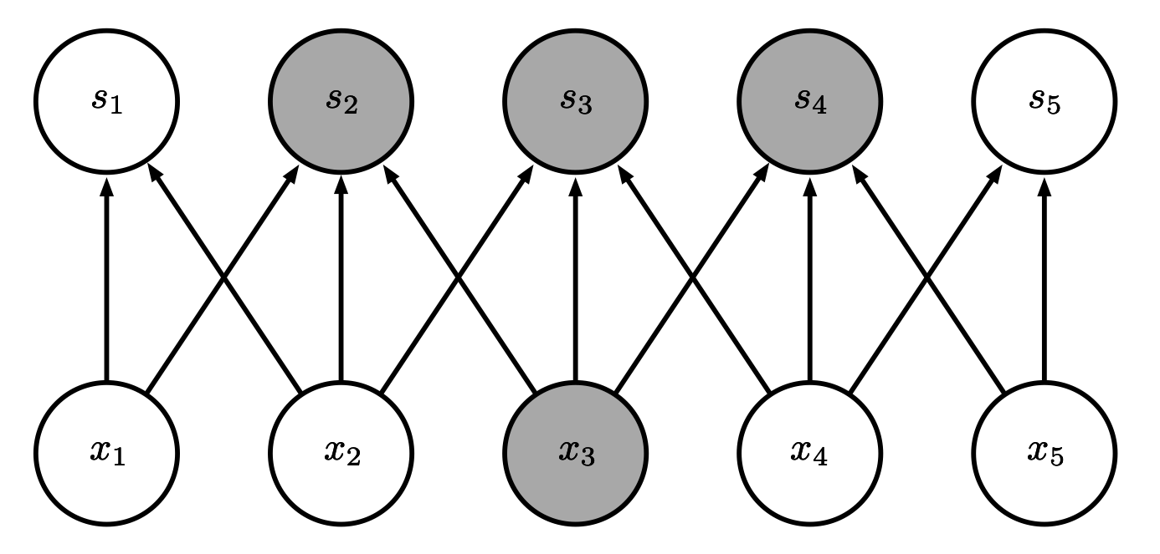
1. Sparse Interactions
Dense
connections
A two-layer neural network, with five input units x1...x5 and five output units s1..s5. Each input unit has an edge outgoing to all five output units. Input unit x3 is highlighted, and so is every output unit.
Sparse
connections
A two-layer neural network, with five input units x1...x5 and five output units s1..s5. Each input unit points to the output unit with the same index, one to the left (if present) and one to the right (if present). Input unit x3 is highlighted, and so are output units s2, s3, and s4 (the units to which x3 has outgoing edges).
(Images: Goodfellow 2016)

Slide 14
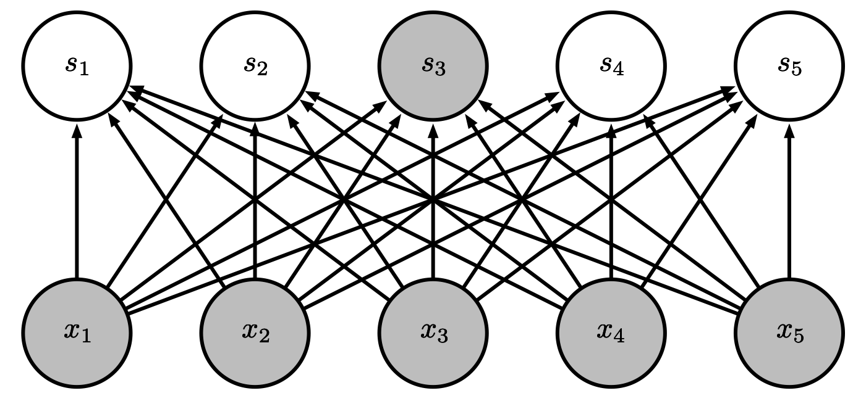
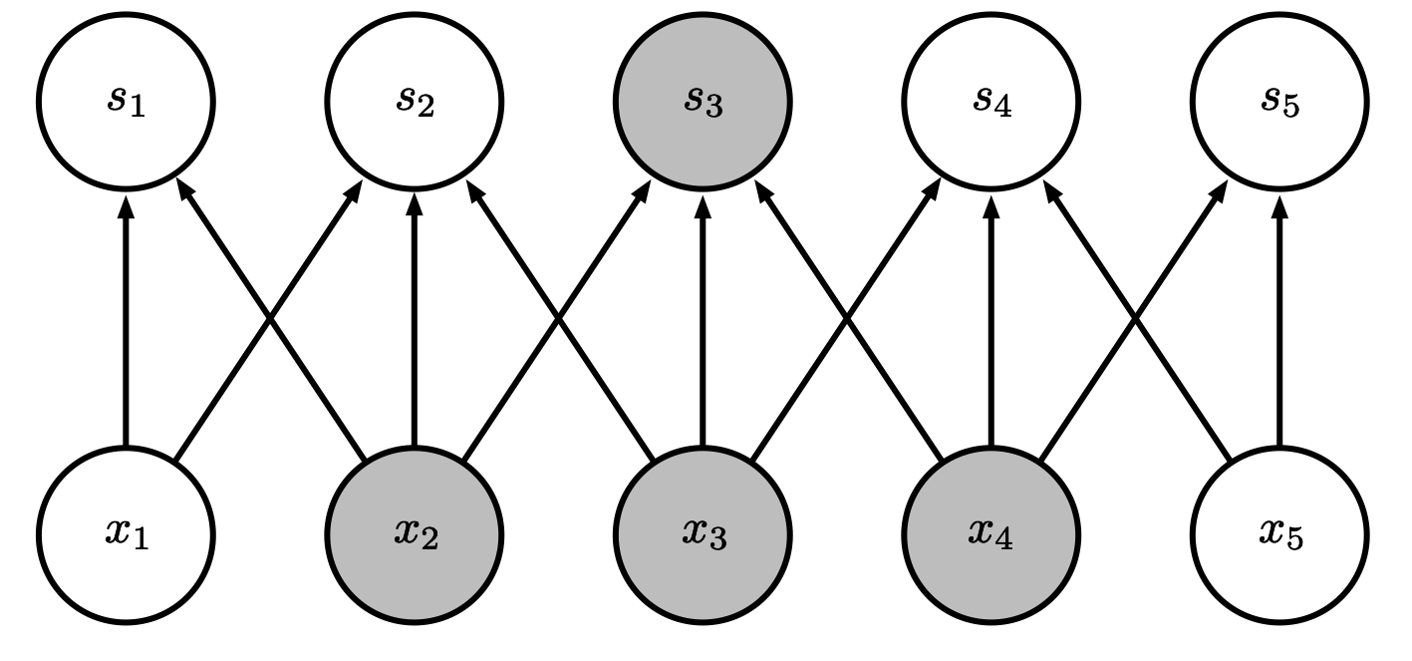
1. Sparse Interactions
Dense
connections
A two-layer neural network, with five input units x1...x5 and five output units s1..s5. Each input unit has an edge outgoing to all five output units. Output s3 is highlighted, and so are all input units.
Sparse
connections
A two-layer neural network, with five input units x1...x5 and five output units s1..s5. Each input unit points to the output unit with the same index, one to the left (if present) and one to the right (if present). Output unit s3 is highlighted, and so are input units x2, x3, and x4 (the units which have outgoing edges to s3).
(Images: Goodfellow 2016)

Slide 15
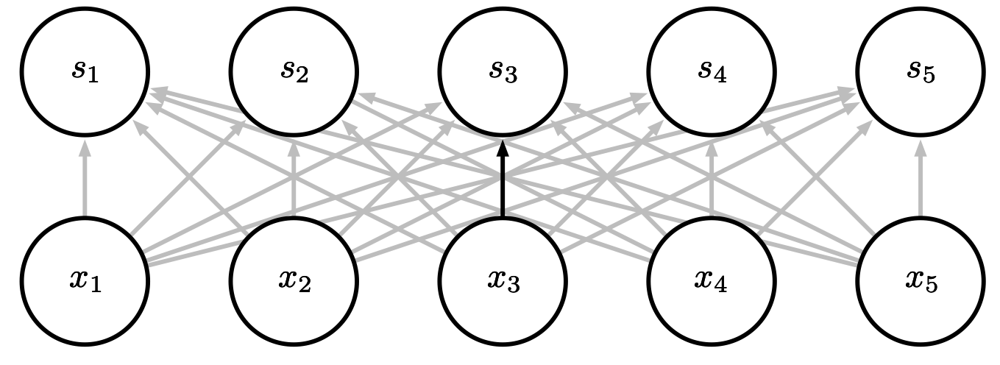
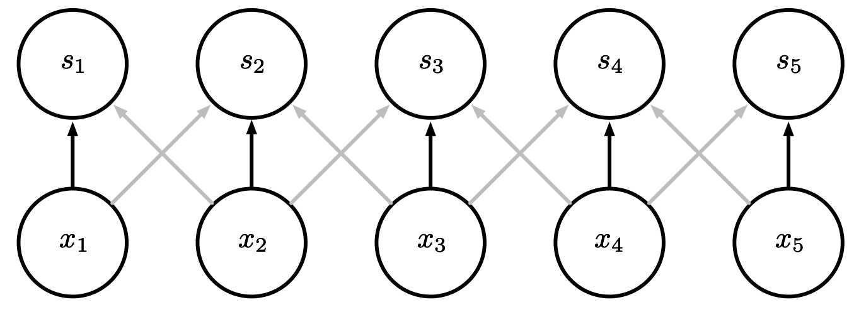
2. Parameter Sharing
Traditional neural nets
learn a unique value
for each connection
A two-layer neural network, with five input units x1...x5 and five output units s1..s5. Each input unit has an edge outgoing to all five output units. The edge from x3 to s3 is highlighted.
Convolutional neural nets
constrain multiple
parameters to be equal
A two-layer neural network, with five input units x1...x5 and five output units s1..s5. Each input unit points to the output unit with the same index, one to the left (if present) and one to the right (if present). The edges from x1 to s1, x2 to s2, x3 to s3, x4 to s4, and x5 to s5 are highlighted.
(Images: Goodfellow 2016)

Slide 16
3. Equivariant Representations
We want to be able to recognize transformed versions of inputs we have seen before
    e.g., translation
Without having been trained on all transformed versions
Equivariance: Changes in the input induce the same changes in the output
FIVE
NONE
=
NONE
NONE
A box with a pixellated handwritten "5" in the top left corner, followed by an equal sign, followed by a box that has "FIVE" in the top left corner and "NONE" in the other three corners.
NONE
FIVE
=
NONE
NONE
A box with a pixellated handwritten "5" in the top right corner, followed by an equal sign, followed by a box that has "FIVE" in the top right corner and "NONE" in the other three corners.

Slide 17
Operation: Matrix Product
zero
Recall that we can represent the activations in a densely connected neural network by a matrix product
x1,1
h1,1
h2,1
x1,2
h1,2
h2,2
one
x1,3
h1,3
h2,3
.
.
.
.
.
.
.
.
.
.
.
.
$$W^{(1)}x=\left[\begin{matrix}w_{x_{1}→h_{1}}^{(1)} & w_{x_{2}→h_{1}}^{(1)} & ⋯w_{x_{n}→h_{1}}^{(1)} \\ w_{x_{1}→h_{2}}^{(1)} & ⋱ & \\ ⋮ & & \\ w_{x_{1}→h_{m}}^{(1)} & & w_{x_{n}→h_{m}}^{(1)}\end{matrix}\right]\left[\begin{aligned}x_{1} \\ x_{2} \\ ⋮ \\ x_{n}\end{aligned}\right]$$
nine
x32,32
h1,512
h2,256
A fully-connected feedforward neural network with ten output nodes labelled "zero", "one", ..., "nine". The output node "one" is highlighted.
$$\begin{matrix}h_{1} & =g_{h}\left(W^{(1)}x+b^{(1)}\right) \\ h_{2} & =g_{h}\left(W^{(2)}h_{1}+b^{(2)}\right) \\ y & =g_{y}\left(W^{(3)}h_{2}+b^{(3)}\right)\end{matrix}$$
(Image: Goodfellow 2016)

Slide 18
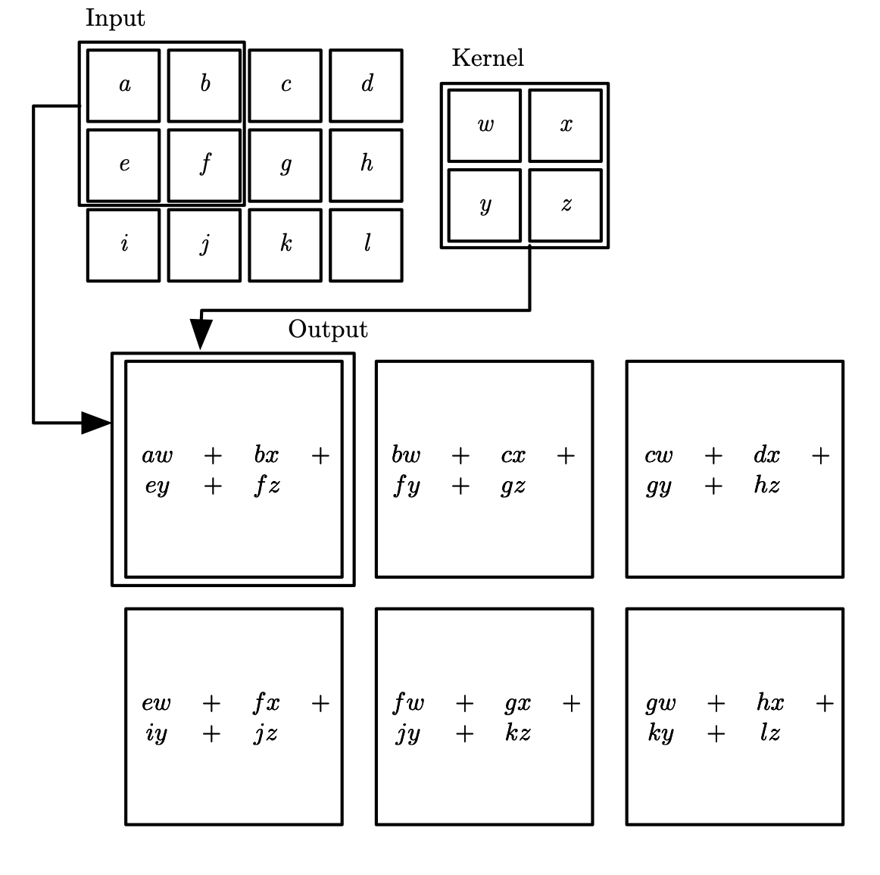
Operation: 2D Convolution
Convolution scans a small block of weights (called the kernel) over the elements of the inputs, taking weighted averages
    Note that input and output dimensions need not match
    Same weights used for very many combinations
The number of elements skipped by each "slide" is called the stride
    This example has a stride of 1
Squares respectively containing "a,b,c,...,l" arranged in 3 rows and 4 columns, with the top-left four squares (a,b,e,f) highlighted and labelled "input". Next to this, four squares respectively containing "w,x,y,z" arranged in 2 rows and columns, highlighted and labelled "kernel". Below, large squares arranged in 2 rows and 3 columns. The "Input" and "Kernel" squares have arrows pointing to the top-left large square, labelled "Output". The top-left large square contains "aw + bx + ey + fz". The top-center sqaure contains "bw + cx + fy + gz". The top-right large square contains "cw + dx + gy + h". The bottom-left large square contains "ew + fx + iy + jz". The bottom-center large square contains "fw + gx + jy + kz". The bottom-right large square contains "gw + hx + ky + lz".
(Image: Goodfellow 2016)

Slide 19
Replace Matrix Multiplication by Convolution
Main idea: Replace matrix multiplications with convolutions
    Sparsity: Inputs only combined with neighbours
    Parameter sharing: Same kernel used for entire input

Slide 20
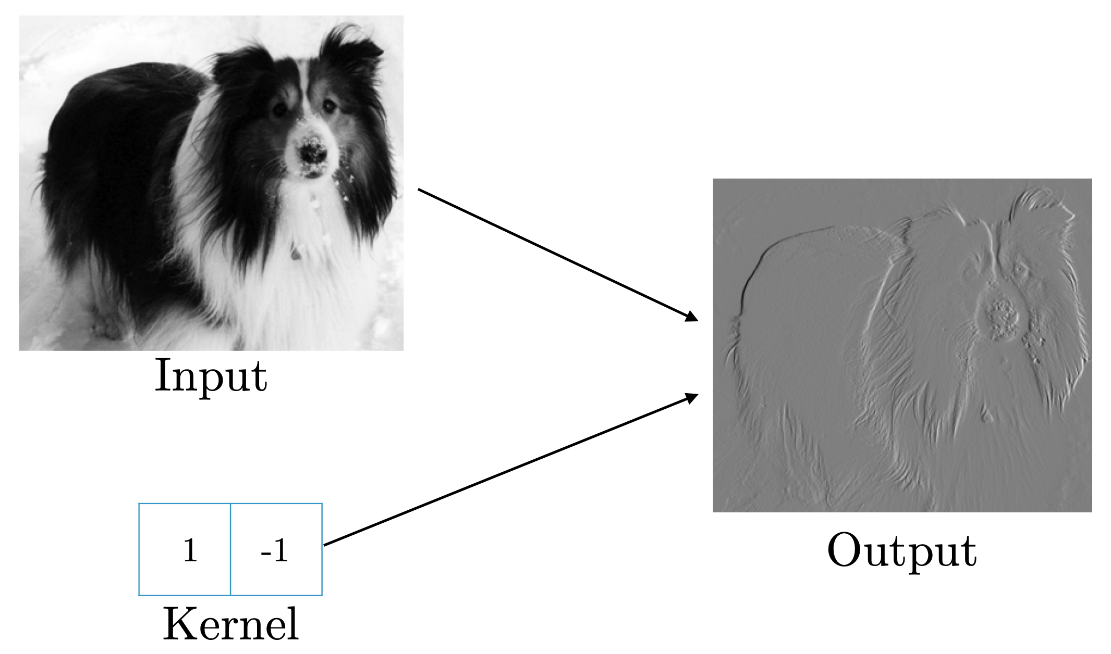
Example: Edge Detection
An image of a dog labeled "input" and two boxes arranged horizontally with 1 in the left box and -1 in the right box labeled "kernel". An arrow from each to a greyscale image labelled "output" where edges of the dog are either black or white.
(Image: Goodfellow 2016)

Slide 21
Efficiency of Convolution
Input size: 320 by 280
Kernel size: 2 by 1
Output size: 319 by 280
 | Dense matrix | Sparse matrix | Convolution
Stored floats | 319*280*320*280 > 8e9 | 2*319*280 = 178,640 | 2
Float muls or adds | > 16e9 | Same as convolution (267,960) | 319*280*3 = 267,960
(Goodfellow 2016)

Slide 22
Operation: 2D Pooling
Pooling summarizes its inputs into a single value, e.g.,
    max
    average
Max-pooling is parameter-free (no bias or edge weights to learn)
    This example has stride of 1
$$max\{a,b,e,f\}$$
$$max\{b,c,f,g\}$$
$$max\{c,d,g,h\}$$
$$max\{e,f,i,j\}$$
$$max\{f,g,j,k\}$$
$$max\{g,h,k,l\}$$
Squares respectively containing "a,b,c,...,l" arranged in 3 rows and 4 columns, with the top-left four squares (a,b,e,f) highlighted and labelled "input". Below, large squares arranged in 2 rows and 3 columns. The "Input" square has an arrow pointing to the top-left large square, labelled "Output". The top-left large square contains "max{a,b,e,f}". The top-center large square contains "max{b,c,f,g}". The top-right large square contains "max{c,d,g,h}". The bottom-left large square contains "max{e,f,i,j}". The bottom-center large square contains "max{f,g,j,k}". The bottom-right large square contains "max{g,h,k,l}".
(Image: adapted from Goodfellow 2016)

Slide 23
Operation: 1D Softmax
Softmax converts a vector of real values into a vector of probabilities
Often used as the final operation in a classifier
$$a$$
$$\frac{expa}{expa+expb+expc}$$
$$b$$
$$\frac{expb}{expa+expb+expc}$$
$$c$$
$$\frac{expc}{expa+expb+expc}$$

Slide 24
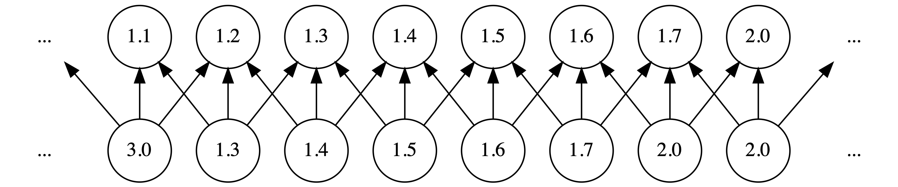
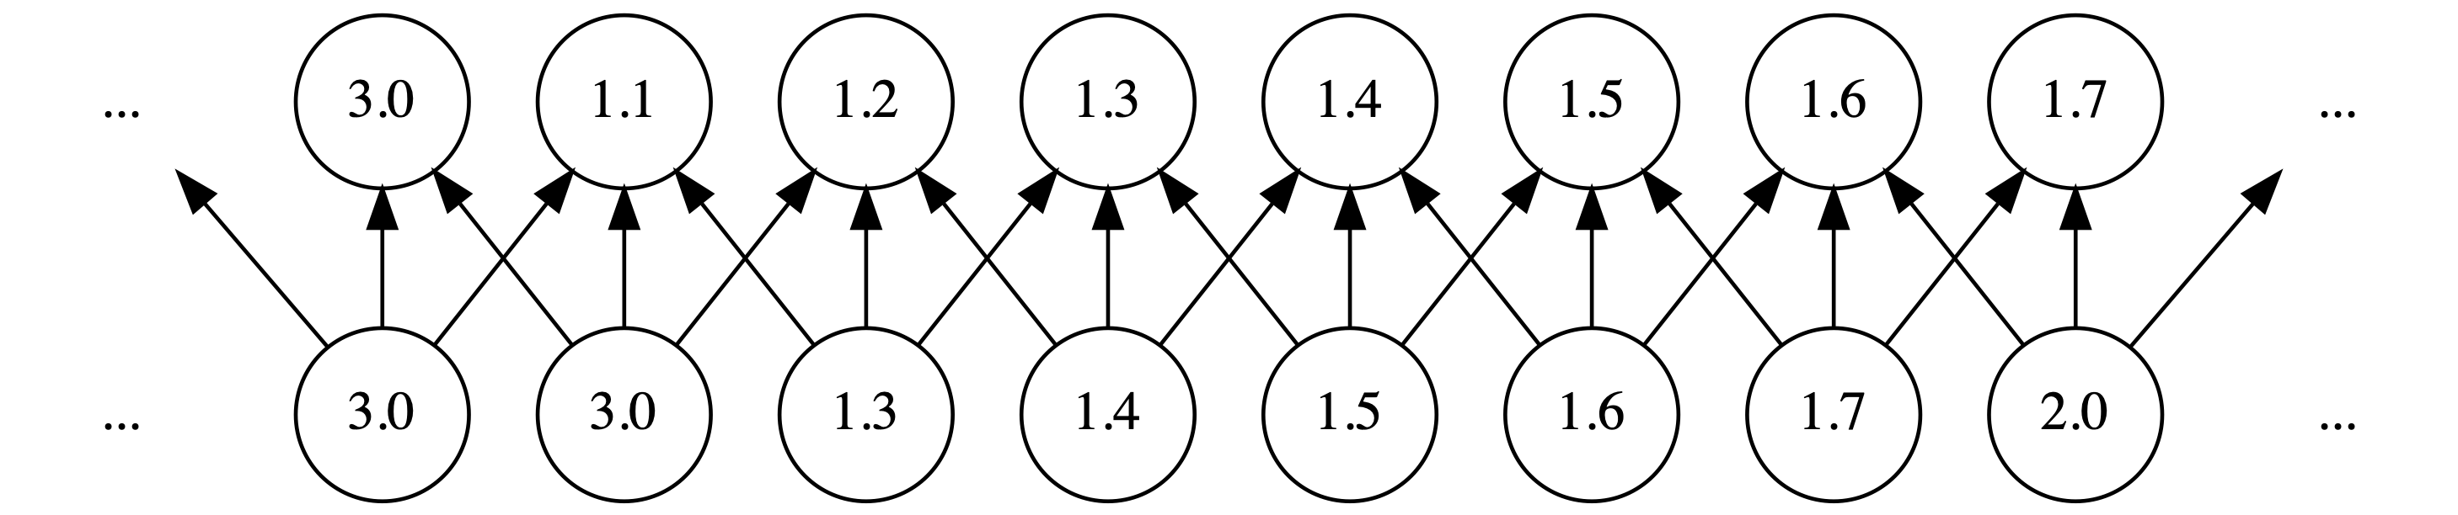
Example:
Translation Equivariance

Slide 25
Channels & Kernels
Convolution of a $224×224$ image with an $11×11$ kernel with a stride of $4$ yields a single $55×55$ output
But we might want to learn more than one kernel!
If we apply $6$ different kernels to the input image, we will get $6$ different $55×55$ outputs
    Each output is called a channel
    Convolution with a single kernel yields a single channel
$$11$$
$$224$$
$$11$$
$$55$$
CONV
(stride 4)
$$224$$
$$55$$
A 224 by 224 box, with an arrow pointing to the words "CONV (stride 4)", which has another arrow pointing to a 55 by 55 box. Above "CONV (stride 4)" is an orange 11 by 11 box.
$$11$$
$$224$$
$$11$$
$$6\text{kernels}$$
$$55$$
CONV
(stride 4)
$$55$$
$$224$$
$$6\text{channels}$$
A 224 by 224 box, with an arrow pointing to the words "CONV (stride 4)", which has another arrow pointing to 6 55 by 55 boxes, labeled "6 channels". Above "CONV (stride 4)" are 6 orange 11 by 11 boxes, labelled "6 kernels".

Slide 26
Typical Architecture
Input
Image
Convolution
Pooling
Convolution
Pooling
Fully-connected
Outputs
Often convolution-then-pooling is
collectively referred to as a
"convolution layer"
A rectangle labelled "input image" with an arrow pointing to a rectangle labelled "pooling" with an arrow pointing to a rectangle labelled "convolution" with an arrow pointing to a rectangle labelled "pooling" with an arrow pointing to a rectangle labelled "fully connected" with an arrow pointing to a rectangle labelled "outputs". The first two rectangles labelled "convolution" and "pooling" are in an orange outline.

Slide 27
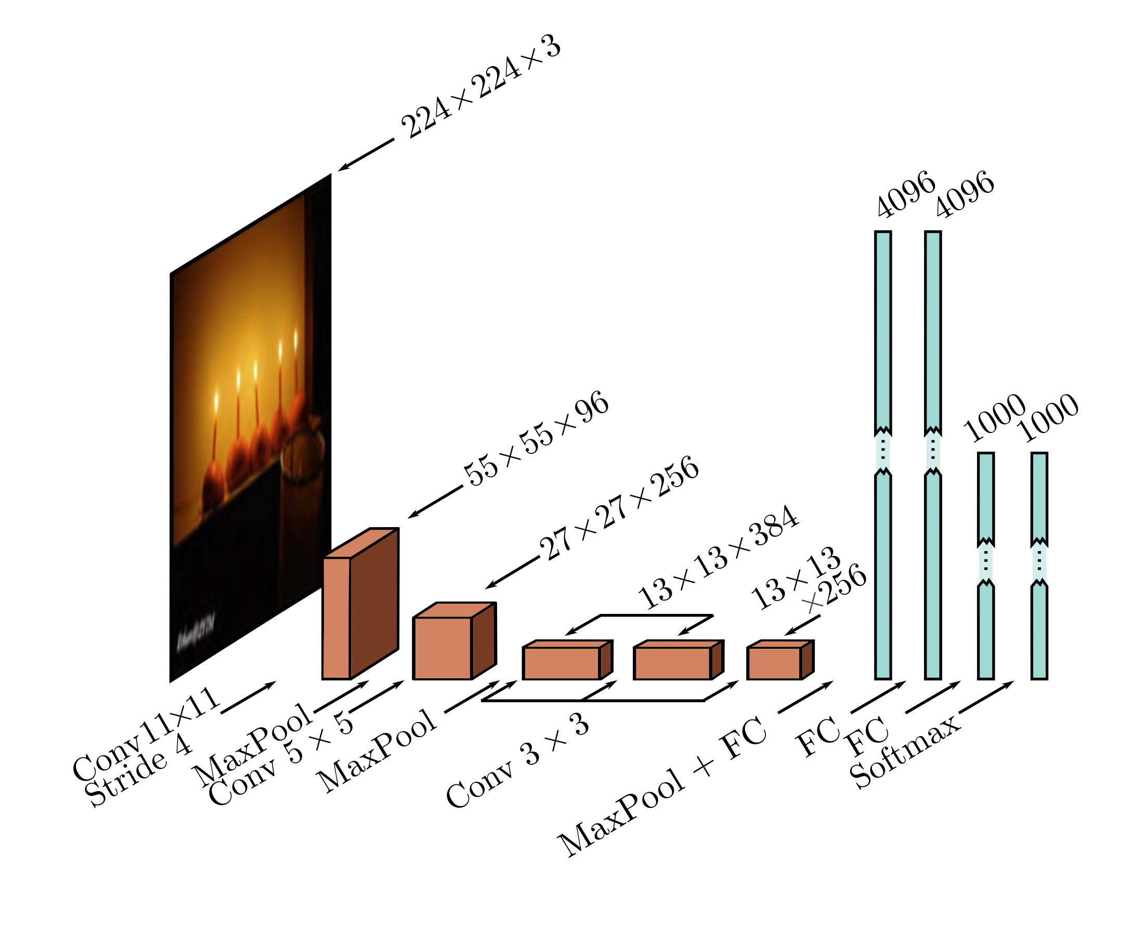
Example Architecture: AlexNet
[Krizhevsky et al. 2012]
Question:
How many weights are needed to convert the 43,264 vector after the final convolution layer into the 4096 vector of the next hidden layer?
How many biases?
(Image: Prince 2023)
A color image of candles, labelled "224x224x3", with an arrow labelled "Conv 11x11 Stride 4" pointing to a flat slab labelled "55x55x96", with an arrow labelled "MaxPool" followed by an arrow labelled "Conv 5x5" pointing to a cube labelled "27x27x256" with an arrow labelled "MaxPool" followed by an arrow labelled "Conv 3x3" pointing to a long slab labelled "13x13x384" with an arrow also labelled "Conv 3x3" pointing to another long slab also labelled "13x13x384" followed by an arrow labelled "Conv 3x3" pointing to a slab labelled "13x13x256" with an arrow labelled "MaxPool + FC" pointing to a long rectangle labelled "4096" with an arrow labelled "FC" pointing to a long rectangle also labelled "4096" with an arrow labelled "FC" pointing to a long rectangle labelled "1000" with an arrow labelled "Softmax" pointing to a long rectangle also labelled "1000".

Slide 28
Example: Invariance to Learned Transformations

Slide 29
Summary
Classifying images with a standard feedforward network requires vast quantities of parameters (and hence data)
Convolutional networks add pooling and convolution
    Sparse connectivity
    Parameter sharing
    Translation equivariance
Fewer parameters means far more efficient to train

