Slide 1
Neural Networks
  CMPUT 261: Introduction to Artificial Intelligence
  P §3.1-3.6

Slide 2
Logistics
Assignment #2 late deadline is Friday (tomorrow) at 11:59pm
Midterm is Tuesday, Oct 24
    Coverage: Everything up to and including today (Neural Networks)
    Usual lecture time & place
    Cheat sheet: One sheet of paper, double-sided okay, hand-written

Slide 3
Lecture Outline
Recap
Nonlinear models
Feedforward neural networks
After this lecture, you should be able to:
define an activation function
define a rectified linear activation and give an expression for its value
describe how the units in a feedforward neural network are connected
give an expression in matrix notation for a layer of a feedforward network
explain (high level) what the Universal Approximation Theorem guarantees
describe the basic procedure for training a neural network
identify the parameters of a feedforward neural network

Slide 4
Recap: Supervised Learning
Supervised learning task:
predict the values of target features $Y$ based on input features $X$
Formally: Choose a hypothesis $h:X→Y$ from a hypothesis space $H$
We use the value of a loss function $L$ applied to a set of training examples $S=\{(x^{(1)},y^{(1)}),…,(x^{(n)},y^{(n)})\}$ to choose the hypothesis
    Regularization penalty biases optimization toward simpler functions:
    $\overset{̂}{h}=arg\min_{h∈H}L(h)=\overset{n}{\underset{i=1}{∑}}ℓ(h(x^{(i)}),y^{(i)})+λpenalty(h)$
    Simpler functions are more likely to generalize
Generalization performance is evaluated on the test set
Another way to reduce overfitting: Learn distribution over hypotheses (Bayesian)
    Many regularization approaches amount to a MAP estimate with a particular prior

Slide 5
Recap: Calculus
Derivatives can be used for optimization
  Minimization: Increase $x$ if derivative is negative & vice versa
Partial derivatives are derivatives of "frozen" function:
$\frac{∂}{∂x}f(x,y)=\frac{d}{dx}(f)_{y=y}(x)$
Gradient of a function is a vector of all its partial derivatives:
$(∇f)(x,y)=\left[\begin{aligned}\frac{∂}{∂x}f(x,y) \\ \frac{∂}{∂y}f(x,y)\end{aligned}\right]$

Slide 6
(Generalized) Linear Models
Supervised models we have considered so far have been linear:
    Linear classification / regression
    Logistic regression
Advantages: Efficient to fit (closed form sometimes!)
Disadvantages: Can be really limited
weights
$$y=h(x;w)=g(w^{⊤}x)=g\left(\overset{n}{\underset{i=1}{∑}}w_{i}x_{i}\right)$$
Linear model
inputs
activation
function

Slide 7
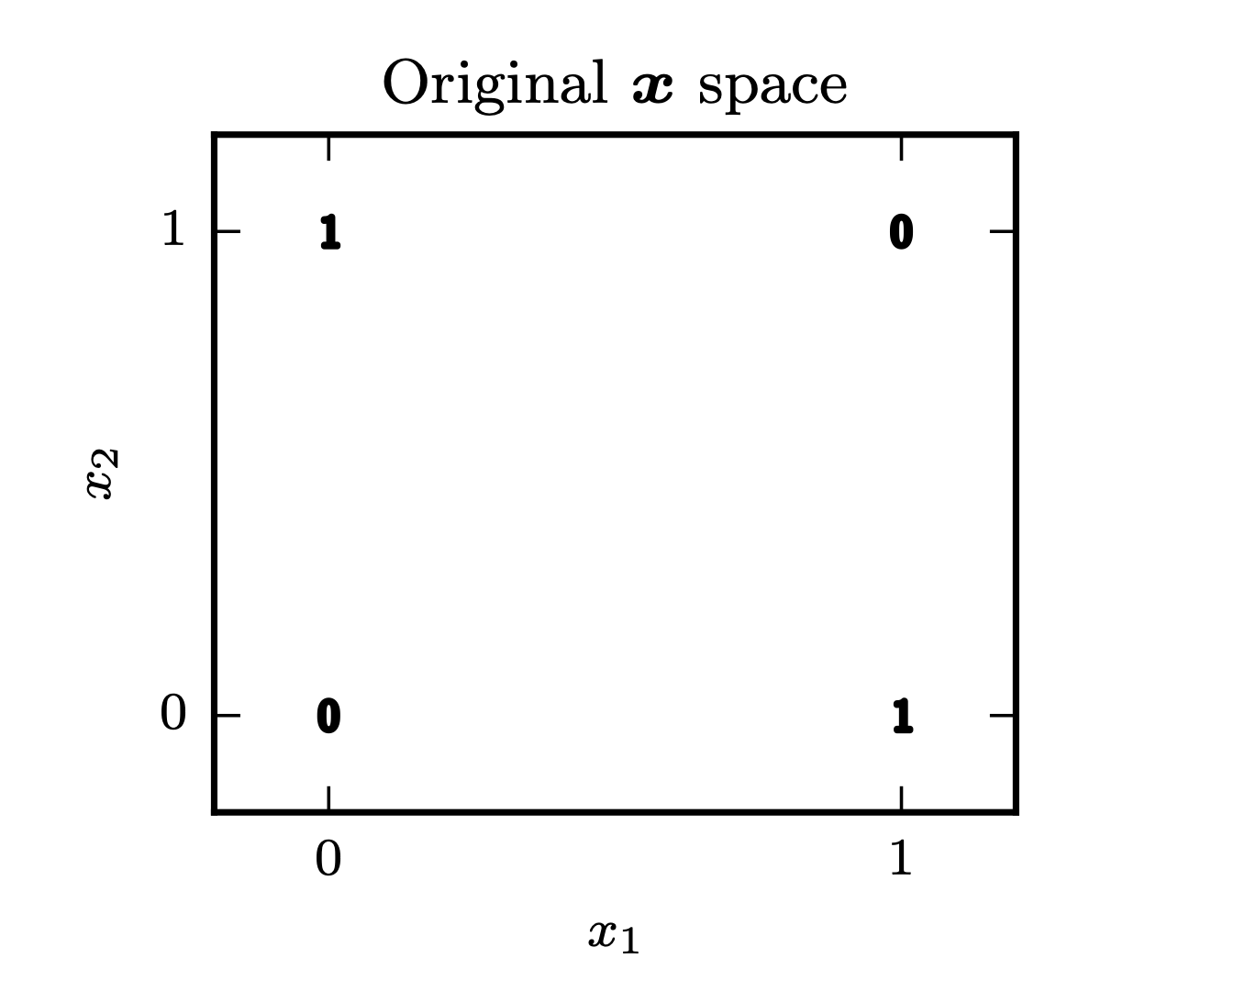
Example: XOR
The function $h(x_{1},x_{2})=(x_{1}\text{XOR}x_{2})$
is not linearly separable
    There is no way to draw a straight line with all of the 1's on one side and all of the 0's on the other
    This means that no linear model can represent XOR exactly; there will always be some errors
Question: What else could we do?
A 2D graph with 0 and 1 on the x axis and 0 and 1 on the y axis, representing XOR: at the 0,0 and 1,1 corners, there is a 0; at the 1,0 and 0.1 corners, there is a 1. A vertical line has both 0 and 1 on its left, and a 0 and 1 on its right; a diagonal line has a single 1 above it, and both 0s and a 1 below it.
(Image: Goodfellow 2017)

Slide 8
Nonlinear Features
$h(x;w)=g(w^{⊤}x)=g\left(\sum_{j=1}^{d}{w_{j}}x_{j}\right)$
One option: Learn a linear model on richer inputs
  Define a feature mapping $ϕ(x)$ that returns functions of the original inputs
  Learn a linear model of the features instead of the inputs
  $h(x;w)=g(w^{⊤}ϕ(x))=g\left(\sum_{j=1}^{d}{w_{j}}[ϕ(x)]_{j}\right)$

Slide 9
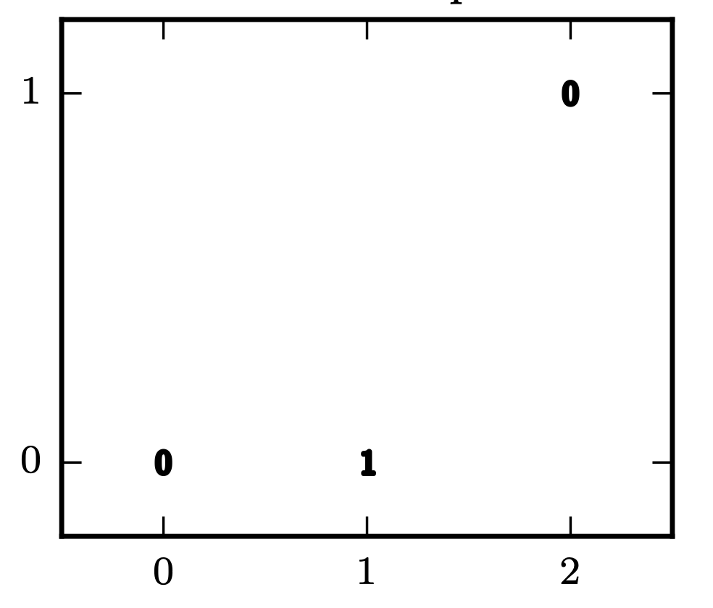
Nonlinear Features for XOR
Question:
What additional features would help?
The product of $x_{1}$ and $x_{2}$!
    $$ϕ(x_{1},x_{2})=[1,x_{1},x_{2},x_{1}x_{2}]^{⊤}$$
    $$w=[-0.2,0.5,0.5,-2]^{⊤}$$
$h(x;w)=w^{⊤}ϕ(x)>0$ for $(0,1)$ and $(1,0)$
$h(x;w)=w^{⊤}ϕ(x)<0$ for $(1,1)$ and $(0,0)$
A 2D graph with 0 and 1 on the x axis and 0 and 1 on the y axis, representing XOR: at the 0,0 and 1,1 corners, there is a 0; at the 1,0 and 0.1 corners, there is a 1.
x1 × x2
x1 + x2
A 2D graph with 0,1,and 2 on the x axis, labelled x1+x2; and 0 and 1 on the y axis labelled x1 * x2. At the 0,0 and 1,2 corners, there is a 0; at the 1,0 position, there is a 1. A diagonal line has the 1 below it and both zeroes above it.
(Image: Goodfellow 2017)

Slide 10
Learning Nonlinear Features
Manually constructing good features is hard
Manually constructed features are not transferrable between domains
    e.g., SIFT features were a revolution in computer vision, but are only for computer vision
Deep learning aims to learn $ϕ$ automatically from the data
Notes:
\

Slide 11
Neural Units
Deep learning learns $ϕ$ by composing little functions
These function are called units
Question: How is this different from a generalized linear model?
b
$$h(x;w,b)=g(b+w^{⊤}x)=g\left(b+\overset{d}{\underset{j=1}{∑}}w_{j}x_{j}\right)$$
x1
$$w_{1}$$
h
x2
offset
$$w_{2}$$
activation
function
weights
A single neuron labelled h, with two incoming arrows from inputs x1 and x2 with the edges labelled w1 and w2 respectively. There is a b above the neuron, and a single outgoing arrow.

Slide 12
Feedforward Neural Network
A neural network is many units composed together
Feedforward neural network: Units arranged into layers
    Each layer takes outputs of previous layer as its inputs
$$h_{1}=g\left(w_{1,1}^{(1)}x_{1}+w_{1,2}^{(1)}x_{2}+b_{1}^{(1)}\right)$$
$$w_{1,1}^{(1)}$$
x1
h1
$$w_{1}^{(2)}$$
$$w_{2,1}^{(1)}$$
y
$$y=g\left(w_{1}^{(2)}h_{1}+w_{2}^{(2)}h_{2}+b^{(2)}\right)$$
$$w_{1,2}^{(1)}$$
$$w_{2}^{(2)}$$
x2
$$w_{2,2}^{(1)}$$
h2
$$h_{2}=g\left(w_{2,1}^{(1)}x_{1}+w_{2,2}^{(1)}x_{2}+b_{2}^{(1)}\right)$$
A graph representing a feedforward neural network. There are two nodes labelled x1 and x2, two additional nodes labelled h1 and h2, and a final node labelled y. h1 has incoming edges from both of x1 and x2, labelled $w_{1,1}^{(1)}$and $w_{2,1}^{(1)}$respectively. h2 has incoming edges from both of x1 and x2, labelled $w_{1,2}^{(1)}$and $w_{2,2}^{(1)}$ respectively. y has incoming edges from both of h1 and h2, labelled $w_{1}^{(2)}$ and $w_{2}^{(2)}$ respectively.

Slide 13
$$w_{1,1}^{(1)}$$
x1
h1
$$w_{1}^{(2)}$$
$$w_{2,1}^{(1)}$$
yp
$$w_{1,2}^{(1)}$$
$$w_{2}^{(2)}$$
x2
$$w_{2,2}^{(1)}$$
h2
y
$$w_{1,1}^{(1)}$$
L
x1
h1
$$w_{1}^{(2)}$$
$$w_{2,1}^{(1)}$$
yp
$$w_{1,2}^{(1)}$$
$$w_{2}^{(2)}$$
x2
$$w_{2,2}^{(1)}$$
h2

Slide 14
Example: XOR network
+1
x1
h1
+1
-1
y
-1
x2
h2
+1
+1
A graph representing a feedforward neural network. There are two nodes labelled x1 and x2, two additional nodes labelled h1 and h2, and a final node labelled y. h1 has an incoming edge from x1 labeled +1 and an incoming edge from x2 labeled -1. h2 has an incoming edge from x1 labeled -1 and an incoming edge from x2 labeled +1. y has incoming edges from h1 and h2, both labeled +1.
Activation: $g(z)=max\{0,z\}$ ("rectified linear unit")
Offsets: $0$
Weights:
    $[+1,-1]$ for $h_{1}$; $[-1,+1]$ for $h_{2}$
    $[+1,+1]$ for $y$
Question:
When does $h_{1}=1$?

Slide 15
Matrix Representation of Layers
You can think of the outputs of each layer as a vector $h$
The weights from all the outputs of a previous layer to each of the units of the layer can be collected into a matrix $W∈R^{k×d}$
The offset term for each unit can be collected into a vector $b∈R^{k}$:
$h=g\left(Wx+b\right)$
x
h
y
A graph representing a feedforward network. One node is labelled $x$, one is labelled $h$, and one is labelled $y$. There is an edge from $x$ to $h$, and an edge from $h$ to $y$.
x1
h1
# hidden units
# inputs
y
x2
h2
A graph representing a feedforward neural network. There are two nodes labelled x1 and x2, two additional nodes labelled h1 and h2, and a final node labelled y. h1 has an incoming edge from x1 and an incoming edge from x2. h2 has an incoming edge from x1 and an incoming edge from x2. y has incoming edges from h1 and h2.

Slide 16
Architecture
h1
x1
y
h2
x2
A graph representing a feedforward neural network. There are two nodes labelled x1 and x2, two additional nodes labelled h1 and h2, and a final node labelled y. h1 has an incoming edge from x1 and an incoming edge from x2. h2 has an incoming edge from x1 and an incoming edge from x2. y has incoming edges from h1 and h2.
Design decisions:
Depth: number of layers
Width: number of nodes in each layer
Fully connected?

Slide 17
Universal Approximation Theorem
Theorem: (Hornik et al. 1989; Cybenko 1989; Leshno et al. 1993)
A feedforward network with one hidden layer with a "squashing" activation or rectified linear activation and a linear output layer can approximate any function to within any given error bound, given enough hidden units.
So a wide but shallow feedforward network can represent any function we're trying to learn!
Question: Why bother with multiple layers? (i.e., depth > 1)

Slide 18
Training
A neural network is a function $f(x;W^{(1)},b^{(1)},…,W^{(L)},b^{(L)})$ that maps from input features to target features
    The function is identified by the parameters $W^{(1)},b^{(1)},…,W^{(L)},b^{(L)}$
    We train a neural network by setting these parameters
Neural networks are trained using variants of gradient descent
    e.g., stochastic gradient descent
Back propagation is an algorithm that allows for efficient computation of the gradient
Modern frameworks can compute the gradient in other ways (e.g., automatic differentiation) even for complicated units

Slide 19
Neural Network Parameters
x1
h1
$y=h(x;θ)$
y
x2
h2
A neural network is just a supervised model
    It is a function that takes inputs $x$, and computes an output $y$ based on parameters $θ$
    Question: What is $θ$ in a feedforward neural network?

Slide 20
Training Neural Networks
Specify a loss $L$ and a set of training examples:
$S=(x^{(1)},y^{(1)}),...,(x^{(n)},y^{(n)})$
Training by gradient descent:
    Compute loss on training data: $L(W,b)=\overset{n}{\underset{i=1}{∑}}ℓ\left(h(x^{(i)};W,b),y^{(i)}\right)$
    Compute gradient of loss: $∇L(W,b)$
    Update parameters to make loss smaller:
    $\left[\begin{aligned}W^{new} \\ b^{new}\end{aligned}\right]=\left[\begin{aligned}W^{old} \\ b^{old}\end{aligned}\right]-η∇L(W^{old},b^{old})$
Loss function
(e.g., squared error)
Prediction
Target
(Subsequent lecture)

Slide 21
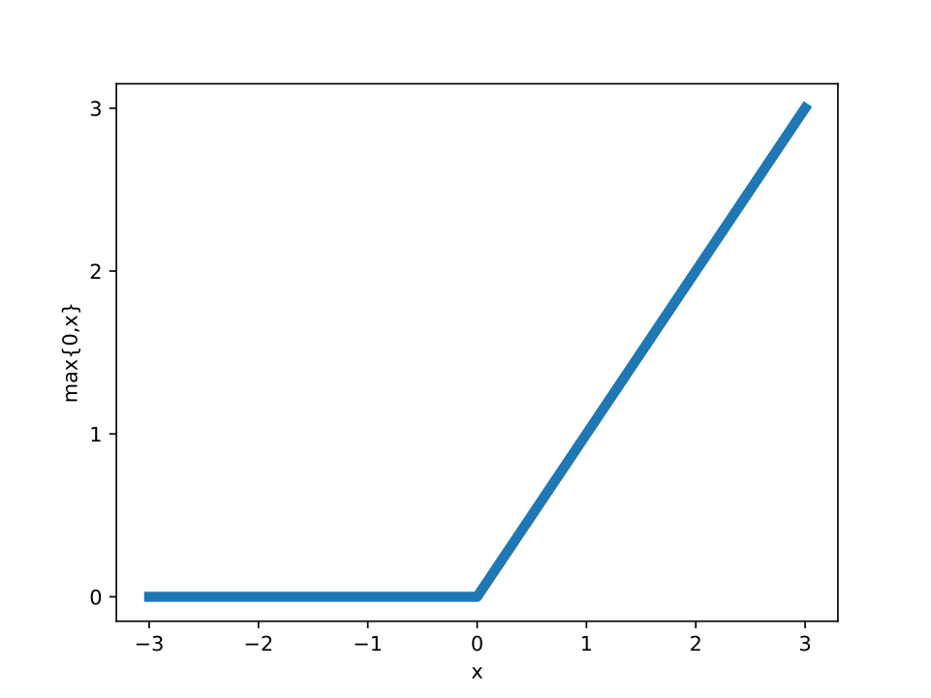
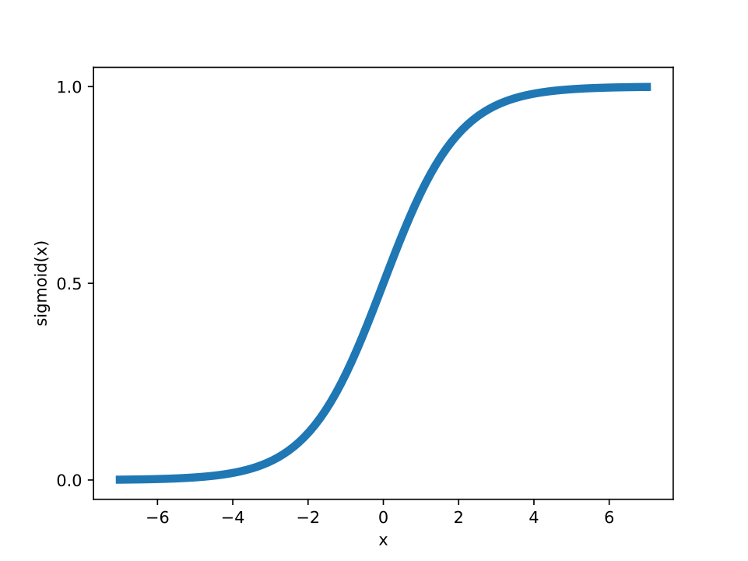
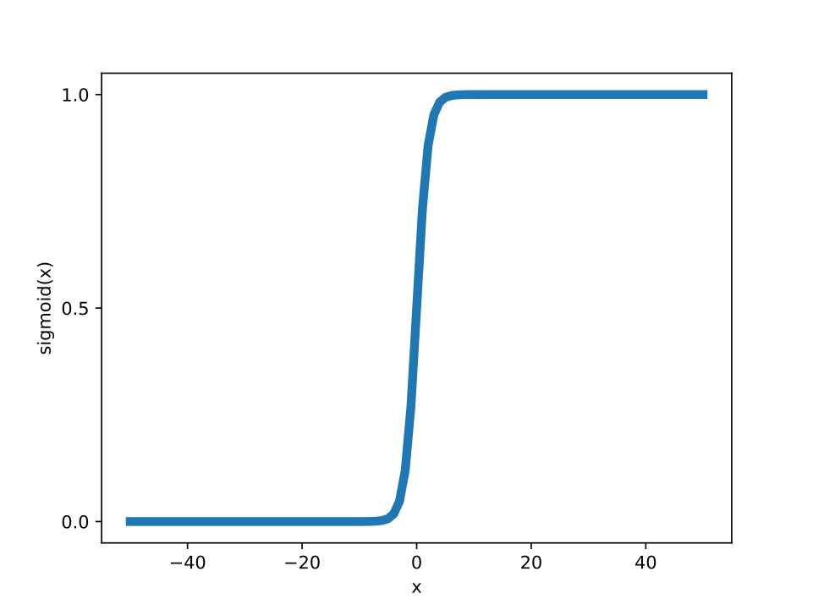
Hidden Unit Activations
Default choice: Rectified linear units (ReLU)
$g(z)=max\{0,z\}$
Other common types:
    $$tanh(z)$$
    $\frac{1}{1+e^{-z}}$ (sigmoid)
Sigmoid suffers from vanishing gradients; ReLU does not
A graph representing the linear rectified unit activation function. Left of 0, the function is flat at 0; right of 0, the function is a straight 45-degree diagonal line.
The graph for the sigmoid function; the x-axis plots t from -5 to 5, and the y-axis plots the sigmoid function with a range within 0 to 1.

Slide 22
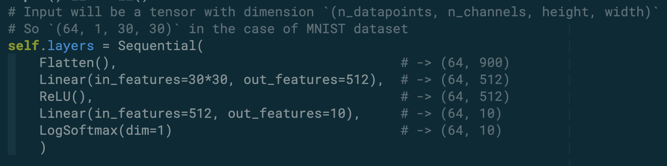
Torch: Representating Layers
Torch thinks about operations rather than units
    We've been thinking about a unit as "weighted sum and then activation"
    Torch specifies the weighting (Linear) and then the activation (ReLU) separately
    This is especially handy for output layers, where you often want to normalize by the sum of all the outputs (e.g., LogSoftmax)

Slide 23
Output Units

Slide 24
Summary
Generalized linear models are insufficiently expressive for many applications
Composing GLMs into a network is arbitrarily expressive
    A neural network with a single hidden layer can approximate any function
    But the network might need to be impractically large, prone to overfitting, or inefficient to train
Neural networks are trained using variants of gradient descent
Architectural choices can make a network easier to train, less prone to overfitting

