Slide 1
Linear Models
  CMPUT 261: Introduction to Artificial Intelligence
  P&M §7.3

Slide 2
Title
Definition:
A function $f$ is a linear function of $x$ if it can be written as $f(x)=w_{0}+w_{1}x$
example text here
  likelihood
  prior
Questions:
If $f$ can be literally any function, then what is the solution?
  Is that desirable?
What could we do instead?
Why are we squaring the difference?
(Image: Goodfellow 2016)

Slide 3
Assignment #2
Assignment #2 is due Tue Oct 21/2025 (one week from today) at 11:59pm
    Submissions past the deadline will have late penalty applied
    Leave yourself some margin for error when submitting!
  Midterm is October 23/2025

Slide 4
Recap: Supervised Learning
Definition: A supervised learning task consists of
  A set of input features $X_{1},…,X_{n}$
  A set of target features $Y_{1},…,Y_{k}$
  A set of training examples, for which both input and target features are given
  A set of test examples, for which only the input features are given
  The goal is to predict the values of the target features given the input features;
  i.e., learn a function $h(x)$ that will map features $X$ to a prediction of $Y$
  We want to predict new, unseen data well; this is called generalization
  Can estimate generalization performance by reserving separate test examples

Slide 5
Recap: Loss Functions
A loss function gives a quantitative measure of a hypothesis's performance
There are many commonly-used loss functions, each with its own properties
Loss | Definition
0/1 error
absolute error
squared error
worst case
likelihood
log-likelihood
$$\overset{n}{\underset{i=1}{∑}}1\left[y^{(i)}≠h(x^{(i)})\right]$$
$$\sum_{i=1}^{n}{\left|y^{(i)}-h(x^{(i)})\right|}$$
$$\sum_{i=1}^{n}{{\left(y^{(i)}-h(x^{(i)})\right)}^{2}}$$
$$\max_{1≤i≤n}\left|y^{(i)}-h(x^{(i)})\right|$$
$$Pr(S∣h)=\underset{(x,y)∈S}{∏}h(x)_{y}$$
$$logPr(S∣h)=\underset{(x,y)∈S}{∑}logh(x)_{y}$$

Slide 6
Recap: Loss Functions
A loss function gives a quantitative measure of a hypothesis's performance
There are many commonly-used loss functions, each with its own properties
Loss | Definition
0/1 error
absolute error
squared error
worst case
likelihood
log-likelihood
$$\overset{n}{\underset{i=1}{∑}}1\left[y^{(i)}≠h(x^{(i)})\right]$$
$$\sum_{i=1}^{n}{\left|y^{(i)}-h(x^{(i)})\right|}$$
$$\sum_{i=1}^{n}{{\left(y^{(i)}-h(x^{(i)})\right)}^{2}}$$
$$\max_{1≤i≤n}\left|y^{(i)}-h(x^{(i)})\right|$$
$$Pr(S∣h)=\underset{(x,y)∈S}{∏}h(x)_{y}$$
$$logPr(S∣h)=\underset{(x,y)∈S}{∑}logh(x)_{y}$$

Slide 7
Recap: Optimal Trivial Predictors
for Binary Data
Suppose we are predicting a binary target
$n_{0}$ negative examples
$n_{1}$ positive examples
Question: What is the optimal single prediction?
Measure | Optimal Prediction
0/1 error | 0 if n0 > n1 else 1
absolute error | 0 if n0 > n1 else 1
squared error
worst case
likelihood
log-likelihood
$$\frac{n_{1}}{n_{0}+n_{1}}$$
$$\{\begin{matrix}0 & \text{if}n_{1}=0 \\ 1 & \text{if}n_{0}=0 \\ 0.5 & \text{otherwise}\end{matrix}$$
$$\frac{n_{1}}{n_{0}+n_{1}}$$
$$\frac{n_{1}}{n_{0}+n_{1}}$$
Notes:
relationship to marginal distribution? meh

Slide 8
Probabilistic Predictors
Rather than predicting exactly what a target value will be, many common algorithms predict a probability distribution over possible values
    Especially for classification tasks
Vectors of indicator variables are the most common data representation for this scheme:
    Target features of training examples have a single 1 for the true value
    Predicted target values are probabilities that sum to 1
Notes:
24W: Start from here

Slide 9
Probabilistic Predictions Example
Training examples
Output on test example
X | Ycat | Ydog | Ypanda
 | 1 | 0 | 0
 | 0 | 1 | 0
X | h(X)cat | h(X)dog | h(X)panda
 | 0.5 | 0.45 | 0.05

Slide 10
Likelihood
For probabilistic predictions, we can use likelihood to measure the performance of a learning algorithm
Definition:
The likelihood for a dataset $S$ of examples and hypothesis $h$ is the probability of independently observing the examples according to the probabilities assigned by the hypothesis:
$$Pr(S∣h)=\underset{(x,y)∈S}{∏}h(x)_{y}$$
This has a clear Bayesian interpretation
We want to maximize likelihood, so it's not a loss (why?)
    Question: What is the corresponding loss?
Numerical stability issues: product of probabilities shrinks exponentially!
    Example: Probability of any sequence of 5000 coin tosses has probability $2^{-5000}$!
    Floating point underflows almost immediately
    (double-precision floating point can't represent anything smaller than $2^{-1021}$)

Slide 11
Log-Likelihood
Definition:
The log-likelihood for a dataset $S$ of examples and hypothesis $h$ is the log-probability of independently observing the examples according to the probabilities assigned by the hypothesis:
$\begin{matrix}logPr(S∣h) & =log\underset{(x,y)∈S}{∏}h(x)_{y} \\ & =\underset{(x,y)∈S}{∑}logh(x)_{y}\end{matrix}$
Taking log of the likelihood fixes the underflow issue (why?)
The log function grows monotonically, so maximizing log-likelihood is the same thing as maximizing likelihood:
$$\left(Pr(S|h_{1})>Pr(S|h_{2})\right)⟺\left(logPr(S|h_{1})>logPr(S|h_{2})\right)$$
Notes:
A: sum of logs shrinks much more slowly than product of probabilities

Slide 12
Lecture Outline
Recap & Logistics
Trivial Predictors
Linear Regression
Linear Classification
After this lecture, you should be able to:
specify and/or implement linear regression, linear classification, logistic regression
explain the benefits of different approaches to learning linear models

Slide 13
Trivial Predictors
The simplest possible predictor ignores all input features and just predicts the same value $v$ for any example
Question: Why would we every want to think about these?

Slide 14
Optimal Trivial Predictors
for Binary Data
Suppose we are predicting a binary target
$n_{0}$ negative examples
$n_{1}$ positive examples
Question: What is the optimal single prediction?
Measure | Optimal Prediction
0/1 error | 0 if n0 > n1 else 1
absolute error | 0 if n0 > n1 else 1
squared error
worst case
likelihood
log-likelihood
$$\frac{n_{1}}{n_{0}+n_{1}}$$
$$\{\begin{matrix}0 & \text{if}n_{1}=0 \\ 1 & \text{if}n_{0}=0 \\ 0.5 & \text{otherwise}\end{matrix}$$
$$\frac{n_{1}}{n_{0}+n_{1}}$$
$$\frac{n_{1}}{n_{0}+n_{1}}$$

Slide 15
Optimal Trivial Predictor Derivations
0/1 error | 0 if n0 > n1 else 1
$$L(v)=vn_{0}+(1-v)n_{1}$$
(negative) log-likelihood
$$\begin{matrix}L(v) & =-logPr(S∣v) \\ & =-n_{1}logv-n_{0}log(1-v) \\ \frac{d}{dv}L(v) & =0 \\ 0 & =-\frac{n_{1}}{v}+\frac{n_{0}}{1-v} \\ \frac{n_{1}}{v} & =\frac{n_{0}}{1-v} \\ \frac{n_{1}}{n_{0}} & =\frac{v}{1-v}\end{matrix}$$
$$\frac{n_{1}}{n_{0}+n_{1}}$$
$$\frac{d}{dz}logz=\frac{1}{z}$$
$$\frac{d}{dz}log(1-z)=-\frac{1}{1-z}$$
$$∧(0<v<1)⟹v=\frac{n_{1}}{n_{0}+n_{1}}$$

Slide 16
Linear Regression
Linear regression is the problem of fitting a linear function to a set of training examples
    Both input and target features must be numeric
Linear function of the input features:
$$\begin{matrix}h(x;w) & =w_{0}+w_{1}x_{1}+…+w_{d}x_{d} \\ & =\overset{d}{\underset{j=0}{∑}}w_{j}x_{j}\end{matrix}$$
For convenience, we often add a special
"constant feature" $x_{0}=1$ for all examples

Slide 17
Ordinary Least-Squares
For the squared error loss, it is possible to find the optimal predictor for a dataset analytically:
  $$L(w)=\overset{n}{\underset{i=1}{∑}}{\left(y^{(i)}-h(x^{(i)};w^{(i)})\right)}^{2}=\overset{n}{\underset{i=1}{∑}}{\left(y^{(i)}-\overset{d}{\underset{j=0}{∑}}w_{j}^{(i)}x_{j}^{(i)}\right)}^{2}$$
  Recall that $∇L(w^{*})=0$ for $w^{*}∈arg\min_{w∈R^{d+1}}L(w)$
  Derive an expression for $∇L(w^{*})$ and solve for 0
    For $d$ input features, solve a system of $d+1$ equations
    Requires inverting a $(d+1)×(d+1)$ matrix $O(d^{3})$
    Constructing the matrix requires adding $n$ matrices (one for each example) $O(nd^{2})$
    Total cost: $O(nd^{2}+d^{3})$

Slide 18
Gradient Descent
The analytic solution is tractable for small datasets with few input features
    ImageNet has about 14 million images with $256×256=65,536$ input features
For others, we use gradient descent
    Gradient descent is an iterative method to find the minimum of a function.
    For minimizing error:
    $$w_{j}^{(t+1)}←w_{j}^{(t)}-η\frac{∂}{∂w_{j}^{(t)}}error(S,w^{(t)})$$

Slide 19
Recap: Gradient Descent
The gradient of a function tells how to change every element of a vector to increase the function
    If the partial derivative of $x_{i}$ is positive, increase $x_{i}$
Gradient descent:
Iteratively choose new values of x in the (opposite) direction of the gradient:
$x^{new}=x^{old}-η∇f(x^{old})$ .
    This only works for sufficiently small changes (why?)
    Question: How much should we change $x^{old}$?
Small step in gradient direction decreases the function; too-large step moves past the minimum and actually increases the function
learning rate

Slide 20
Gradient Descent Variations
Incremental gradient descent: update each weight after each example in turn
$$∀1≤i≤n:w_{j}^{(t+1)}←w_{j}^{(t)}-η\frac{∂}{∂w_{j}^{(t)}}error\left(\{(x^{(i)},y^{(i)})\},w^{(t)}\right)$$
Batched gradient descent: update each weight based on a batch of examples
$$∀S_{i}:w_{j}^{(t+1)}←w_{j}^{(t)}-η\frac{∂}{∂w_{j}^{(t)}}error\left(S_{i},w^{(t)}\right)$$
Stochastic gradient descent: update repeatedly on random examples:
$$i∼U(\{1,…,n\}):w_{j}^{(t+1)}←w_{j}^{(t)}-η\frac{∂}{∂w_{j}^{(t)}}error\left(\{(x^{(i)},y^{(i)})\},w^{(t)}\right)$$
Question
Why would we ever use any of these?

Slide 21
Linear Classification
For binary targets, we can use linear regression to do classification
Represent binary classes by $\{-1,+1\}$
If regression target is negative, predict $-1$, else predict $+1$
$h(x;w)=sgn\left(\overset{d}{\underset{j=0}{∑}}w_{j}x_{j}\right)$
The line defined by $\overset{d}{\underset{j=0}{∑}}w_{j}x_{j}=0$ is called the decision boundary
$$w_{0}+w_{1}x_{1}+w_{2}x_{2}=0$$
$$x_{2}$$
A scatterplot with a group of green dots and one red star on the left of a diagonal line, and a group of red stars with a single green dot on right of the same line.
$$x_{1}$$
$sgn$ returns +1 for positive arguments and -1 for negative arguments

Slide 22
  Probabilistic Linear Classification
For binary targets represented by $\{0,1\}$ or numeric input features, we can use linear function to estimate the probability of the class
Issue: we need to constrain the output to lie within $[0,1]$
Instead of outputting results of the function directly, send it through an activation function $f:R→[0,1]$ instead:
$$h(x;w)=f\left(\overset{d}{\underset{j=0}{∑}}w_{j}x_{j}\right)$$

Slide 23
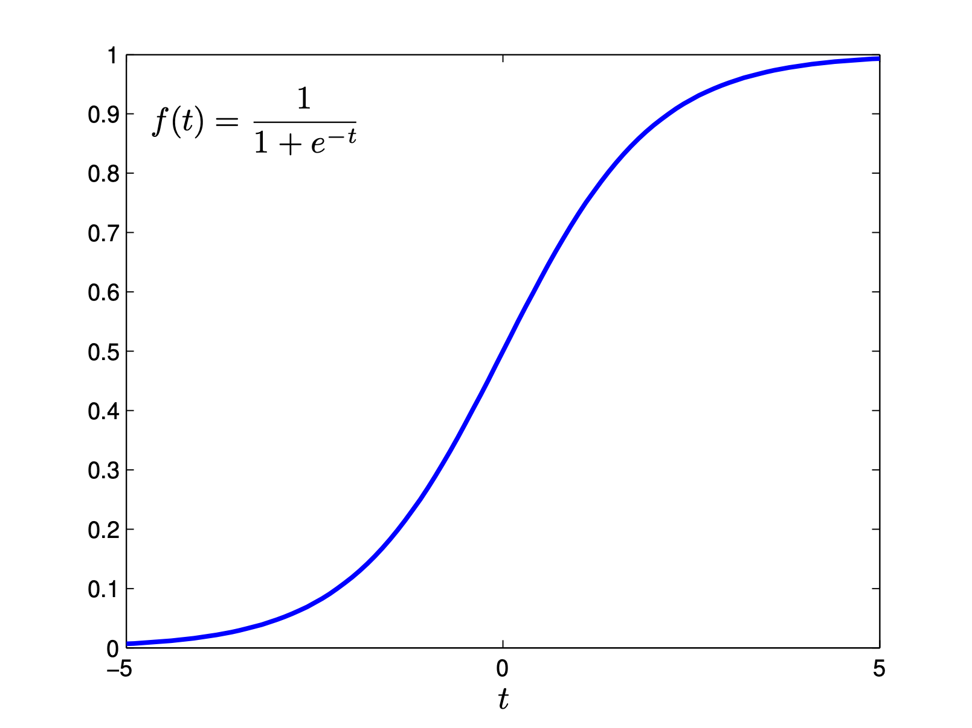
Logistic Regression
A very commonly used activation function is the logistic function:
$$s(t)=\frac{1}{1+e^{-t}}$$
Linear classification with a logistic activation function is often referred to as logistic regression:
$$h(x;w)=s\left(\overset{d}{\underset{j=0}{∑}}w_{j}x_{j}\right)$$
The graph for the sigmoid function; the x-axis plots t from -5 to 5, and the y-axis plots the sigmoid function with a range within 0 to 1.
Question: What is the decision boundary in logistic regression?

Slide 24
Non-Binary Target Features
What if the target feature has $k>2$ values?
  Use $k$ indicator variables
  Learn each indicator variable separately
  Normalize the predictions:
  $$h_{ℓ}(x;w)=\frac{exp\left(∑_{j=0}^{d}w_{ℓ,j}x_{j}\right)}{∑_{p=1}^{k}exp\left(∑_{j=0}^{d}w_{p,j}x_{j}\right)}$$

Slide 25
Decision Trees
Decision trees are a simple approach to classification
Definition:
A decision tree is a tree in which
    Every internal node is labelled with a condition
    (Boolean function of an example)
    Every internal node has two children, one labelled true and one labelled false
    Every leaf node is labelled with a point estimate on the target

Slide 26
Decision Trees Example
Long
Example | Author | Thread | Length | Where | Action
e1 | known | new | long | home | skips
e2 | unknown | new | short | work | reads
e3 | unknown | followup | long | work | skips
e4 | known | followup | long | home | skips
e5 | known | new | short | home | reads
e6 | known | followup | long | work | skips
e7 | unknown | followup | short | work | skips
e8 | unknown | new | short | work | reads
e9 | known | followup | long | home | skips
e10 | known | new | long | work | skips
e11 | unknown | followup | short | home | skips
e12 | known | new | long | work | skips
e13 | known | followup | short | home | reads
e14 | known | new | short | work | reads
e15 | known | new | short | home | reads
e16 | known | followup | short | work | reads
e17 | known | new | short | home | reads
e18 | unknown | new | short | work | reads
true
false
skips
New
true
false
Unknown
reads
true
false
skips
reads
Long
true
false
skips
reads with
probability 0.82

Slide 27
Building Decision Trees
How should an agent choose a decision tree?
  Bias: which decision trees are preferable to others?
  Search: How can we search the space of decision trees?
      Search space is prohibitively large
      Idea: Choose features to branch on one by one

Slide 28
Tree Construction Algorithm
learn_tree(Cs, Y, Es):
Input: conditions Cs; target feature Y; training examples Es
  if stopping condition is true:
  v := point_estimate(Y, Es)
  T(e) := v
  return T
  else:
  select condition c ∈ Cs
  true_examples := { e ∈ Es | c(e) }
  t1 := learn_tree(Cs \ {c}, Y, true_examples)
  false_examples := { e ∈ Es | ¬c(e) }
  t0 := learn_tree(Cs \ {c}, Y, false_examples)
  T(e) := if c(e) then t1(e) else t0(e)
  return T

Slide 29
Tree Construction Algorithm
learn_tree(Cs, Y, Es):
Input: conditions Cs; target feature Y; training examples Es
  if stopping condition is true:
  v := point_estimate(Y, Es)
  T(e) := v
  return T
  else:
  select condition c ∈ Cs
  true_examples := { e ∈ Es | c(e) }
  t1 := learn_tree(Cs \ {c}, Y, true_examples)
  false_examples := { e ∈ Es | ¬c(e) }
  t0 := learn_tree(Cs \ {c}, Y, false_examples)
  T(e) := if c(e) then t1 else t0
  return T
Unspecified

Slide 30
Stopping Criterion
Question: When must the algorithm stop?
    No more conditions
    No more examples
    All examples have the same label
Additional possible criteria:
    Minimum number of examples: Do not split a node with too few examples (why?)
    Minimum child size: Do not split a node if there would be too few examples in one of the children (why?)
    Improvement criteria: Do not split a node unless it improves some criterion sufficiently (why?)
    Maximum depth: Do not split if the depth reaches a maximum (why?)

Slide 31
Leaf Point Estimates
Question: What point estimate should go on the leaves?
    Modal target value
    Median target value (unless categorical)
    Mean target value (unless categorical or ordinal)
    Distribution over target values
Question: What point estimate optimally classifies the leaf's examples?

Slide 32
Split Conditions
Question: What should the set of conditions be?
    Boolean features can be used directly
    Partition domain into subsets
        E.g., thresholds for ordered features
    One branch for each domain element

Slide 33
Choosing Split Conditions
Question: Which condition should be chosen to split on?
Standard answer: myopically optimal condition
    If this was the only split, which condition would result in the best performance?

Slide 34
Summary
Linear regression is a simple model for predicting real quantities
Linear classification can be built from linear regression
    Based on sign of prediction ("discriminative"), or
    Using logistic regression ("probabilistic")
    For non-binary target features, can normalize probabilistic predictions for individual classes
Gradient descent is a general, widely-used training procedure (with several variants)
    Linear models can be optimized in closed form for certain losses
    In practice often optimized with gradient descent

