Slide 1
Branch & Bound
or, How I Learned to Stop Worrying and Love Depth First Search
  CMPUT 261: Introduction to Artificial Intelligence
  P&M §3.7-3.8

Slide 2
Logistics
Assignment #1 was released last week
    Available on Canvas
    Due: Thursday, September 25 at 11:59pm

Slide 3
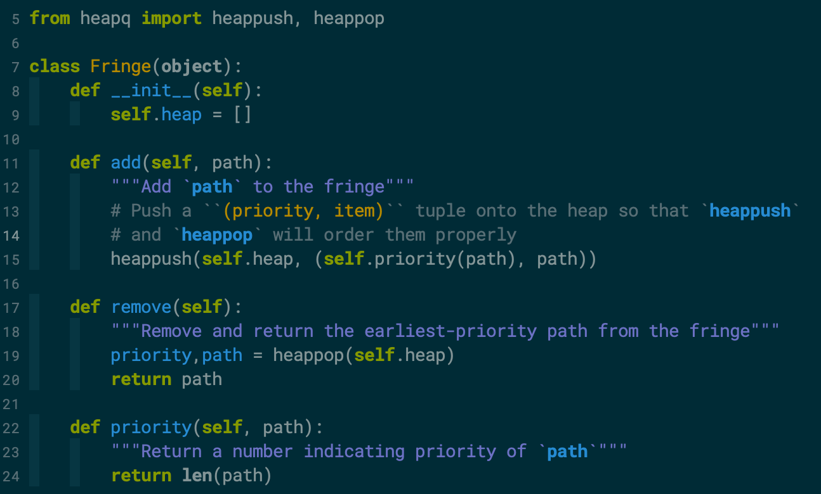
Example: Heaps in Python
Source: https://jrwright.info/introai/examples/fringe.py

Slide 4
Recap: Heuristics
Definition:
A heuristic function is a function $h(n)$ that returns a non-negative estimate of the cost of the cheapest path from node $n$ to some goal node.
    E.g., Euclidean distance instead of travelled distance
Definition:
A heuristic function is admissible if $h(n)$ is always less than or equal to the actual cost of the cheapest path from $n$ to any goal node.
    i.e., $h(n)$ is a lower bound on $\text{cost}(⟨n,…,g⟩)$ for any goal node $g$

Slide 5
Recap: A* Search
A* search uses both path cost information and heuristic information to select paths from the frontier
Let $f(p)=\text{cost}(p)+h(p)$
  $f(p)$ estimates the total cost to the nearest goal node starting from $p$
A* removes paths from the frontier with smallest $f(p)$
$$\underset{\text{f(p)}}{\underset{⏟}{\underset{\text{cost(p)}}{\underset{⏟}{\text{start}\overset{\text{actual}}{→}}}n\underset{\text{h(n)}}{\underset{⏟}{\overset{\text{estimated}}{→}\text{goal}}}}}$$

Slide 6
Recap: A* Search Algorithm
Input: a graph; a set of start nodes; a $goal$ function
    $frontier:=\{⟨s⟩∣s\text{is a start node}\}$
    while $frontier$ is not empty:
    select $f$-minimizing path $⟨n_{0},…,n_{k}⟩$ from frontier
    remove $⟨n_{0},…,n_{k}⟩$ from $frontier$
    if $goal(n_{k})$:
    return $⟨n_{0},…,n_{k}⟩$
    for each neighbour $n$ of $n_{k}$:
    add $⟨n_{0},…,n_{k},n⟩$ to frontier
    end while
i.e., $f(⟨n_{0},…,n_{k}⟩)≤f(p)$
for all other paths $p∈frontier$

Slide 7
Recap: A* is Optimal
  Theorem:
  If there is a solution of finite cost, A* using heuristic function $h$ always returns an optimal solution (in finite time), if
  The branching factor is finite, and
  All arc costs are greater than some $ϵ>0$, and
  $h$ is an admissible heuristic.
  Proof:
  No suboptimal solution will be removed from the frontier whenever the frontier contains a prefix of the optimal solution
  The optimal solution is guaranteed to be removed from the frontier eventually

Slide 8
Summary of Last Lecture
Domain knowledge can help speed up graph search
Domain knowledge can be expressed by a heuristic function, which estimates the cost of a path to the goal from a node
Admissible heuristics can be built from relaxations of the original problem
Simple uses of heuristics do not guarantee improved performance
A* algorithm for use of admissible heuristics with guarantees

Slide 9
Lecture Outline
Recap & Logistics
Optimal Heuristic Usage
Branch & Bound
Cycle Pruning
Exploiting Search Direction
After this lecture, you should be able to:
Construct an admissible heuristic for an arbitrary search problem
Define heuristic consistency, identify whether a heuristic is consistent
Implement cycle pruning
Explain when cycle pruning is and is not space- and time-efficient
Implement branch & bound and IDA* and demonstrate their operation
Derive the space and time complexity for branch & bound and IDA*
Predict whether forward, backward, or bidirectional search are more efficient for a search problem

Slide 10
Consistent Heuristic
Definition:
A heuristic $h$ is consistent if, for every pair of nodes $n,n^{′}∈N$,
$h(n^{′})≤cost(n,n^{′})+h(n)$.
That is, a heuristic never decides that things are "harder than it thought" along a given path
Question: is $h$ consistent on the graph below?
Question: is $h$ admissible on the graph below?
3
2
5
a
b
c
z
2
1
5
0
A path from a to b to c to z.
The path from a to b costs 3, from b to c costs 2, from c to z costs 5.
The heuristic values are 2 at a, 1 at b, 5 at c, and 0 at z.

Slide 11
Heuristic Usage of A*
Definition:
Let $p^{*}$ be an optimal solution.
A path $p$ is surely removed by A* if $f(p)<f(p^{*})$.
Theorem:
Any path that is surely removed by A* using a consistent heuristic $h$ will also be removed from the frontier by any other optimal graph search algorithm using $h$.
I.e., there is no way to use a given consistent heuristic that is guaranteed to find an optimal solution faster than A*, "up to tie-breaking"

Slide 12
Space Complexity of A*
A* makes use of heuristic information to improve time complexity
    Focuses on parts of the search graph that are likely to contain solution
Explores paths in order of $f$-value
    Frontier might need to contain all paths of the same cost as the solution at some point
Using heuristic to change the order that depth-first-search puts paths go into the frontier doesn't reliably improve its time complexity
    In general, DFS with heuristic-ordering will expand more paths than A* with same heuristic
    Can we use a heuristic in some other way to improve DFS's time complexity without giving up its good space complexity?

Slide 13
Branch & Bound
The $f(p)$ function provides a path-specific lower bound on solution cost starting from $p$
Idea: Maintain a global upper bound on solution cost also
    Then prune any path whose lower bound exceeds the upper bound
Question: Where does the upper bound come from?
    Cheapest solution found so far
    Before solutions found, specified on entry

Slide 14
Branch & Bound Algorithm
Input: a graph; a set of start nodes; a $goal$ function; heuristic $h(n)$; $bound_{0}$
      $frontier:=\{⟨s⟩∣s\text{is a start node}\}$
      $bound:=bound_{0}$
      $best:=Ø$
      while $frontier$ is not empty:
      select the newest path $⟨n_{0},…,n_{k}⟩$ from $frontier$
      remove $⟨n_{0},…,n_{k}⟩$ from $frontier$
      if $f(⟨n_{0},…,n_{k}⟩)≤bound:$
      if $goal(n_{k})$:
      $bound:=cost(⟨n_{0},…,n_{k}⟩)$
      $best:=⟨n_{0},…,n_{k}⟩$
      else:
      for each neighbour $n$ of $n_{k}$:
      add $⟨n_{0},…,n_{k},n⟩$ to $frontier$
      end while
      return $best$
Question: Why $cost$ instead of $f$ here?

Slide 15
Choosing $bound_{0}$
If $bound_{0}$ is set to just above the optimal cost, branch & bound will explore no more paths than A*
    Won't explore any paths $p^{′}$ that are more costly than the optimal solution, because $f(p^{′})>bound_{0}$
    Will eventually find the optimal solution path $p^{*}$ because $f(p^{*})<bound_{0}$
But we don't (in general) know the cost of the optimal solution!
One possibility: Initialize $bound_{0}=∞$
    What problems could this have?
Solution: iteratively increase $bound_{0}$ (like with IDS)
    This algorithm is sometimes called IDA*
    Some lower-cost paths will be re-explored
        Initialize $bound_{0}$
        until solution found:
            Perform branch & bound using $bound_{0}$
              Increase $bound_{0}$

Slide 16
Iterative Deepening A* (IDA*)
What should we initialize $bound_{0}$ to?
How much should we increase $bound_{0}$ by at each step?
    One idea:
    Iteratively increase bound to the lowest $f$-value path that was pruned
        Guarantees at least one more path will be explored
        Can stop immediately after finding a solution (why?)
        Time complexity can be much worse than A*:
        $O(b^{2m})$ instead of $O(b^{m})$ (why?)
    Need to increase $bound_{0}$ by enough (else won't explore enough),
    but not too much (else won't prune enough)
    Choosing next $f$-limit is an active area of research
    (see https://www.movingai.com/SAS/IDA/)
        Initialize $bound_{0}$
        until solution found:
            Perform branch & bound using $bound_{0}$
              Increase $bound_{0}$

Slide 17
10
s
$$8$$
$$9$$
7
4
a
x
$$7$$
$$7$$
$$9$$
$$4$$
12
b
c
0
12
y
z
0
Notes:
I don't remember what this figure was for!

Slide 18
 | Heuristic Depth First | A* | Branch & Bound | IDA*
Space complexity | O(mb) | O(b^{m}) | O(mb) | O(mb)
Time Complexity | O(b^{m}) | O(b^{m}) | O(b^{m}) | (depends on how bound increases)
Heuristic Usage | Limited | Optimal (up to tie-breaking, for consistent h) | Optimal (if bound low enough) | Close to Optimal
Optimal? | No | Yes | Yes (if bound high enough) | Yes

Slide 19
Cycle Pruning
Questions:
Is depth-first search on with cycle pruning complete for finite graphs?
What is the time complexity for cycle checking in depth-first search?
What is the time complexity for cycle checking in breadth-first search?
Even on finite graphs, depth-first search may not be complete, because it can get trapped in a cycle.
A search algorithm can prune any path that ends in a node already on the path without missing an optimal solution
(Why?)

Slide 20
Cycle Pruning
Depth First Search
Input: a graph; a set of start nodes; a $goal$ function
    $frontier:=\{⟨s⟩∣s\text{is a start node}\}$
    while $frontier$ is not empty:
    select the newest path $⟨n_{0},…,n_{k}⟩$ from $frontier$
    remove $⟨n_{0},…,n_{k}⟩$ from $frontier$
    if $n_{k}≠n_{j}$ for all $0≤j<k$:
    if $goal(n_{k})$:
    return $⟨n_{0},…,n_{k}⟩$
    for each neighbour $n$ of $n_{k}$:
    add $⟨n_{0},…,n_{k},n⟩$ to $frontier$
    end while

Slide 21
Exploiting Search Direction
When we care about finding the path to a known goal node, we can search forward, but we can often search backward
Given a search graph $G=(N,A)$, known goal node $g$, and set of start nodes $S$, can construct a reverse search problem $G=(N,A^{r})$:
    Designate $g$ as the start node
    $$A^{r}=\left\{⟨n_{2},n_{1}⟩∣⟨n_{1},n_{2}⟩∈A\right\}$$
    $goal^{r}(n)=1$ if $n∈S$
    (i.e., if $n$ is a start node of the original problem)
Questions:
When is this useful?
When is this infeasible?

Slide 22
Reverse Search
Definitions:
Forward branch factor: Maximum number of outgoing neighbours
Notation: $b$
    Time complexity of forward search: $O(b^{m})$
Reverse branch factor: Maximum number of incoming neighbours
Notation: $r$
    Time complexity of reverse search: $O(r^{m})$
When the reverse branch factor is smaller than the forward branch factor, reverse search is more time-efficient.
A blue node with three outgoing edges
A blue node with two incoming edges

Slide 23
Bidirectional Search
Idea: Search backward from from goal and forward from start simultaneously
Time complexity is exponential in path length, so exploring half the path length is an exponential improvement
    Even though must explore half the path length twice
Main problems:
    Guaranteeing that the frontiers meet
    Checking that the frontiers have met
Questions:
What bidirectional combinations of search algorithm make sense?
    Breadth first + Breadth first?
    Depth first +
    Depth first?
    Breadth first +
    Depth first?

Slide 24
Summary
A* uses consistent heuristics optimally ("up to tie breaking")
Branch & bound combines the optimality guarantee and heuristic efficiency of A* with the space efficiency of depth-first search
IDA* is an iterative-deepening version of branch & bound that doesn't require that you get the initial bound "right"
    But its time complexity can be significantly worse
Tweaking the direction of search can yield efficiency gains

