Slide 1
Function Approximation & Policy Gradient Methods
  CMPUT 261: Introduction to Artificial Intelligence
  S&B §9.0-9.5.4, 13.0-13.3

Slide 2
Lecture Outline
After this lecture, you should be able to:
explain why function approximation is useful
define tile coding
explain the difference between action-value and policy gradient methods for control
state the Policy Gradient Theorem and explain why it is important
trace an execution of the REINFORCE algorithm
Recap & Logistics
Parameterized Value Functions
Gradient Descent
Approximation Schemes
Parameterized Policies
Policy Gradient Theorem
REINFORCE algorithm

Slide 3
Logistics
Assignment #4 is due December 4 at 11:59pm (this Thursday!)
    Late submissions for 20% deduction
    No EA or remarking for empty submissions
SPOT (formerly USRI) surveys are now available
    Available until December 10
    You should have gotten an email
Next lecture: Game theory for multiagent systems

Slide 4
Recap: TD Learning
Temporal Difference Learning bootstraps and learns from experience
    Dynamic programming bootstraps, but doesn't learn from experience (requires full dynamics)
    Monte Carlo learns from experience, but doesn't bootstrap
Prediction: TD(0) algorithm
Sarsa estimates action-values of actual $ϵ$-greedy policy
Q-Learning estimates action-values of optimal policy while executing an
$ϵ$-greedy policy

Slide 5
Tabular Value Functions
We have been assuming a tabular representation for value function estimates $V(s)$ and $Q(s,a)$
    We can separately set the value of $V(s)$ or $Q(s,a)$ for every possible $s∈S$ and $a∈A$
This implicitly means that we must store a separate value for every possible input for the value function
Question: What should we do if there are too many states to store a value for each? (e.g., pixel values in the Atari setting)
Question: What should we do if the state isn't fully observable?

Slide 6
Example: Number Line Walk
-1
0
0
0
0
0
0
+1
1
...
499
500
501
...
1000
$$π(a|s)=0.5∀s∈S,a∈\{\text{left},\text{right}\}$$
1D gridworld with states 1 to 1000 with double-ended arrows labelled 0 between them. Left of 1 is a terminal state with an arrow to it labelled -1. Right of 1000 is a terminal state with an arrow to it labelled +1.
Question: Would dynamic programming, Monte Carlo, or TD(0) work to estimate $v_{π}$?
Question: How much storage would that require?
Question: What could we do instead?
(Image: Sutton & Barto, 2018)

Slide 7
Parameterized Value Functions
A parameterized value function's values are set by setting the values of a weight vector $w∈R^{d}$:
$\overset{̂}{v}(s,w)≈v_{π}(s)$
    $\overset{̂}{v}$ could be a linear function: $w$ is feature weights for state features $x(s)$
    $\overset{̂}{v}$ could be a neural network: $w$ is weights, biases, kernels, etc.
Many fewer weights than states: $d≪|S|$
  Changing one weight changes the estimated value of many states
  Updating a single state generalizes to affect many other states' values

Slide 8
Decoupled Estimates
With tabular estimates:
    Can update the value of a single state individually
    Estimates can be exactly correct for each state
For parameterized estimates:
    Estimates cannot necessarily be correct for each state (e.g., when two states have identical features but different values)
    Cannot independently adjust state values

Slide 9
Prediction Objective
Since we cannot guarantee that every state will be correct, we must trade off estimation quality of one state vs. another
We will use a distribution $μ(s)$ to specify how much we care about the quality of our value estimate for each state
We will optimize the mean squared value error:
$\overline{VE}(w)≐\underset{s∈S}{∑}μ(s){\left[v_{π}(s)-\overset{̂}{v}(s,w)\right]}^{2}$
Note: If we knew $v_{π}$, this would be a supervised learning problem with a loss of $\overline{VE}$
Question: What should we use for $μ(s)$?
Notes:
This is basically a supervised learning problem now, with a loss of VE

Slide 10
Stochastic Gradient Descent with Known True Values
Suppose we are given a new example: $\left(S_{t},v_{π}(S_{t})\right)$
How should we update our weight vector $w$?
Stochastic Gradient Descent: After each example, adjust weights a tiny bit in direction that would most reduce error on that example:
$\begin{matrix}w_{t+1} & ≐w_{t}-\frac{1}{2}α∇{\left[v_{π}(S_{t})-\overset{̂}{v}(S_{t},w_{t})\right]}^{2} \\ & =w_{t}-\frac{1}{2}α∇\left[(v_{π}(S_{t}))^{2}-2v_{π}(S_{t})\overset{̂}{v}(S_{t},w_{t})+(\overset{̂}{v}(S_{t},w_{t}))^{2}\right] \\ & =w_{t}+α\left[v_{π}(S_{t})-\overset{̂}{v}(S_{t},w_{t})\right]∇\overset{̂}{v}(s,w_{t})\end{matrix}$
target

Slide 11
Stochastic Gradient Descent with Unknown True Values
If we knew $v_{π}(s)$, we would be done!
Instead, we will update toward an approximate target $U_{t}$:
$w_{t+1}←w_{t}+α\left[U_{t}-\overset{̂}{v}(S_{t},w_{t})\right]∇\overset{̂}{v}(s,w_{t})$
$U_{t}$ can be any of our update targets from previous lectures

Slide 12
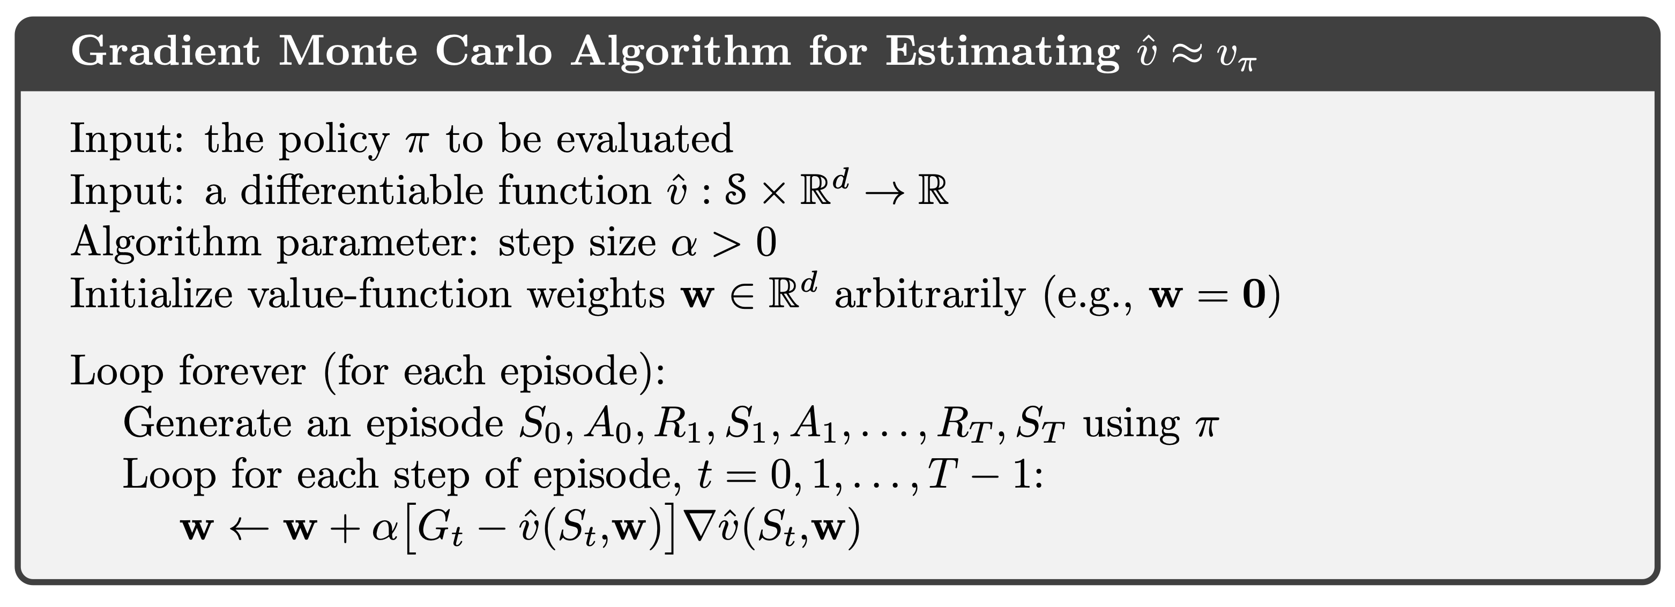
Gradient Monte Carlo
Monte Carlo target: $U_{t}=G_{t}$
$U_{t}$ is an unbiased estimate of $v_{π}(S_{t})$: $E[U_{t}|S_{t}=s]=v_{π}(s)$

Slide 13
Semi-gradient
Generic update: $w_{t+1}←w_{t}+α\left[U_{t}-\overset{̂}{v}(S_{t},w_{t})\right]∇\overset{̂}{v}(s,w_{t})$
TD(0) target: $U_{t}=R_{t+1}+γ\overset{̂}{v}(S_{t+1},w_{t})$
update: $w_{t+1}←w_{t}+α\left[R_{t+1}+γ\overset{̂}{v}(S_{t+1},w_{t})-\overset{̂}{v}(S_{t},w_{t})\right]∇\overset{̂}{v}(s,w_{t})$
Bootstrapping targets like TD(0) depend on the current value of $w_{t}$, so they are not unbiased
Gradient $∇\overset{̂}{v}(s,w_{t})$ accounts for change in the estimate from change in $w_{t}$
But updates to $w$ change both the estimate and the target
We can just ignore the issue, and call the resulting updates semi-gradient updates

Slide 14
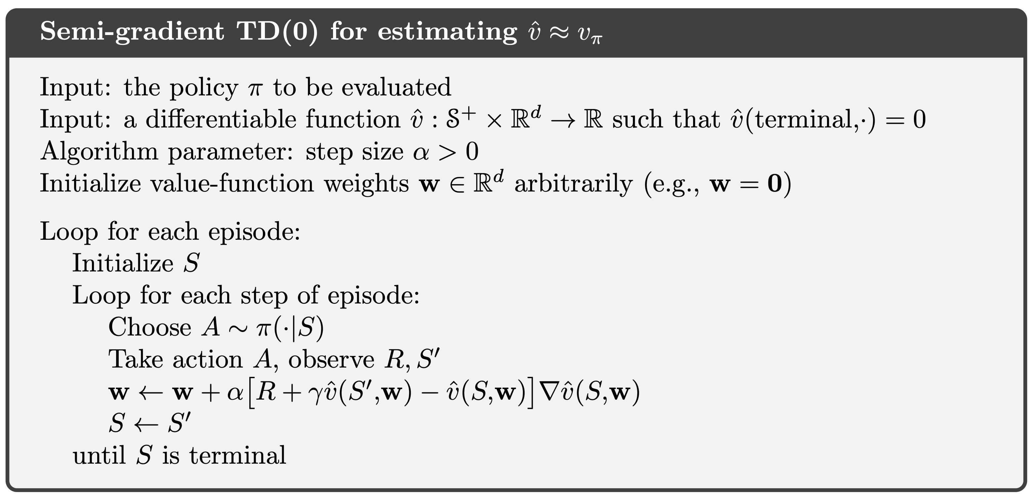
Semi-gradient TD(0)
TD(0) target: $U_{t}=R_{t+1}+γ\overset{̂}{v}(S_{t+1},w_{t})$
Notes:
Don't go through this in too much detail, for timing reasons

Slide 15
State Aggregation
-1
0
0
0
0
0
0
+1
1
...
499
500
501
...
1000
$$π(a|s)=0.5∀s∈S,a∈\{\text{left},\text{right}\}$$
1D gridworld with states 1 to 1000 with double-ended arrows labelled 0 between them. Left of 1 is a terminal state with an arrow to it labelled -1. Right of 1000 is a terminal state with an arrow to it labelled +1.
One easy way to reduce the memory usage for a large state space is to aggregate states together
In the Number Line Walk example, we could group the states into 10 groups of 100 states each
$w$ is a 10-element vector
$\overset{̂}{v}(s,w)=w_{x(s)}$, where $x(s)=⌊\frac{s}{100}⌋$
(Image: Sutton & Barto, 2018)

Slide 16
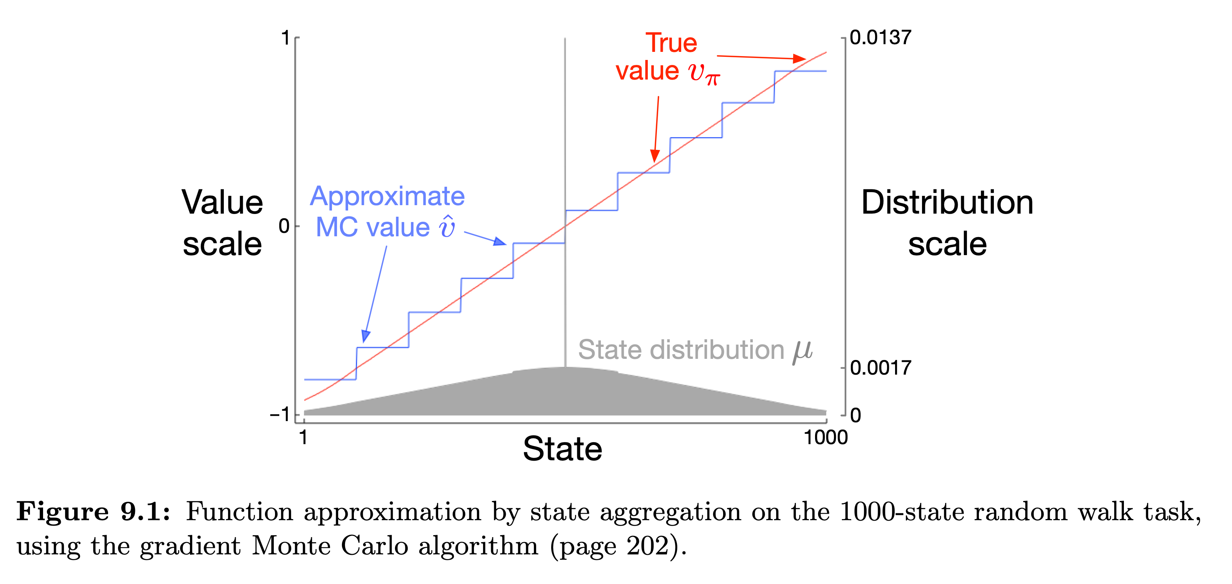
State Aggregation Performance
(Image: Sutton & Barto, 2018)
Y-axis is labelled "Value scale" and goes from -1 to 1, x-axis is labelled "State" and goes from 1 to 1000. A straight red line labelled "True value $v_{π}$" runs from (1,-1) to (1000, 1). A blue step function labelled "Approximate MC value $\overset{̂}{v}$" overlaps it.

Slide 17
Linear Approximation
Every state $s∈S$ is assigned a feature vector $x(s)$
$x(s)≐(x_{1}(s),x_{2}(s),…,x_{d}(s))$
State-value function approximation:
$\overset{̂}{v}(s,w)≐w^{T}x(s)=\overset{d}{\underset{i=1}{∑}}w_{i}x_{i}(s)$
Gradient is easy: $∇\overset{̂}{v}(s,w)=x(s)$
Gradient updates are easy: $w_{t+1}←w_{t}+α\left[U_{t}-\overset{̂}{v}(s,w_{t})\right]x(s)$
State aggregation is a special case of linear approximation (why?)

Slide 18
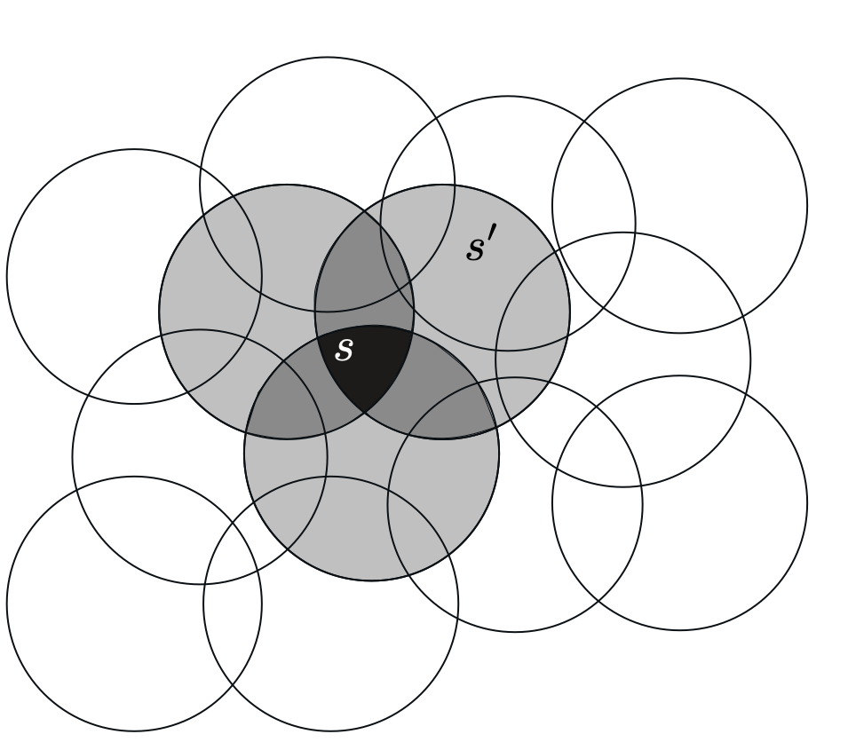
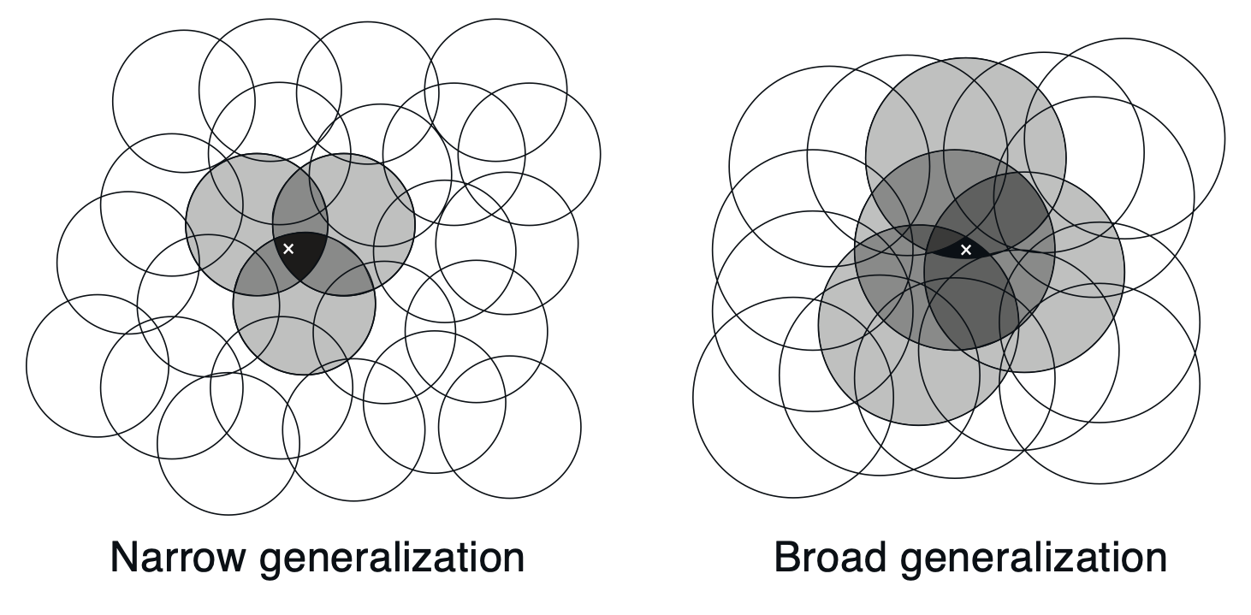
Feature Construction:
Coarse Coding
Divide state space up into overlapping cells
One indicator feature for each cell, set to 1 if the state is in the cell
This is another form of state aggregation
Updating one state generalizes to other states that share a cell
Figure with many overlapping open circles. The intersection of three specific circles is black and contains a state s. Each intersection of two of the circles is dark grey. The rest of the specific circles are light grey. A state s' is in a light grey region.
Another two figures with circles and coloured intersections; the left has many small circles that overlap less and is labelled "Narrow generalization", the right has larger circles that overlap more and is labelled "Broad generalization".
(Image: Sutton & Barto, 2018)

Slide 19
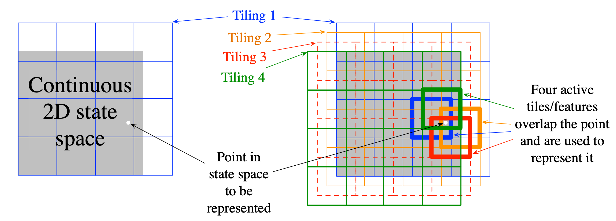
Tile Coding
The most practical form of coarse coding
Partition state space into a uniform grid called a tiling
    Use multiple tilings that are offset
Example of tile coding in a 2D feature space. 4 identical uniform grids, but with random offsets, are overlaid; each grid square that contains a specific point is drawn thicker.
(Image: Sutton & Barto, 2018)

Slide 20
Approaches to Control
Action-value methods (all previous approaches)
    Learn the value of each action in each state: $q_{π}(s,a)$
    Pick the max-value action (usually): $arg\max_{a}q_{π}(s,a)$
Function approximation (just now)
    Prediction: Learn the parameters $w$ of state-value function $\overset{̂}{v}(s,w)$
    Control: Learn the parameters $w$ of action-value function $\overset{̂}{q}(s,w)$
Policy-gradient methods (rest of today)
    Learn the parameters $θ$ of a policy $π(a∣s,θ)$
    Update by gradient ascent in performance

Slide 21
Parameterized Policies
The action probabilities of a parameterized policy $π(a∣s,θ)$ are set by setting the values of a parameter vector $θ∈R^{d^{′}}$
Common approach: softmax in action preferences
    Learn an action preference function $h(s,a,θ)$
    Softmax over action preferences gives action probabilities:
    $π(a|s,θ)≐\frac{e^{h(s,a,θ)}}{\sum_{a^{′}}{e^{h(s,a^{′},θ)}}}$

Slide 22
Action Preferences
Question: What functional forms can we use for action preferences?
Anything we could have used for $\overset{̂}{v}$:
    Linear approximations:
    $h(s,a,θ)≐θ^{T}x(s)=\overset{d}{\underset{i=1}{∑}}θ_{i}x_{i}(s)$
        Including state aggregation, coarse coding, tile coding
    Neural network: 𝜃 are weights, offsets, kernels, etc.
Overlapping circles from generalization slide
x1
h1
y
x2
h2
Feed forward neural network graph

Slide 23
Parameterized Policies Advantage: Deterministic Action
The optimal policy $π^{*}(a∣s)=arg\max_{a}q^{*}(s,a)$ is typically deterministic
If we run an $ϵ$-soft policy, we cannot get to an optimal policy
    Every action is played either with probability $ϵ$ or $(1-ϵ)$
Softmax in action preference policies can learn arbitrary probabilities, because $h(s,a,θ)$ is completely unconstrained:
$$π(a|s,θ)≐\frac{e^{h(s,a,θ)}}{\sum_{a^{′}}{e^{h(s,a^{′},θ)}}}$$
Question: How can a softmax in action preferences policy converge to a deterministic policy?
Question: Can you get the same results with $h(s,a,θ)=\overset{̂}{q}(s,a,θ)$? (why?)

Slide 24
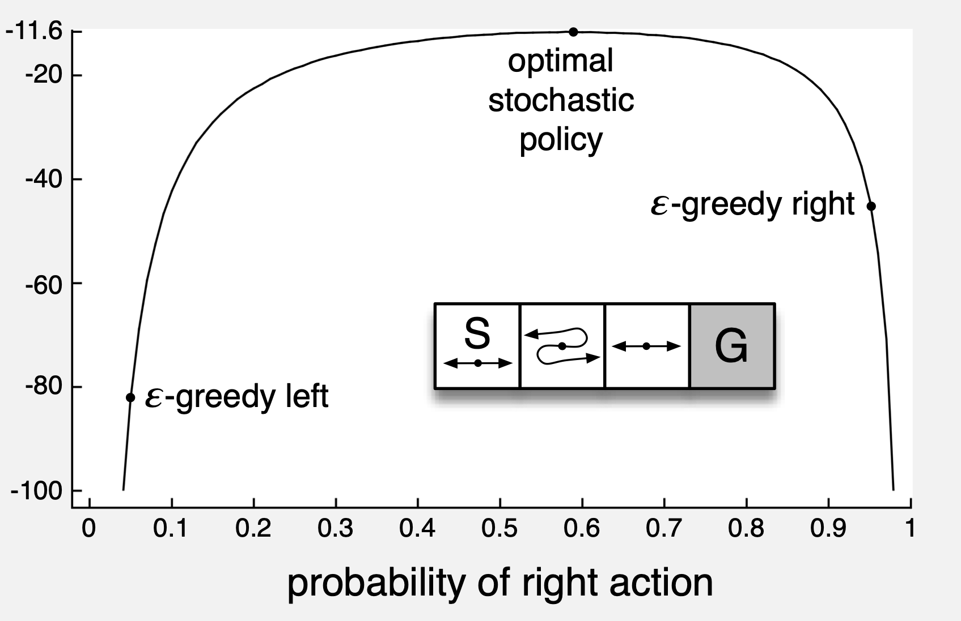
Example:
Switcheroo Corridor
Actions left and right have usual effect
Except in one state they are reversed!
Function approximation makes all the states look identical
Optimal policy is stochastic, with $Pr(\text{right})≈0.59$
But $ϵ$-greedy policies can only pick $Pr(\text{right})$ of $ϵ$ or $(1-ϵ)$!
Corridor environment: A horizontal row of four squares. Leftmost is labelled S and has a double-ended arrow inside. Second square has a dot with one arrow leaving the right of the dot but curving around to point left, and one arrow leaving the left of the dot but curving around to point right. Third square has a regular double-ended arrow, and rightmost square is labelled "G".
Graph: y-axis runs from -100 to -11.6. x-axis is labelled "probability of right action" and runs from 0 to 1. An inverted U shaped graph has three point labelled: "epsilon-greedy left" at approximately (-0.05, -81), "epsilon-greedy right" at approximately (0.95, -41), and "optimal stochastic policy" at (0.6, -11.6).
(Image: Sutton & Barto, 2018)

Slide 25
Parameterized Policies Advantage: Stochastic Actions
Optimal policies are deterministic, but only when there is no state aggregation
When function approximation makes states look the same, or when states are imperfectly observable, the optimal policy might be an arbitrary probability distribution
Parameterized policies can represent arbitrary distributions
    Although not necessarily arbitrary distributions in every possible state (why not?)

Slide 26
Policy Performance
We choose the policy parameters $θ$ in order to maximize the performance of the policy: $J(θ)$
Question: What should $J(θ)$ be in episodic cases?
Expected returns to the policy specified by 𝜃:
$J(θ)≐E_{π_{θ}}\left[G_{0}\right]$
With special single starting state $s_{0}$:
$J(θ)≐v_{π_{θ}}(s_{0})$

Slide 27
Policy Gradient Ascent
Want to maximize performance: $J(θ)=v_{π_{θ}}(s_{0})$
Gradient gives direction that J increases: $∇_{θ}J(θ)$
Update parameters in direction of the gradient:
$$θ_{t+1}←θ_{t}+α∇_{θ}J(θ_{t})$$
θt+1=θt+α∇θvπθ(s0)
Oops!

Slide 28
Policy Gradient Theorem
The gradient of the policy $∇J(θ)$ is just the gradient of the value function with respect to the policy $v_{π_{θ}}(s_{0})$
But we don't know the gradient of the value function!
Policy Gradient Theorem:
$∇J(θ)∝\underset{s}{∑}μ(s)\underset{a}{∑}q_{π}(s,a)∇π(a|s,θ)$
on-policy
stationary
distribution
true
action values
gradient of
policy

Slide 29
Monte Carlo Policy Gradient
$$∇J(θ)∝\underset{s}{∑}μ(s)\underset{a}{∑}q_{π}(s,a)∇π(a|s,θ)$$
$$=E_{π}\left[\underset{a}{∑}q_{π}(S_{t},a)∇π(a|S_{t},θ)\right]$$
$$=E_{π}\left[\underset{a}{∑}q_{π}(S_{t},a)∇π(a|S_{t},θ)\frac{π(a|S_{t},θ)}{π(a|S_{t},θ)}\right]$$
$$=E_{π}\left[\underset{a}{∑}π(a|S_{t},θ)q_{π}(S_{t},a)\frac{∇π(a|S_{t},θ)}{π(a|S_{t},θ)}\right]$$
$$=E_{π}\left[q_{π}(S_{t},A_{t})\frac{∇π(A_{t}|S_{t},θ)}{π(A_{t}|S_{t},θ)}\right]$$
$$=E_{π}\left[G_{t}\frac{∇π(A_{t}|S_{t},θ)}{π(A_{t}|S_{t},θ)}\right]$$
$$\underset{s}{∑}Pr(s)f(s)=E[f(S)]$$
$$f(s)$$
$$\underset{a}{∑}Pr(a)f(a)=E[f(A)]$$
$$f(a)$$
$$E\left[E[f(A)]\right]=E[f(A)]$$

Slide 30
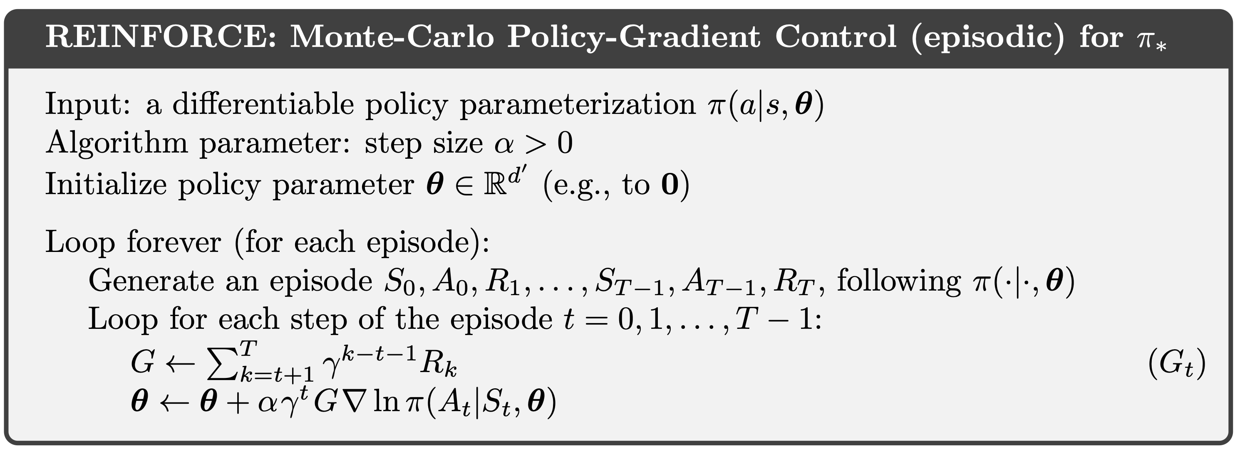
Monte Carlo Policy Gradient Algorithm: REINFORCE
REINFORCE Update: $θ_{t+1}←θ_{t}+αG_{t}\frac{∇π(A_{t}|S_{t},θ_{t})}{π(A_{t}|S_{t},θ_{t})}$
$$\underset{⏟}{}$$
$$\frac{∇π(A_{t}|S_{t},θ)}{π(A_{t}|S_{t},θ)}$$
"eligibility function"
$$\left(∇lnx=\frac{∇x}{x}\right)$$

Slide 31
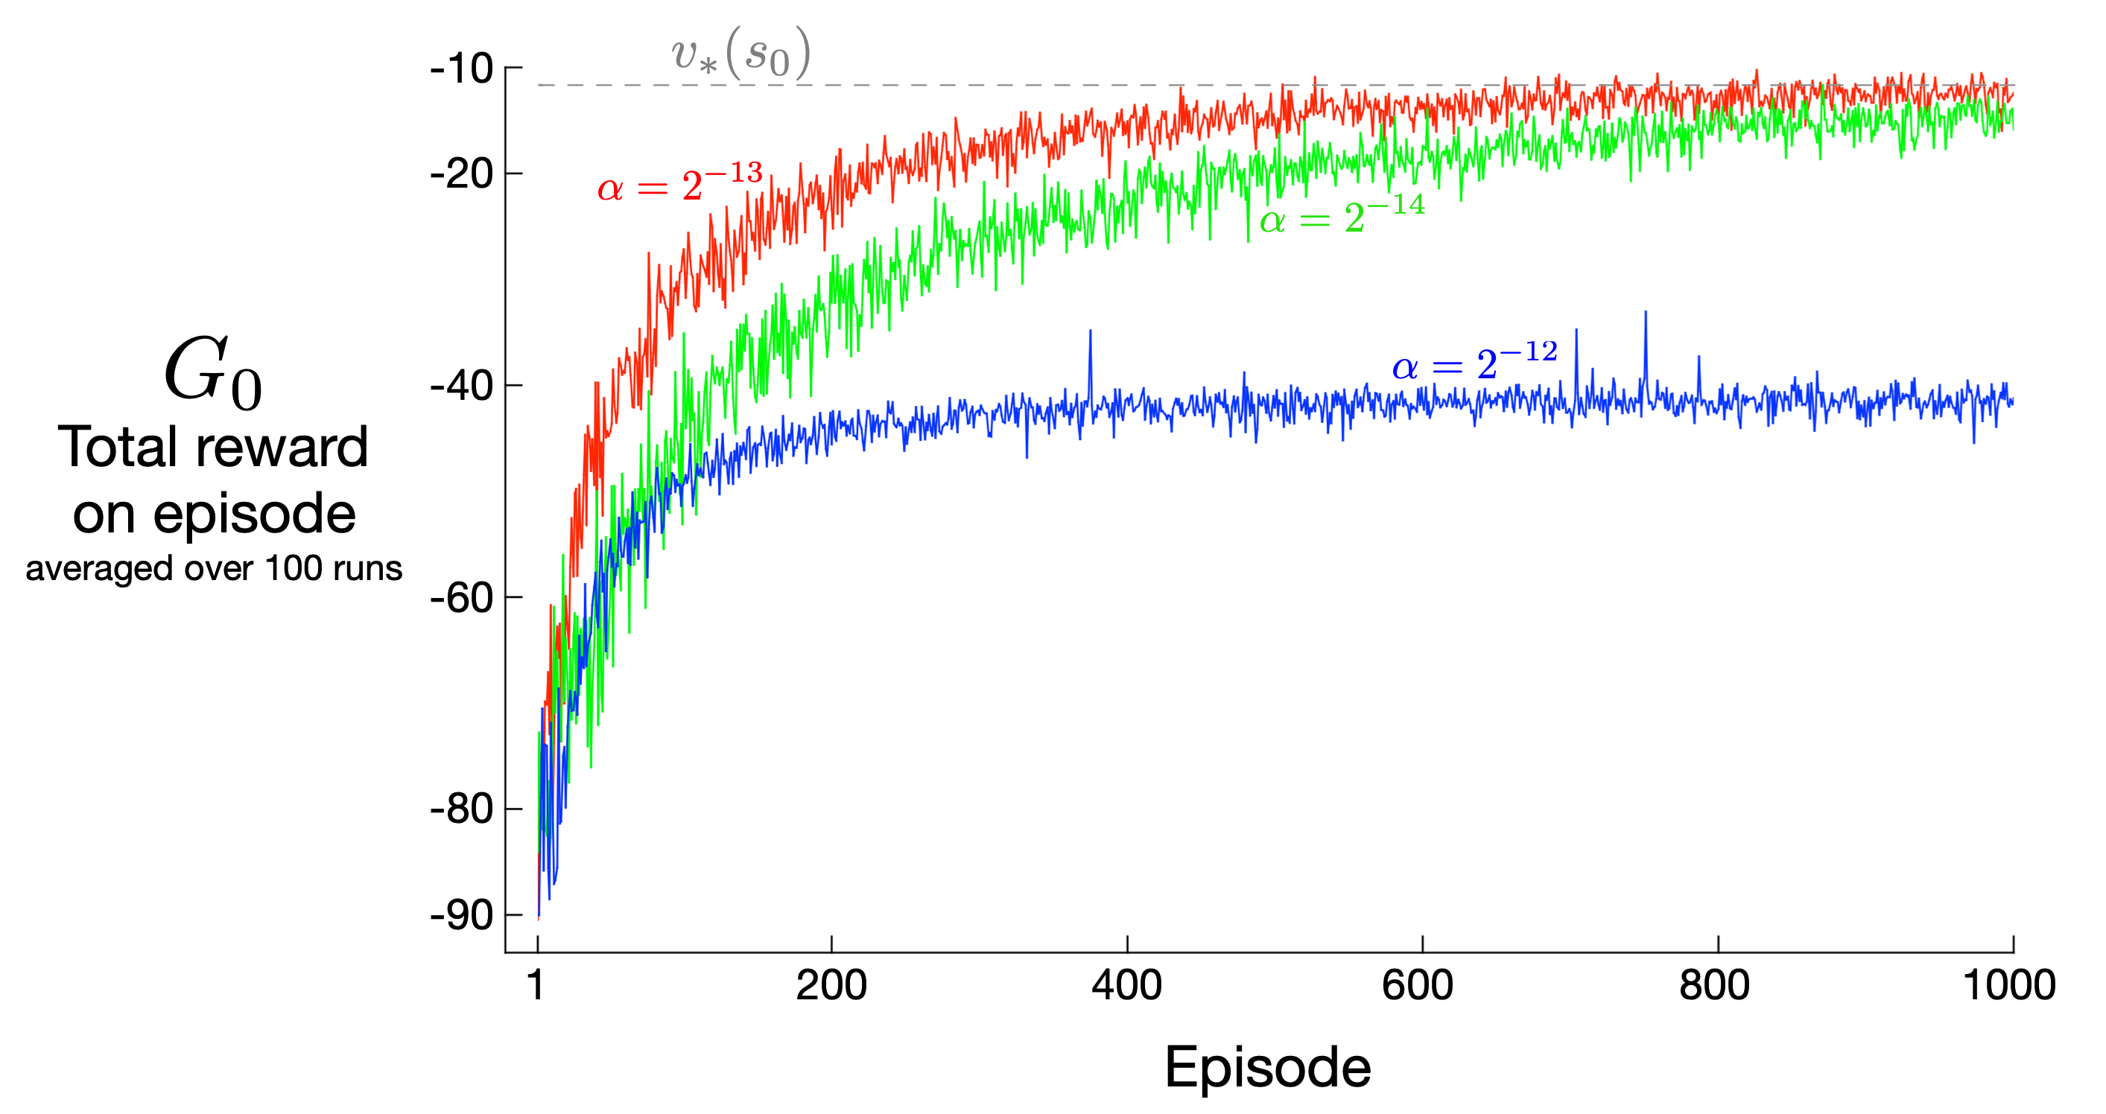
REINFORCE Performance in Switcheroo Corridor
Graph with x-axis labelled "Episode" and y-axis labelled "G0 Total reward on episode averaged over 100 runs". One trace labelled alpha=2^-12 converges to -45 after approximately 150 episodes; another labelled alpha=2^-14 converges to approximately -11 after 1000 episodes; another labelled a=2^-13 converges to approximately -11 after approximately 700 episodes. A horizontal dashed line at approximately -11 is labelled $v_{*}(s_{0})$.
(Image: Sutton & Barto, 2018)

Slide 32
Summary
It is often impractical to track the estimated value for every possible state and/or action
Parameterized value function $\overset{̂}{v}(s,w)$ uses weights $w∈R^{d}$ to specify the values of states
    Weights can be set using gradient descent and semi-gradient descent
All our previous control algorithms were action-value methods
    Approximate the action-value $q^{*}(s,a)$
    Choose maximal-value action at every state
Policy gradient methods:
    Represent policies using parametric policy $π(s∣a,θ)$
    Directly optimize performance $J(θ)$ by adjusting $θ$
Policy Gradient Theorem lets us restate $J(θ)$ in terms of quantities that we know ($∇π$) or can approximate ($q_{π}$)
REINFORCE uses a particular estimation scheme for policy gradients

