Slide 1
Heuristic Search
  CMPUT 261: Introduction to Artificial Intelligence
  P&M §3.6

Slide 2
  Logistics
Labs began this week
    Including a quick Python refresher
Assignment #1 released later today
    Download from (and submit on) Canvas
    Due: Thursday, September 25 at 11:59pm

Slide 3
Lecture Outline
Logistics & Recap
Heuristics
A* Search
Constructing admissible heuristics
After this lecture, you should be able to:
Implement and demonstrate the operation of A* search on a graph
Identify whether a heuristic is admissible
Construct an admissible heuristic for an arbitrary search problem
Identify whether one heuristic dominates another
Construct a dominating heuristic for a set of given heuristics
Explain when a heuristic will allow more efficient exploration

Slide 4
Recap: Uninformed Search
Different search strategies have different properties and behaviour
    Depth first search is space-efficient but not always complete or time-efficient
    Breadth first search is complete and always finds the shortest path to a goal, but is not space-efficient
    Iterative deepening search can provide the benefits of both, at the expense of some time-efficiency
    All three strategies must potentially explore every path, and are not guaranteed to return an optimal solution
    Least cost first search is optimal (under some conditions), but still must potentially explore every path

Slide 5
Recap: Iterative Deepening Search
Input: a graph; a set of start nodes; a $goal$ function
      for max_depth from 1 to $∞$:
      more_nodes := False
      $frontier:=\{⟨s⟩∣s\text{is a start node}\}$
      while $frontier$ is not empty:
      select the newest path $⟨n_{0},…,n_{k}⟩$ from $frontier$
      remove $⟨n_{0},…,n_{k}⟩$ from $frontier$
      if $goal(n_{k})$:
      return $⟨n_{0},…,n_{k}⟩$
      if k < max_depth:
      for each neighbour $n$ of $n_{k}$:
      add $⟨n_{0},…,n_{k},n⟩$ to frontier
      else if $n_{k}$ has neighbours:
      more_nodes := True
      end-while
      if more_nodes = False:
      return None

Slide 6
Recap: Optimality
Definition:
An algorithm is optimal if it is guaranteed to return an optimal
(i.e., minimal-cost) solution first.
Depth-first search, breadth-first search, iterative deepening search are not optimal
Least-cost first search is optimal (if there is a positive lower bound on arc costs)

Slide 7
Recap: Search Strategies
 | Depth First | Breadth First | Iterative Deepening | Least Cost First
Selection | Newest | Oldest | Newest, multiple | Cheapest
Data structure | Stack | Queue | Stack, counter | Priority queue
Complete? | Finite graphs only | Complete | Complete | Complete if cost(p) > 𝜀
Space complexity | O(mb) | O(b^{m}) | O(mb) | O(b^{m})
Time complexity | O(b^{m}) | O(b^{m}) | O(mb^{m}) ** | O(b^{m})
Optimal? | No | No | No | Optimal

Slide 8
Domain Knowledge
Domain-specific knowledge can help speed up search by identifying promising directions to explore
We will encode this knowledge in a function called a heuristic function which estimates the cost to get from a node to a goal node
The search algorithms in this lecture take account of this heuristic knowledge when selecting a path from the frontier

Slide 9
Heuristic Function
Definition:
A heuristic function is a function $h(n)$ that returns a non-negative estimate of the cost of the cheapest path from node $n$ to some goal node.
    For paths: $h(⟨n_{0},…,n_{k}⟩)=h(n_{k})$
    Uses only readily-available information about a node
    (i.e., easy to compute)
    Problem-specific

Slide 10
Admissible Heuristic
Definition:
A heuristic function is admissible if $h(n)$ is always less than or equal to the actual cost of the cheapest path from $n$ to any goal node.
    i.e., $h(n)$ is a lower bound on $\text{cost}(⟨n,…,g⟩)$ for any goal node $g$

Slide 11

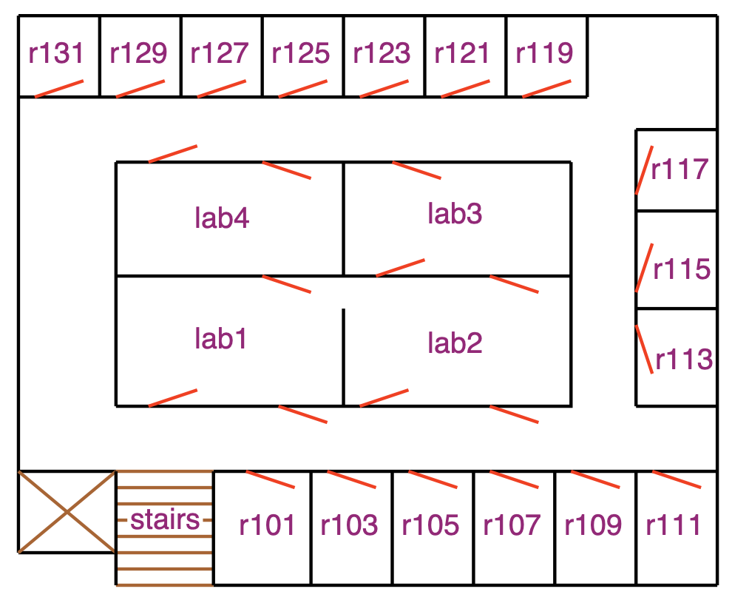





Example Heuristics
Number of dirty rooms for VacuumBot
(ignores the need to move between rooms)
Euclidean distance for DeliveryBot
(ignores that it can't go through walls)
Manhattan distance for DeliveryBot
(also ignores that it can't go through walls)
Farmer problem?
A figure depicting a single state of the VacuumBot example.
VacuumBot is in the left room, and both rooms are dirty.
A figure depicting a single state of the Farmer example.
The Farmer is on the left bank with the boat, the fox, and the grain.
The hen is on the right bank.
A figure depicting the DeliveryBot example. There are rooms around the outside of the rectangular hallway, and four labs in the inside. There is a green dot outside room 103 representing the starting location, and a red star inside room 123 on the other side of the rectangular hallway, representing the goal location. There is an orange dotted line that goes straight from the green dot to the red star, directly through the walls of the labs. There is a blue line that follows the hallway from the green dot to the red star.
Question: Which of these heuristics are admissible? Why?
icons by Icons8

Slide 12
Simple Uses of Heuristics
Heuristic depth first search: Add neighbours to the frontier in decreasing order of their heuristic values, then run depth first search as usual
    Will explore most promising successors first, but
    Still explores all paths through a successor before considering other successors
    Not complete, not optimal
Greedy best first search: Select path from the frontier with the lowest heuristic value
    Not guaranteed to work any better than breadth first search (why?)

Slide 13
A* Search
A* search uses both path cost information and heuristic information to select paths from the frontier
Let $f(p)=\text{cost}(p)+h(p)$
  $f(p)$ estimates the total cost to the nearest goal node starting from $p$
A* removes paths from the frontier with smallest $f(p)$
When $h$ is admissible,
$p^{*}=⟨s,…,n,…,g⟩$ is a solution, and
$p^{′}=⟨s,…,n⟩$ is a prefix of $p^{*}$:
    $f(p^{′})≤\text{cost}(p^{*})$ (why?)
$$\underset{\text{f(p)}}{\underset{⏟}{\underset{\text{cost(p)}}{\underset{⏟}{\text{start}\overset{\text{actual}}{→}}}n\underset{\text{h(n)}}{\underset{⏟}{\overset{\text{estimated}}{→}\text{goal}}}}}$$

Slide 14
A* Search Algorithm
Input: a graph; a set of start nodes; a $goal$ function
    $frontier:=\{⟨s⟩∣s\text{is a start node}\}$
    while $frontier$ is not empty:
    select $f$-minimizing path $⟨n_{0},…,n_{k}⟩$ from frontier
    remove $⟨n_{0},…,n_{k}⟩$ from $frontier$
    if $goal(n_{k})$:
    return $⟨n_{0},…,n_{k}⟩$
    for each neighbour $n$ of $n_{k}$:
    add $⟨n_{0},…,n_{k},n⟩$ to frontier
    end while
i.e., $f(⟨n_{0},…,n_{k}⟩)≤f(p)$
for all other paths $p∈frontier$
Question:
What data structure for the frontier implements this search strategy?

Slide 15
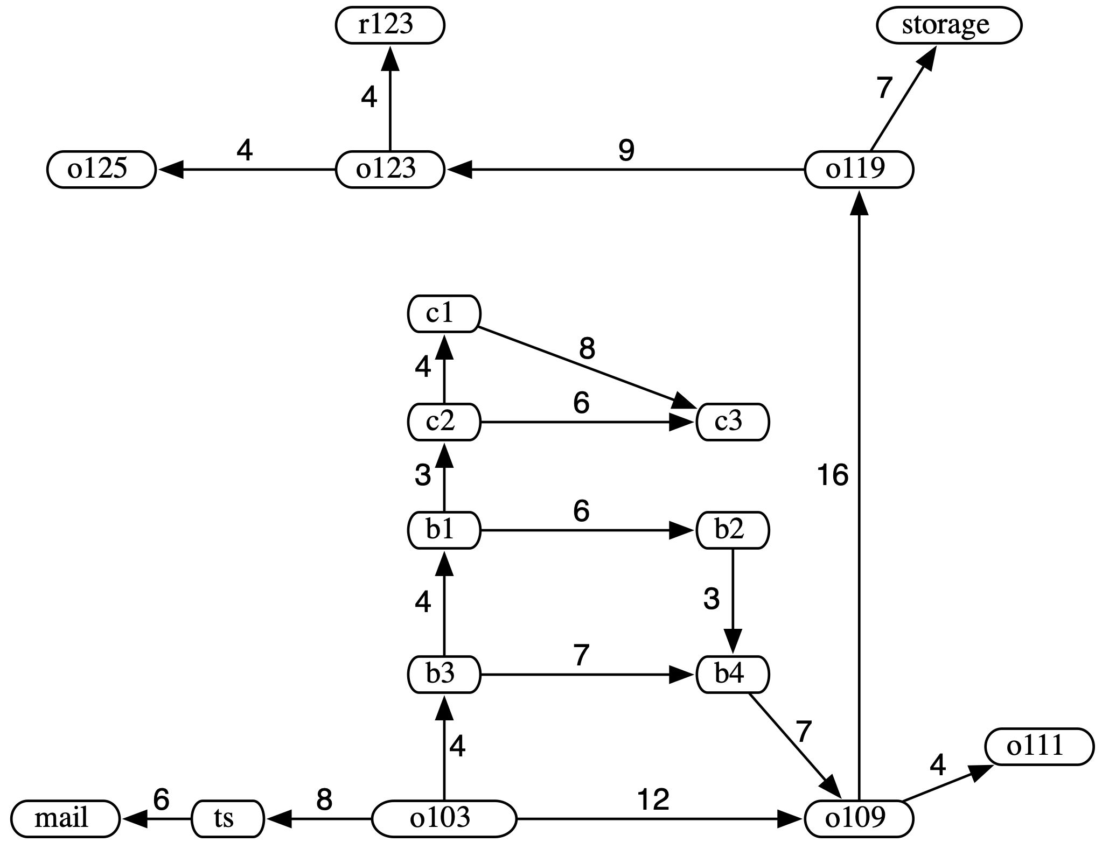
A* Search Example:
DeliveryBot
Heuristic: Euclidean distance
Question: What is $f(⟨o103,b3⟩)$? $f(⟨o103,o109⟩)$?
A* will spend a bit of time exploring paths in the labs before trying to go around via $o109$
At that point the heuristic starts helping more
Question: Does breadth-first search explore paths in the lab too?
Question: Does breadth-first search explore any paths that A* does not?
0
12
6
4
11
6
10
12
13
15
17
18
27
26
23
21
24
A search graph for the DeliveryBot example (long description). The start node is o103; the goal node is r123. o103's neighbours are ts with arc cost 8, b3 with arc cost 4, and o109 with arc cost 12. ts's neighbour is mail with arc cost 6. mail has no neighbours. b3's neighbours are b1 with arc cost 4, b4 with arc cost 7. b1's neighbours are c2 with arc cost 3, b2 with arc cost 6. c2's neighbours are c1 with arc cost 4, c3 with arc cost 6. c1's neighbour is c3 with arc cost 8. b4's neighbour is o109 with arc cost 7. b2's neighbour is b4 with arc cost 3. c3 has no neighbours. o109's neighbours are o119 with arc cost 16 and o111 with arc cost 4. o111 has no neighbours. o119's neighbours are storage with arc cost 7 and o123 with arc cost 9. storage has no neighbours. o123's neighbours are o125 with arc cost 4 and r123 with arc cost 4. o125 and r123 have no neighbours.

Slide 16
A* Optimality
  Theorem:
  If there is a solution of finite cost, A* using heuristic function $h$ always returns an optimal solution (in finite time), if
  The branching factor is finite, and
  All arc costs are greater than some $ϵ>0$, and
  $h$ is an admissible heuristic.
  Proof:
  No suboptimal solution will be removed from the frontier whenever the frontier contains a prefix of the optimal solution
  The optimal solution is guaranteed to be removed from the frontier eventually

Slide 17
A* Optimality Proofs: A Lexicon
An admissible heuristic: $h(n)$
$$f(⟨n_{0},…,n_{k}⟩)=\text{cost}(⟨n_{0},…,n_{k}⟩)+h(n_{k})$$
A start node: $s$
A goal node: $z$ (i.e., $\text{goal}(z)=1$)
The optimal solution: $p^{*}=⟨s,…,a,b,…z⟩$
A prefix of the optimal solution: $p^{′}=⟨s,…,a⟩$
A suboptimal solution: $g=⟨s,q,…,z⟩$

Slide 18
A* Optimality
An admissible heuristic: $h(n)$
$$f(⟨n_{0},…,n_{k}⟩)=\text{cost}(⟨n_{0},…,n_{k}⟩)+h(n_{k})$$
A start node: $s$
A goal node: $z$ (i.e., $\text{goal}(z)=1$)
The optimal solution: $p^{*}=⟨s,…,a,b,…z⟩$
A prefix of the optimal solution: $p^{′}=⟨s,…,a⟩$
A suboptimal solution: $g=⟨s,q,…,z⟩$
Proof part 1: Optimality (no $g$ is removed before $p^{*}$)
$f(g)=\text{cost}(g)$ and $f(p^{*})=\text{cost}(p^{*})$
    $f(⟨n_{0},…,n_{k}⟩)=\text{cost}(⟨n_{0},…,n_{k}⟩)+h(n_{k})$, and $h(z)=0$
$$f(p^{′})<f(g)$$
    $$f(⟨s,…,a⟩)=\text{cost}(⟨s,…,a⟩)+h(a)$$
    $$f(⟨s,…,a,b,…,z⟩)=\text{cost}(⟨s,…,a,b,…,z⟩)+h(z)=\text{cost}(⟨s,…,a⟩)+\text{cost}(a,b,…,z⟩)$$
    $$h(a)≤\text{cost}(⟨a,b,…,z⟩)$$
    $$f(p^{′})≤f(p^{*})<f(g)$$
$$∎$$

Slide 19
A* Completeness
An admissible heuristic: $h(n)$
$$f(⟨n_{0},…,n_{k}⟩)=\text{cost}(⟨n_{0},…,n_{k}⟩)+h(n_{k})$$
A start node: $s$
A goal node: $z$ (i.e., $\text{goal}(z)=1$)
The optimal solution: $p^{*}=⟨s,…,a,b,…z⟩$
A prefix of the optimal solution: $p^{′}=⟨s,…,a⟩$
A suboptimal solution: $g=⟨s,q,…,z⟩$
Proof part 2: A* is complete
Every path that is removed from the frontier is only replaced by more-costly paths (why?)
Since individual arc costs are larger than $ϵ$, every path in the frontier will eventually have cost larger than $k$, for any finite $k$
    Every path with at least $\frac{k}{ϵ}$ arcs will have cost larger than $k$
So every path in the frontier will eventually have cost larger than the cost of the optimal solution
So the optimal solution will eventually be removed from the frontier
Question: Why are we talking about costs and not $f$-values?

Slide 20
Comparing Heuristics
Suppose that we have two admissible heuristics, $h_{1}$ and $h_{2}$
Suppose that for every non-goal node $n$, $h_{2}(n)>h_{1}(n)$
Questions:
Why is it important that $n$ is a non-goal node?
Which heuristic is likely to be better for search with A*? Why?

Slide 21
Dominating Heuristics
Definition:
A heuristic $h_{2}$ dominates a heuristic $h_{1}$ if
  $∀n:h_{2}(n)≥h_{1}(n)$, and
  $$∃n:h_{2}(n)>h_{1}(n).$$
Question:
Which admissible heuristic dominates all other admissible heuristics?

Slide 22
A* Analysis
For a search graph with finite maximum branch factor $b$ and
finite maximum path length $m$...
What is the worst-case space complexity of A*?
[A: $O(m)$] [B: $O(mb)$] [C: $O(b^{m})$] [D: it depends]
What is the worst-case time complexity of A*?
[A: $O(m)$] [B: $O(mb)$] [C: $O(b^{m})$] [D: it depends]
Question: If A* has the same space and time complexity as least cost first search, then what is its advantage?

Slide 23
Constructing
Admissible Heuristics
A figure depicting a single state of the VacuumBot example.
VacuumBot is in the left room, and both rooms are dirty.
Search problems try to find a cost-minimizing path, subject to constraints encoded in the search graph
How to construct an easier problem? Drop some constraints.
    This is called a relaxation of the original problem
The cost of the optimal solution to the relaxation will always be an admissible heuristic for the original problem (Why?)
Neat trick: If you have two admissible heuristics $h_{1}$ and $h_{2}$, then $h_{3}(n)=max\{h_{1}(n),h_{2}(n)\}$ is admissible too! (Why?)
A figure depicting the DeliveryBot example. There are rooms around the outside of the rectangular hallway, and four labs in the inside. There is a green dot outside room 103 representing the starting location, and a red star inside room 123 on the other side of the rectangular hallway, representing the goal location.
A figure depicting a single state of the Farmer example. The Farmer is on the left bank with the boat, the fox, and the grain. The hen is on the right bank.

Slide 24
Summary
Domain knowledge can help speed up graph search
Domain knowledge can be expressed by a heuristic function, which estimates the cost of a path to the goal from a node
Admissible heuristics can be built from relaxations of the original problem
Simple uses of heuristics do not guarantee improved performance
A* algorithm for use of admissible heuristics with guarantees

